Slide 1
RFI measurements at the 65m Tianma Telescope
Bin Li, Rongxia Sun, Wei Gou, Rongbing Zhao
Shanghai Astronomical Observatory
Chinese Academy of Sciences

Slide 2
Outline
Telescope introduction
RFI monitoring system
Receiver output spectrum
HTS filter applications

Slide 3
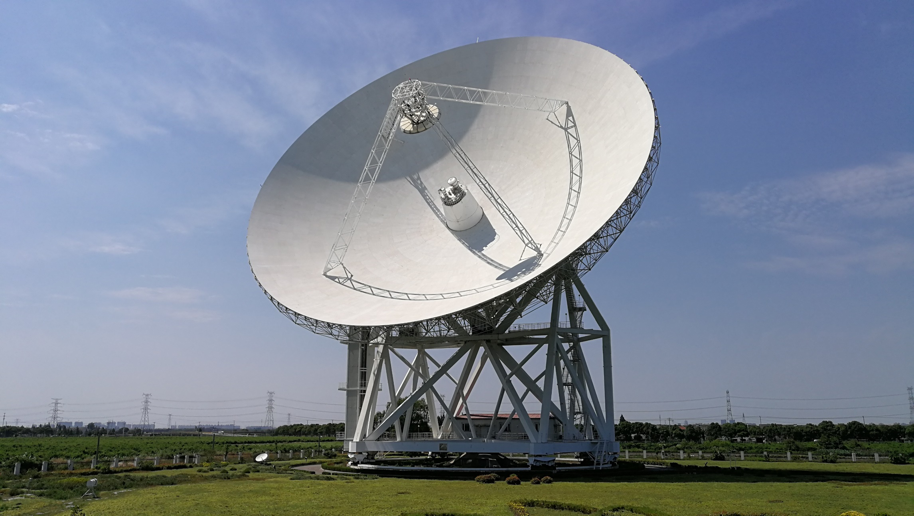
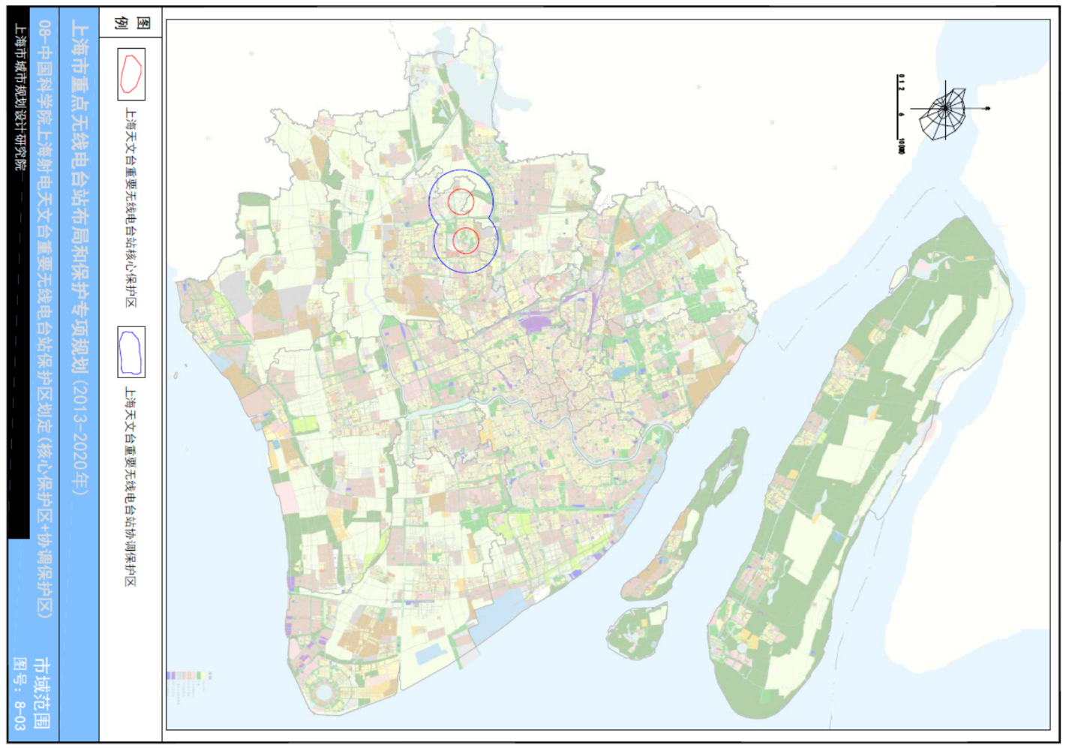
Telescopes and RFI protection
Sheshan Telescope (Sh)
  The first VLBI station in China
  Operated from 1987
  25m diameter
  L, S/X, C, and K-band
Tianma Telescope (T6)
  Single dish and VLBI observation
  Operated from 2012
  65m diameter
  L, S/X, C, Ku, K, X/Ka, Q
National RFI protection
  Urban construction planning
  1 km radius quiet zone
  3 km radius coordinate zone
Hexapot of sub-reflector
1104 pieces Actuators
Receiver cabin

Slide 4
Receiving system of Tianma telescope
Band | "L" | "S₁" | "C" | "X₁" | "X₂" | "Ku" | "K" | "Ka₂" | "Q"
Wavelength (cm) | 21/18 | 13 | 6/5 | 3.6 | 3.6 | 2/2.5 | 1.3 | 0.9 | 0.7
Freq range (GHz) | 1.33-1.73 | 2.2-2.3 | 4-8 | 8.2-9 | 8-9 | 12-18 | 18-26.5 | 30-34 | 35-50
BW/CF (%) | 26 | 4 | 67 | 9 | 12 | 40 | 38 | 13 | 35
Dish diameter (m) | 65 | 65 | 65 | 65 | 65 | 65 | 65 | 65 | 65
FWHP@CF (") | 759.1 | 516.2 | 193.6 | 135.0 | 136.6 | 77.4 | 52.2 | 36.3 | 27.3
T(Sky) (K) | 12 | 12 | 10 | 10 | 10 | 12 | 18 | 20 | 30
T(Rx) (K) | 14 | 21 | 10 | 22 | 20 | 15 | 20 | 35 | 40
T(Sys) (K) | 26 | 33 | 20 | 32 | 30 | 27 | 38 | 55 | 70
Efficiency | 55% | 60% | 65% | 55% | 55% | 55% | 52% | 50% | 50%
SEFD (Jy) | 39 | 46 | 26 | 48 | 45 | 41 | 61 | 91 | 116
Polarization | Lin & Circ | Dual Circ | Dual Circ | Dual Circ | Dual Circ | Dual Circ | Dual Circ | Dual Circ | Dual Circ
Structure | Single Pixel | Dual Band | Single Pixel | Dual Band | Dual Band | Single Pixel | Dual Pixels | Dual Band | Dual Pixels
Status | Installed May 2013 | Installed Dec 2012 | Installed May 2013 | Installed Dec 2012 | Installed Mar 2015 | Installed Sep 2014 | Installed May 2016 | Installed Mar 2015 | Installed Mar 2016
Potential risk caused by RFI
Poor dynamic range of cryogenic LNAs
Wide-band RF and IF amplifier
Wide-band microwave optical transmission

Slide 5
RFI monitoring system at telescope site
5

Slide 6
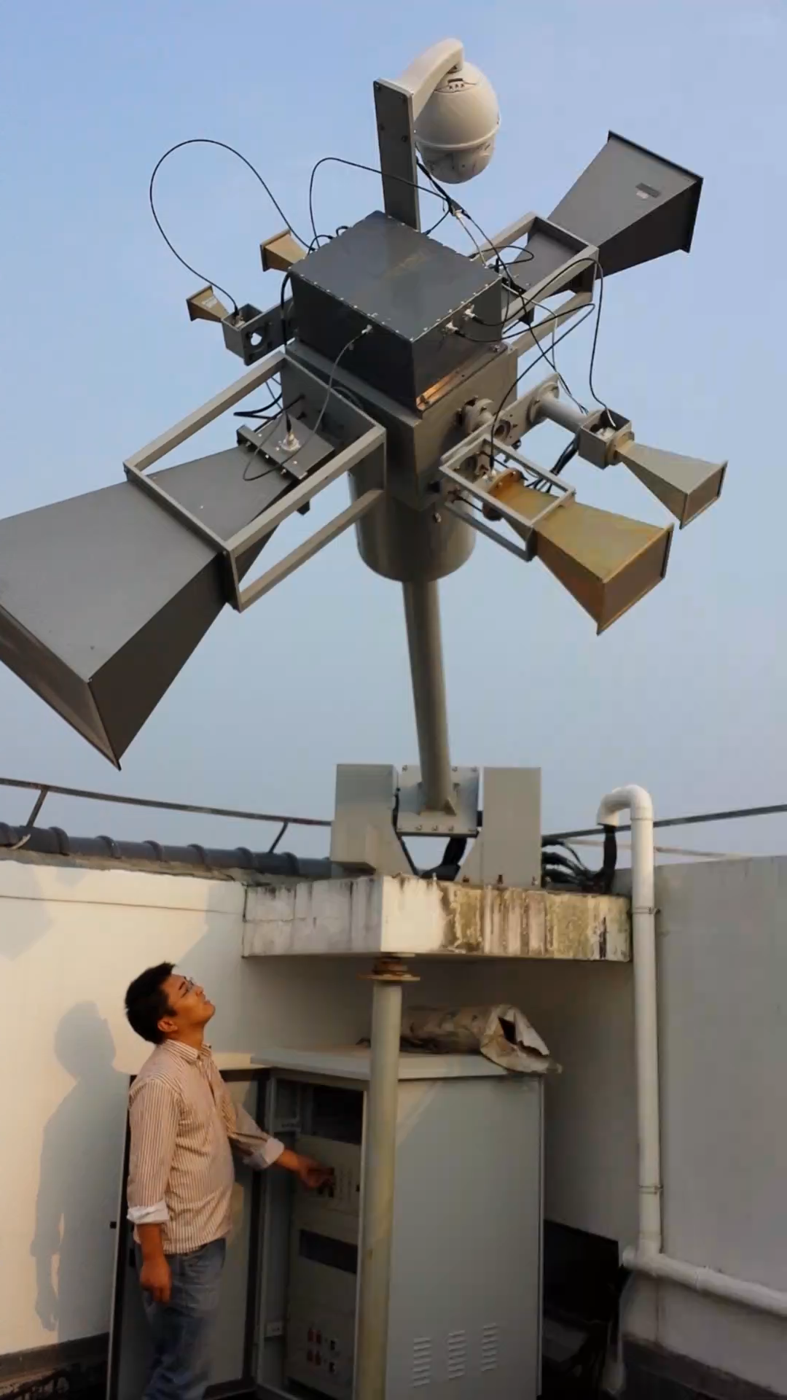
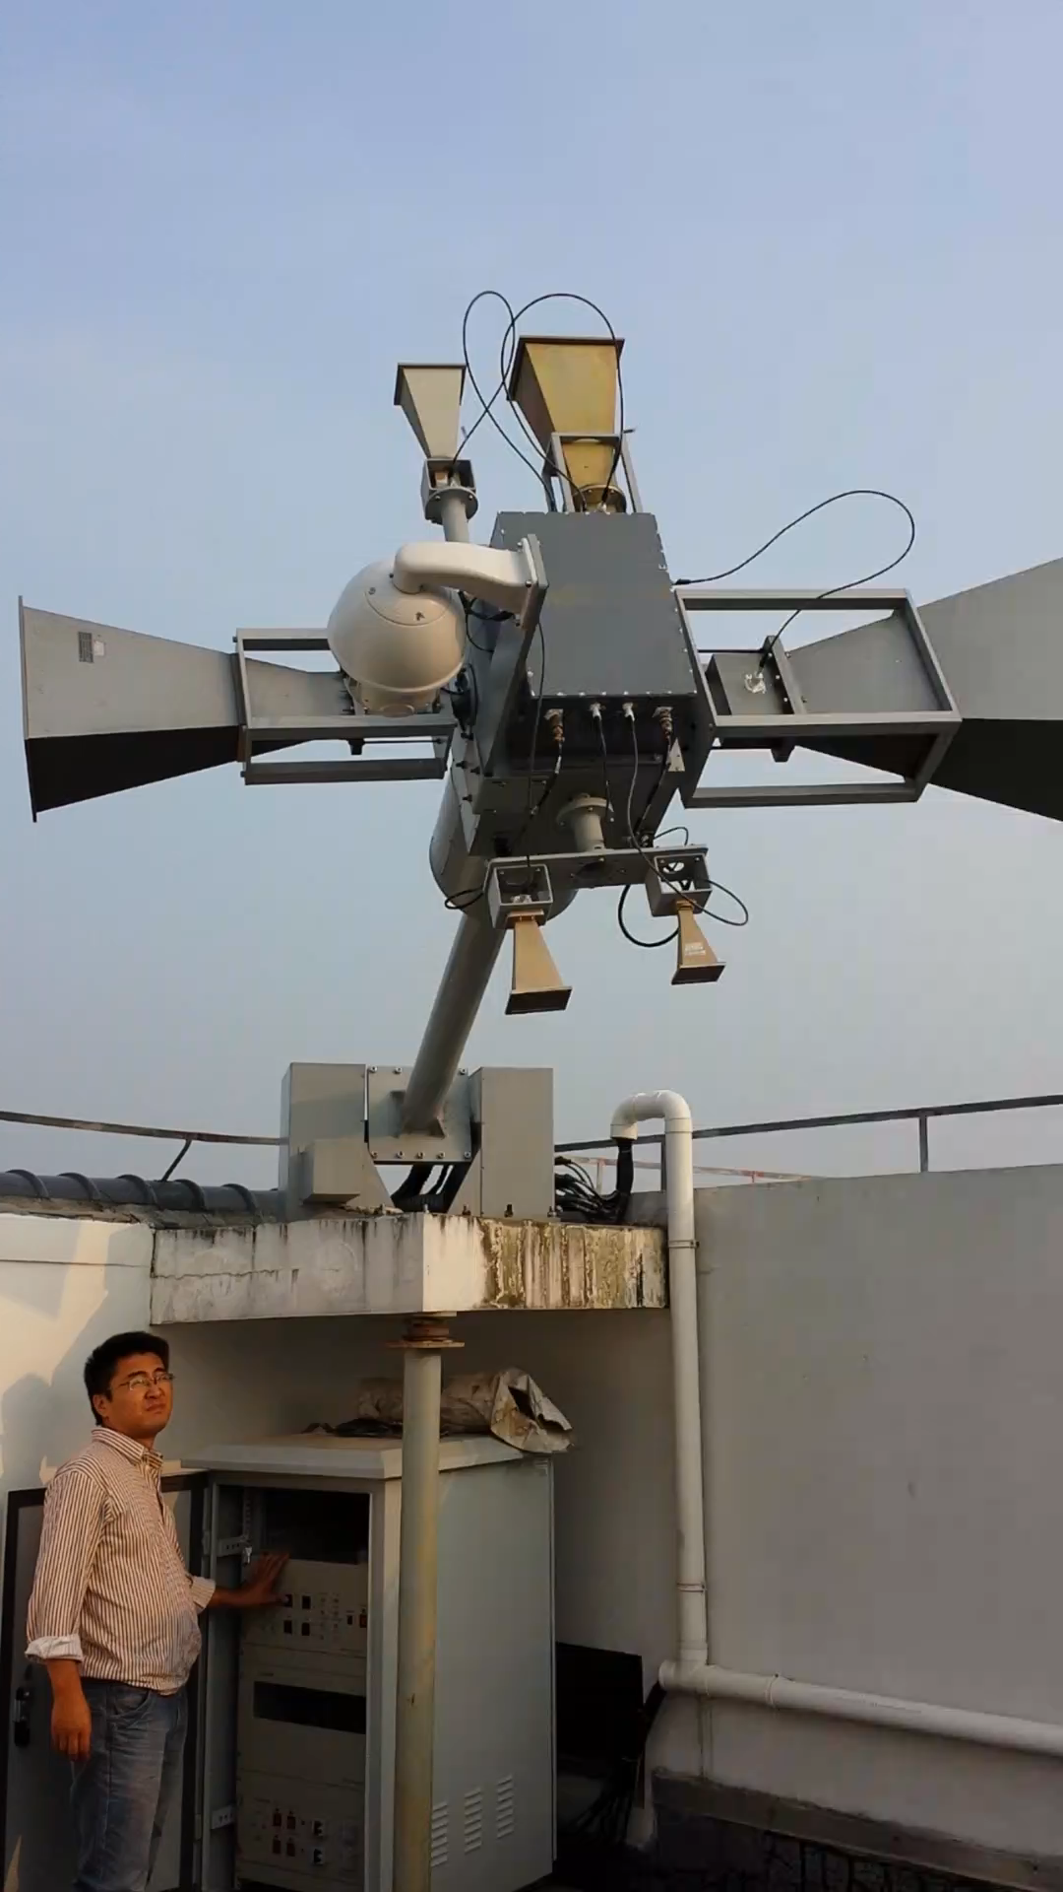
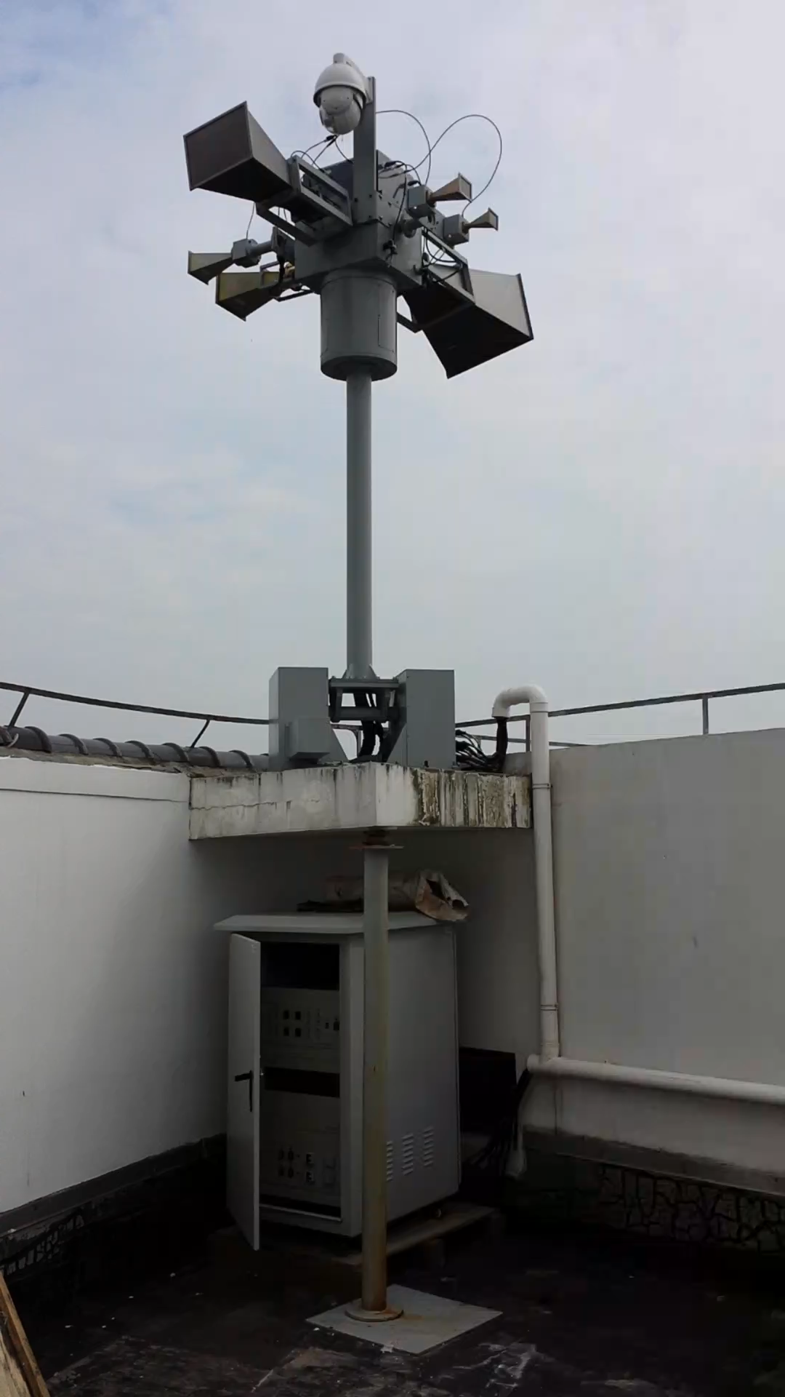
RFI monitoring system at telescope site

Slide 7
Data processing
SKA site spectrum evaluation method
  Sensitivity driven scan mode
  dBm to dBWm⁻²Hz⁻¹
  Maximum, average, median, 90 percentile, 10 percentile
  Channel occupancy bar
Ms. Yunxia Sun’s poster, “RFI monitoring system at the Tianma telescope”
7

Slide 8
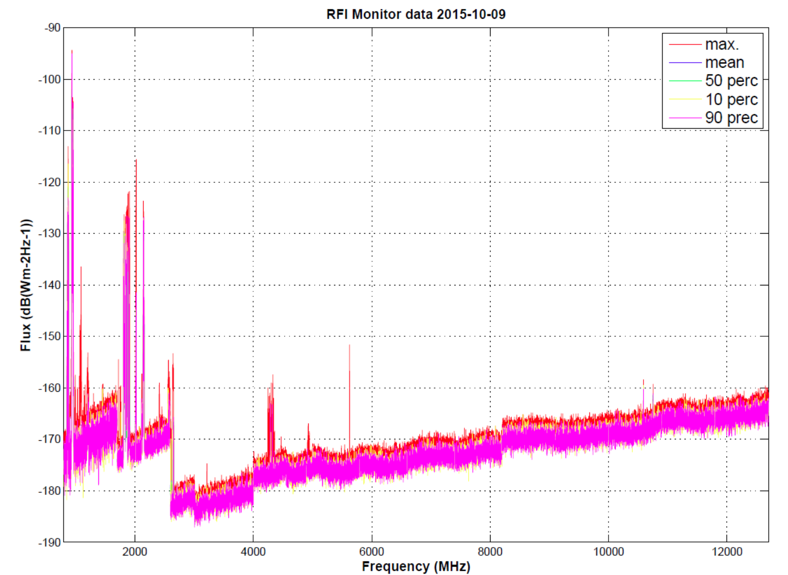
RFI monitoring results

Slide 9
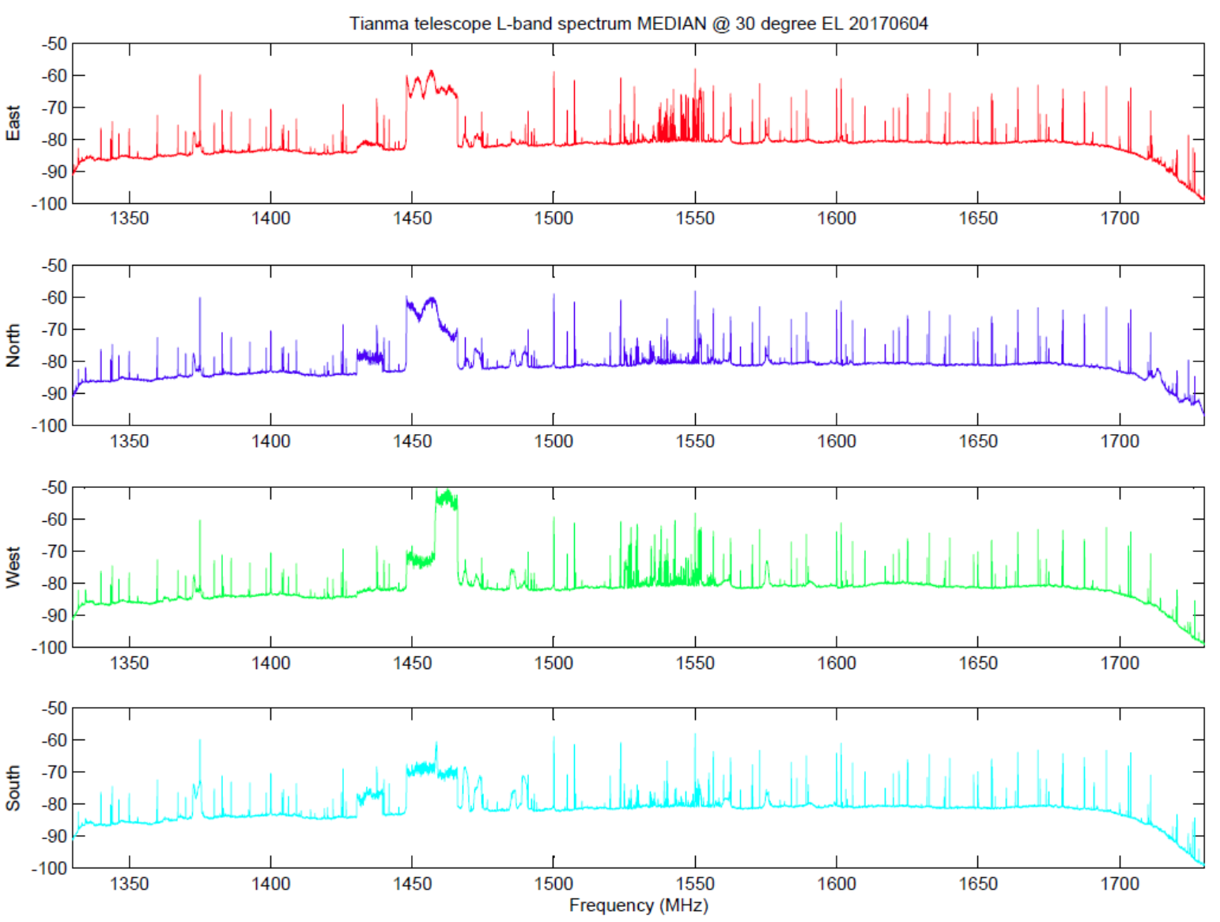
L-band spectrum

Slide 10
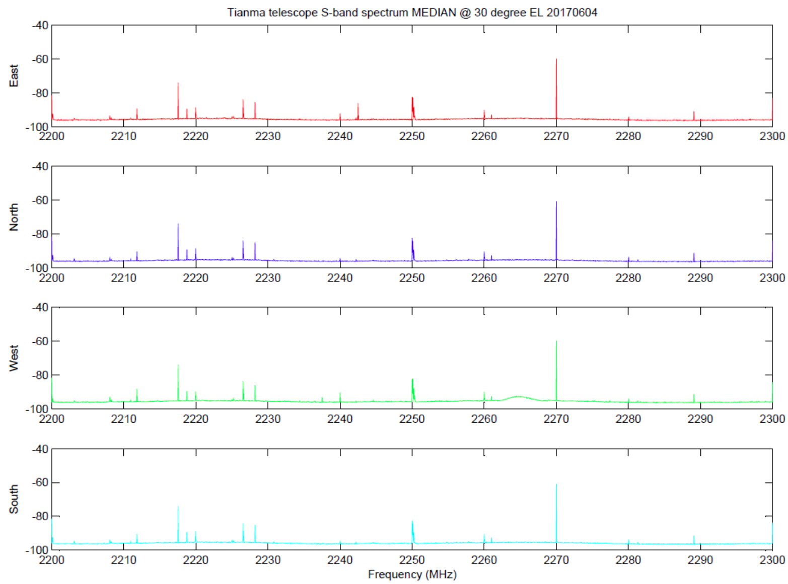
S-band spectrum

Slide 11
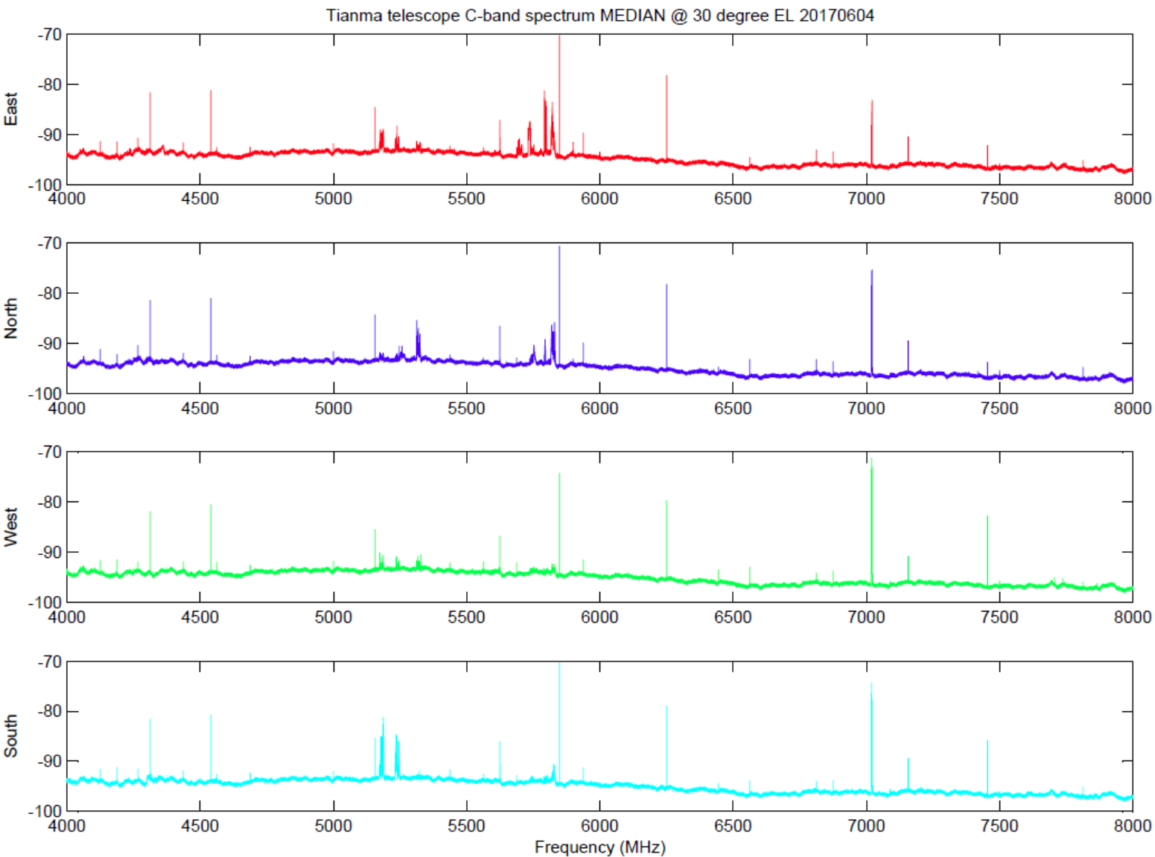
C-band spectrum

Slide 12
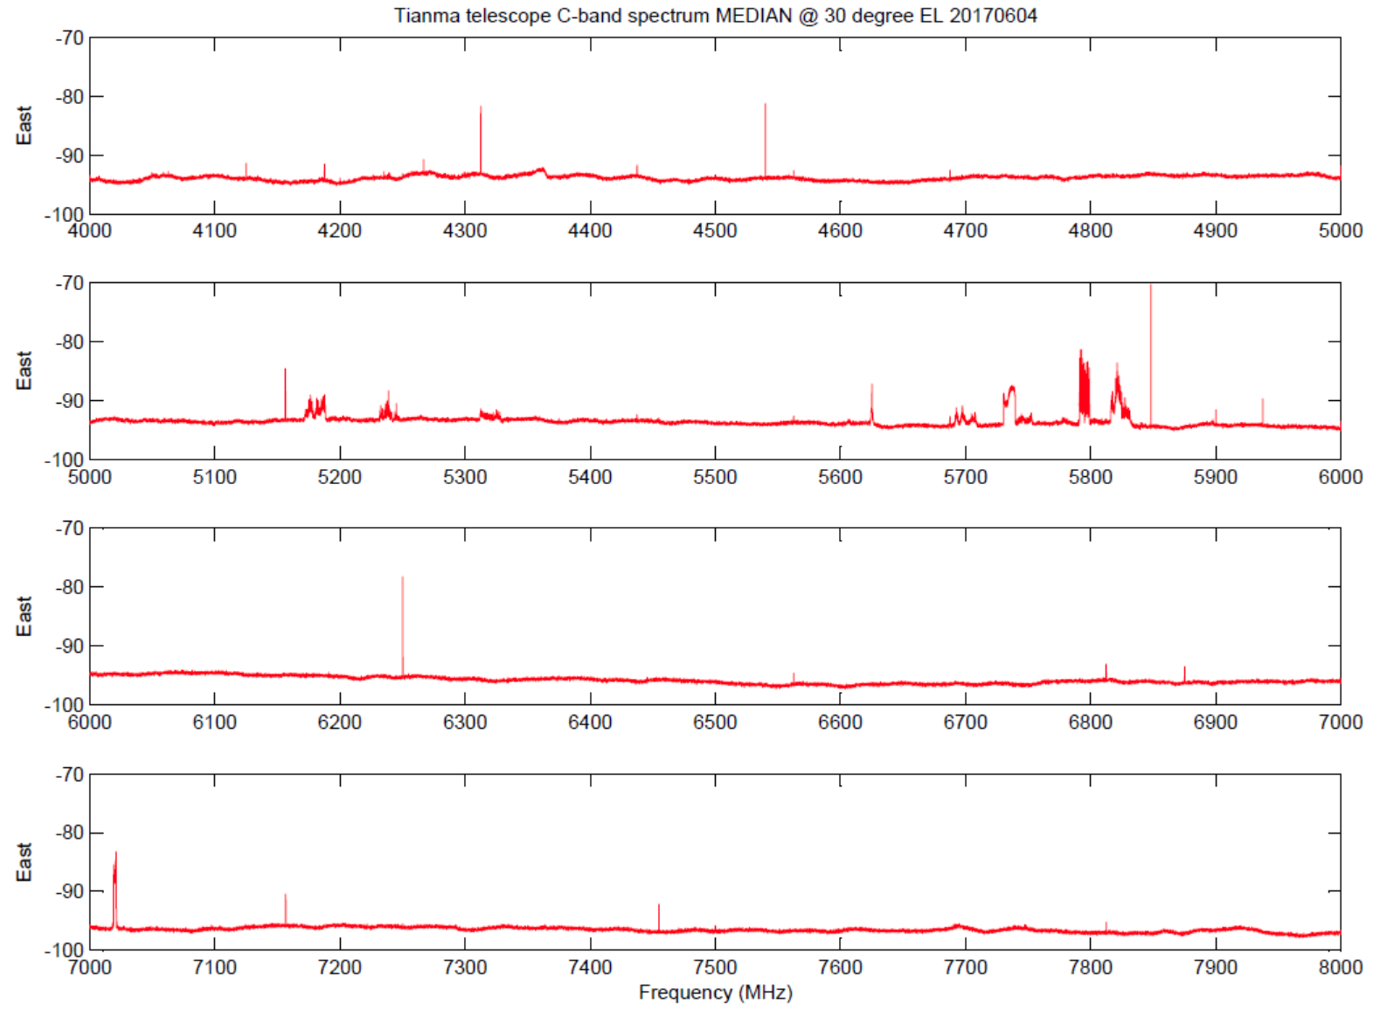
C-band spectrum

Slide 13
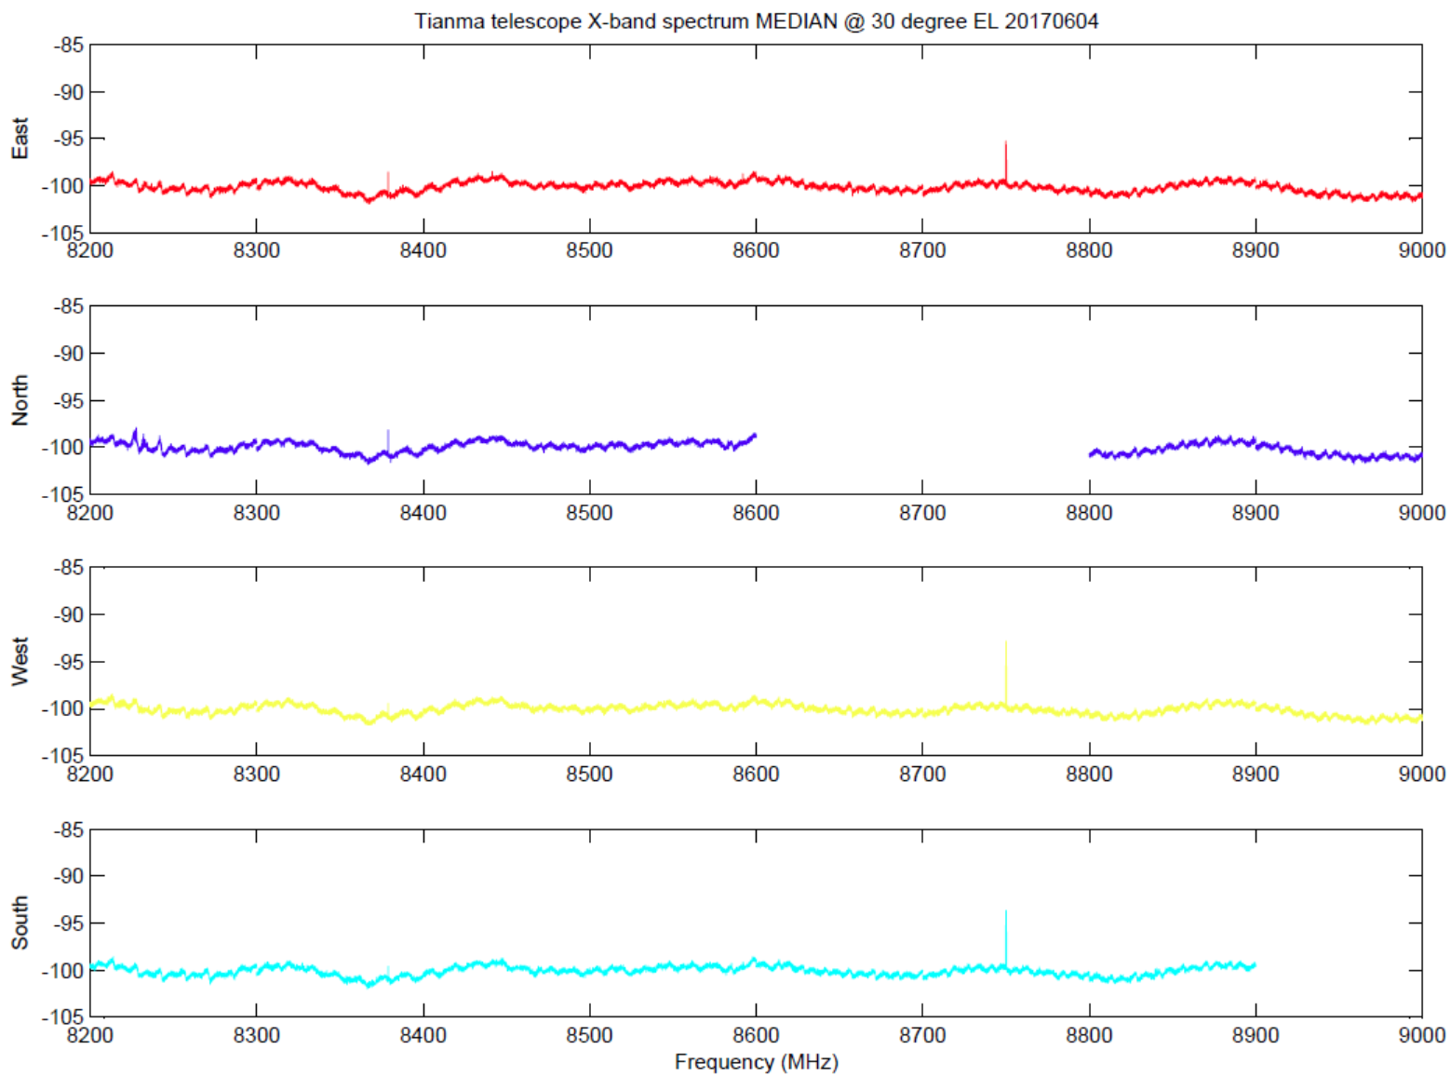
X-band spectrum

Slide 14
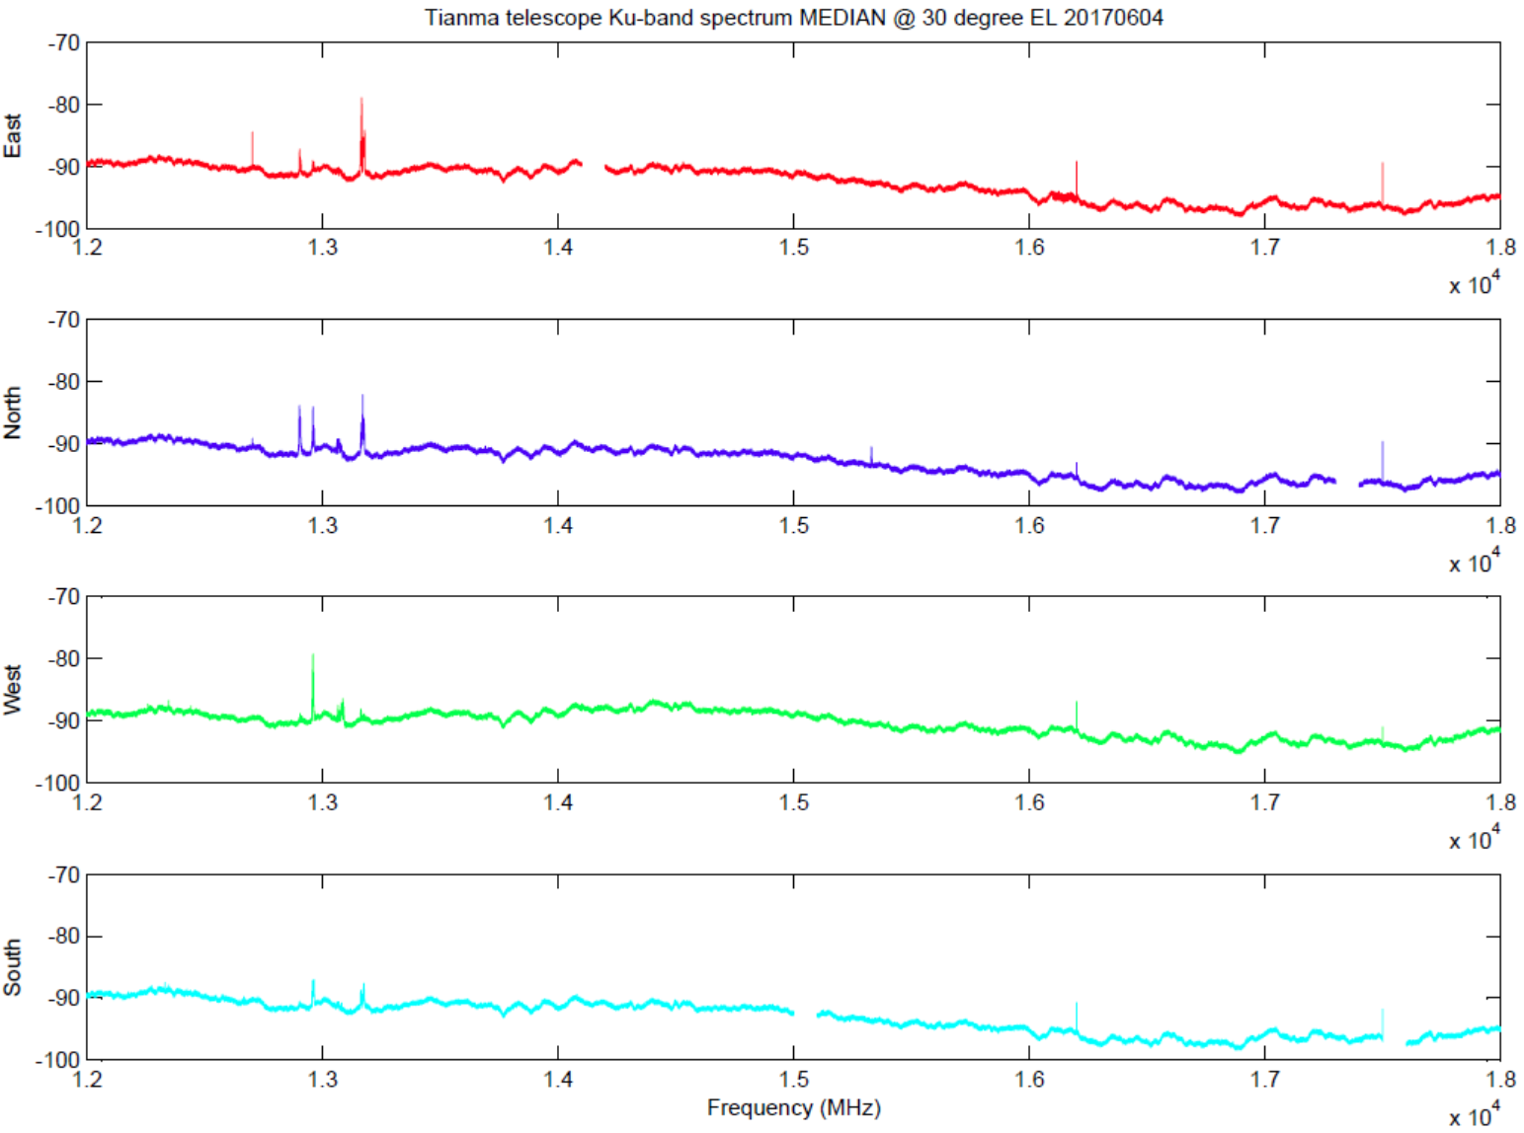
Ku-band spectrum

Slide 15
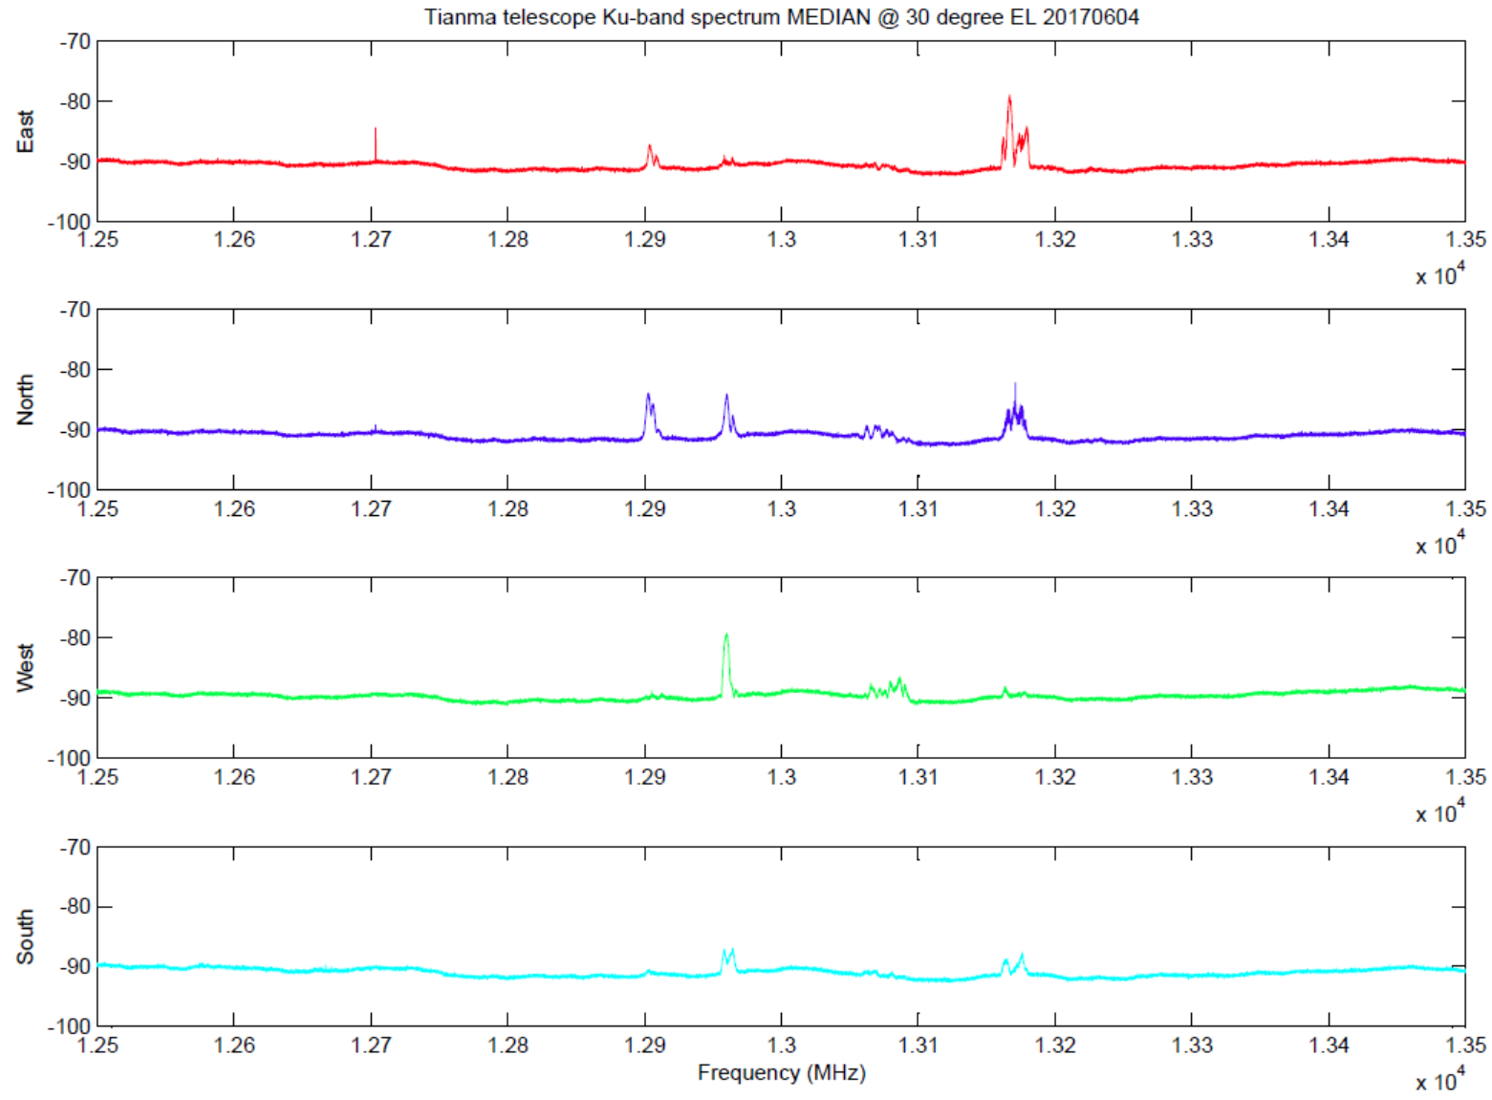
Ku-band spectrum

Slide 16
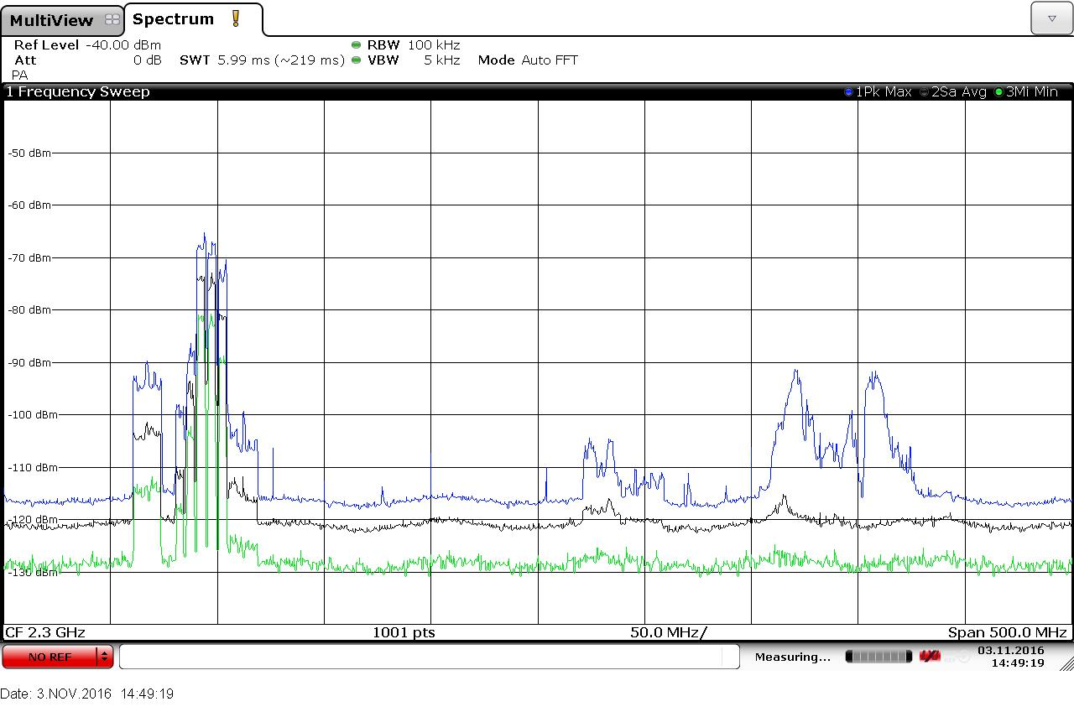
S-band spectrum

Slide 17
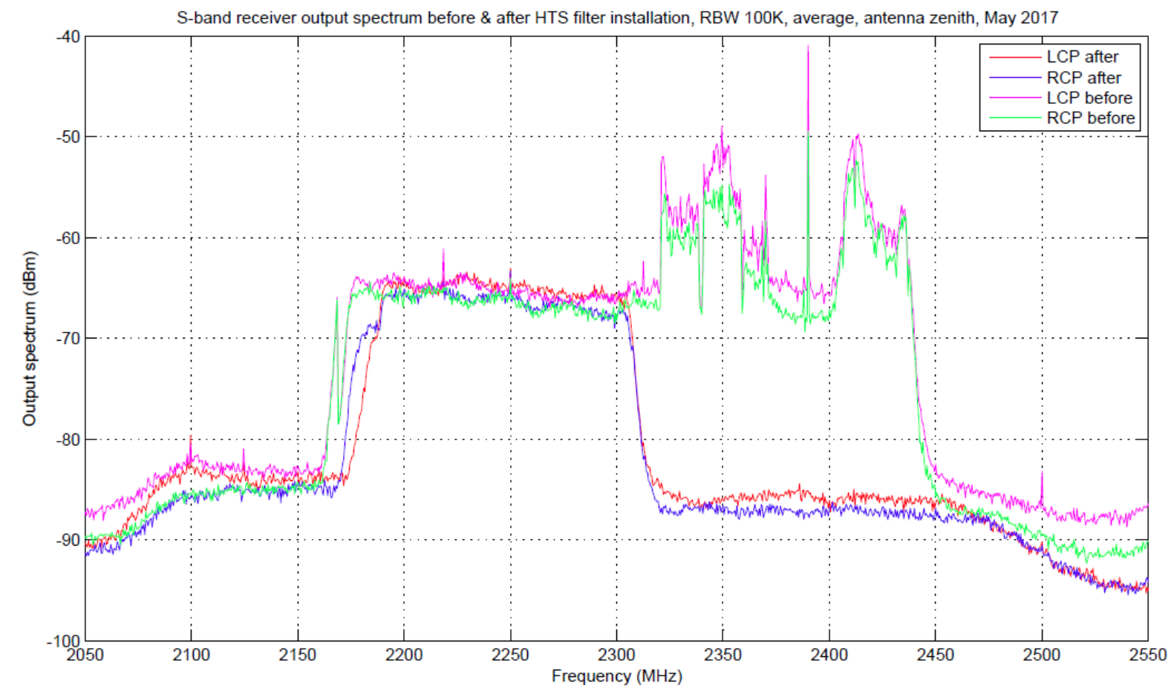
S-band spectrum

Slide 18
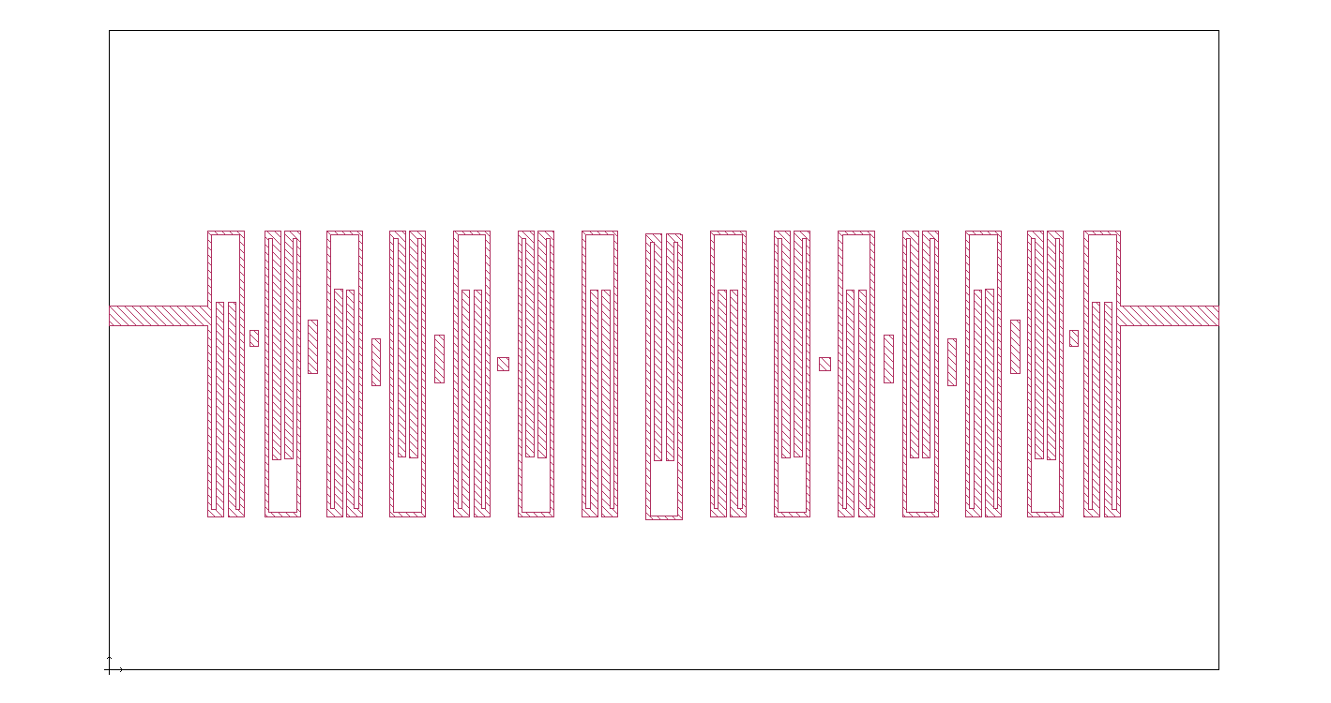
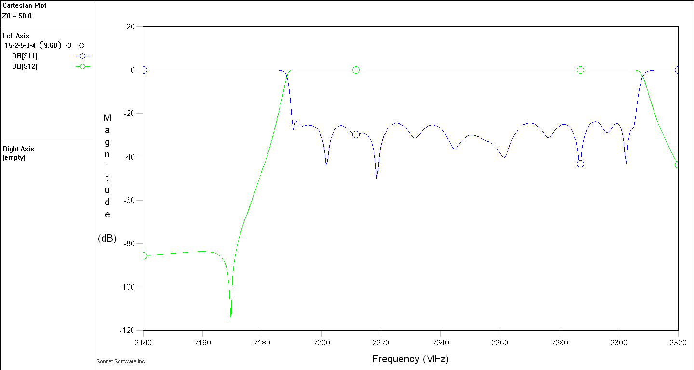
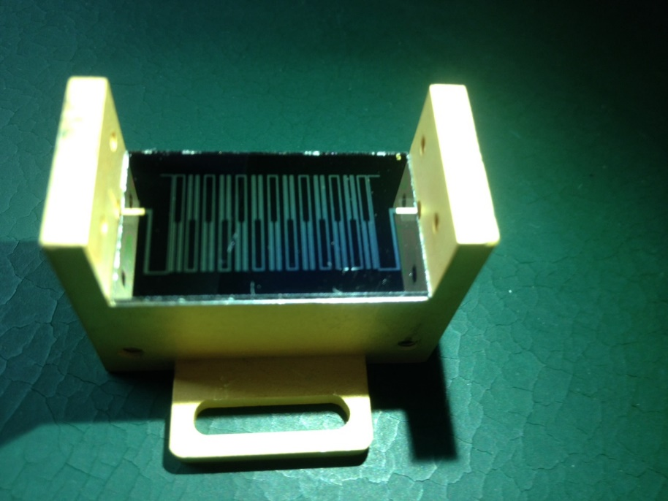
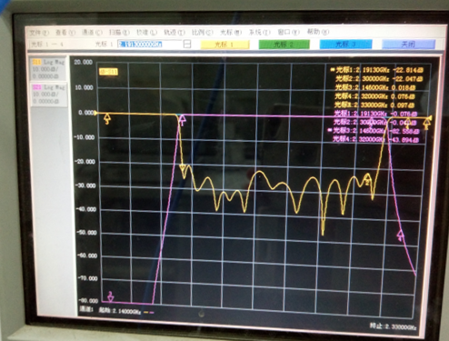
S-band HTS filter
Size： 28 mm * 16 mm * 0.5 mm

Slide 19
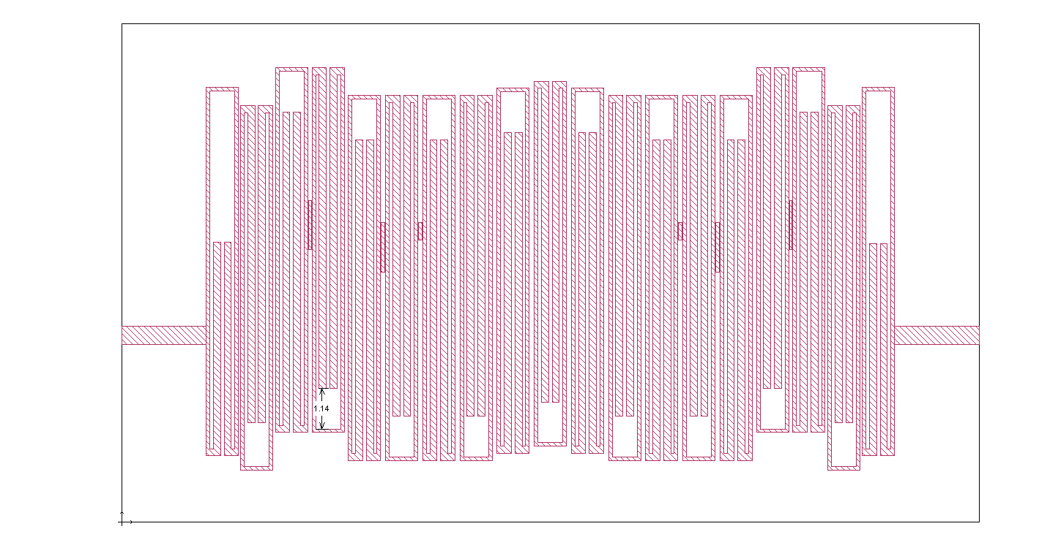
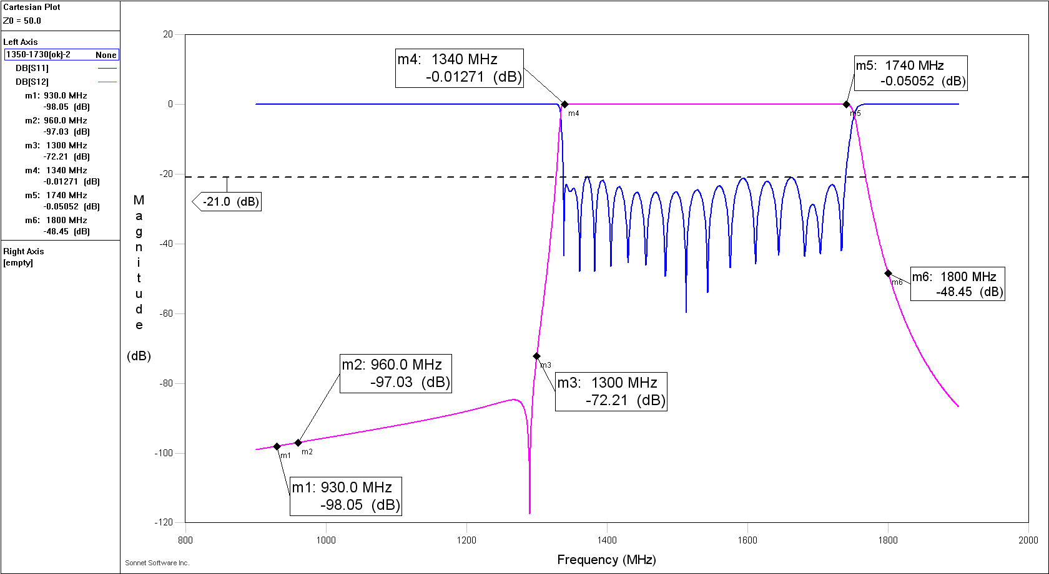
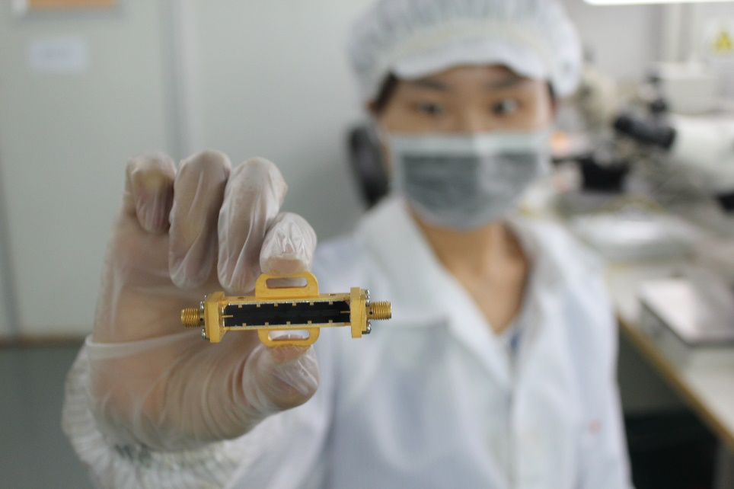
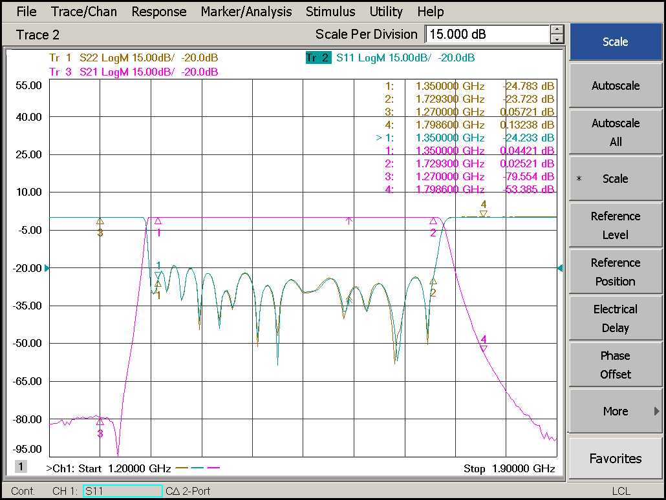
L-band HTS filter
Size: 24 mm * 14 mm *0.5 mm

Slide 20
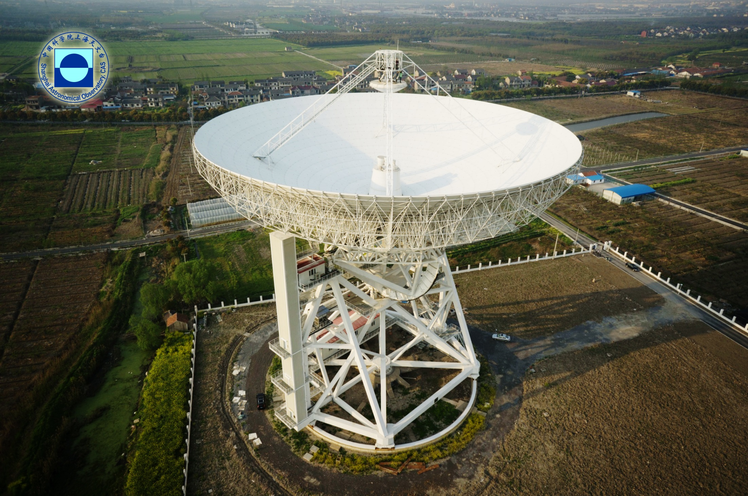
Thanks for your attention !

