Slide 1



The INAF RFI group: recent results in spectrum management & monitoring
Detection and measurement of RFI in radio astronomy
Yebes Observatory (IGN, Spain)
June 8-9, 2017
P. Bolli (OAA), R. Ambrosini (IRA-Bo), C. Bortolotti (IRA-Med), F. Gaudiomonte (OAC), G. Nicotra (IRA-Noto), L. Nicotra (IRA-Noto), M. Roma (IRA-Med), G. Serra (OAC)
This presentation has received funding from the European Union’s Horizon 2020 research and innovation programme under grant agreement No 730562 [RadioNet]
Notes:
One more regulatory and the other more experimental
Complementary techniques to deal with RFI
I will give some general concepts but in particular I will describe the Italian case: so what we do as Italian group
This talk is given o behalf of the Rfi group composed by
None of us is full time involved in this activity. Whowever, at least one FTE is assured at each station

Slide 2
agenda
Introduction: Italian RFI team, goals, radio telescopes
Spectrum management: Italian Frequency Plan
Spectrum monitoring: RFI stations at Medicina, SRT and Noto
Current issues: C-band RAI radio link and R-LAN , 77 GHz heliborne surveillance radars, L-band military radars
Future: Spectra for BRAND project at the Italian sites
Notes:
This talk is organized in 4 main sections:

Slide 3
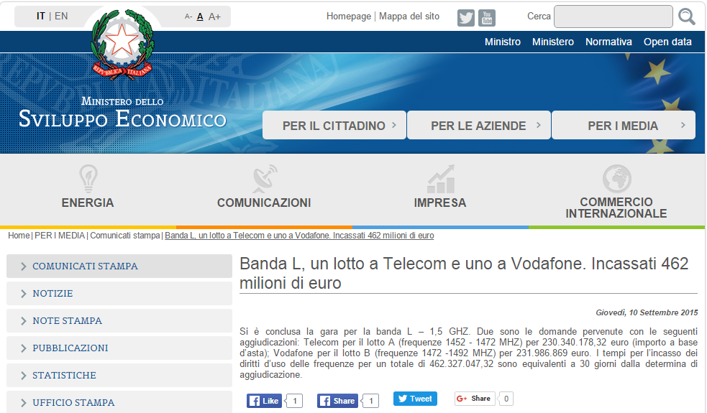
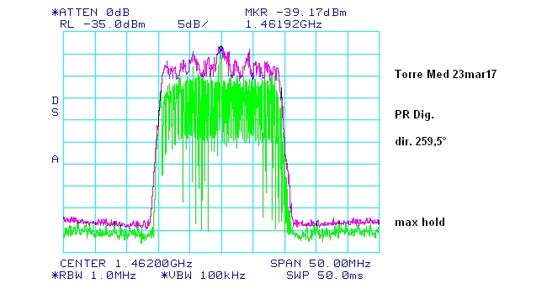
Radio spectrum is a valuable source of revenue
IMT-5G at 1452-1472MHz
Notes:
Piece of news related to the auction of two portions of the radio spectrum. Vodafone and Telecom bought 20 MHz each for a total of half bilion of euro, that is 70% of the value of SKA-phase 1. An other import relevant aspect of this auction is the vicinity to one of the most important astronomical band: the 21 cm line.

Slide 4
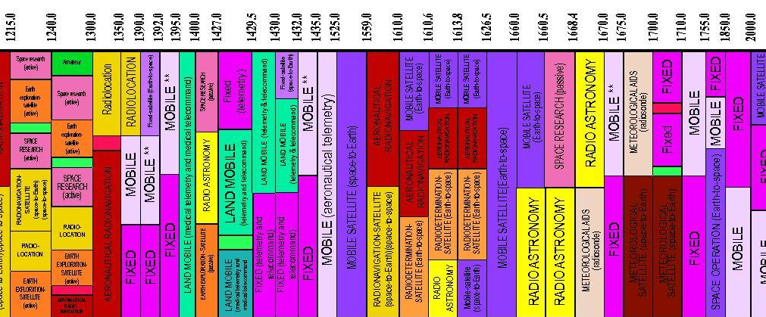
Objective of the RFI group
Minimizing the Radio Frequency Interference issues both in the protected frequency bands and in the not-allocated observed frequency bands with different strategies.
In-band
Out-band
Notes:
The goal of the gorup is to minimze at the Italian adio telescopes the RFI issues. This is done in two different ways: in the legal protected band we must assure the protection according to the regulation. At the same time, we knw very well that the protected bands are not longer sufficient for answering the needs of a modern radio astronomy (increasing the sensitivity radiometer formula and for red-shifted emsissiojn). Monitiring such bands can gie important information like for example the power lvels for better designin the radio astronomical receiver, the modulation of developping ad hoc mitigation techniques, statiscal occupancy for a sort of atenna scheduling according to the temporal distribution of th RFI, or recognizing some sort of auto. RFI

Slide 5
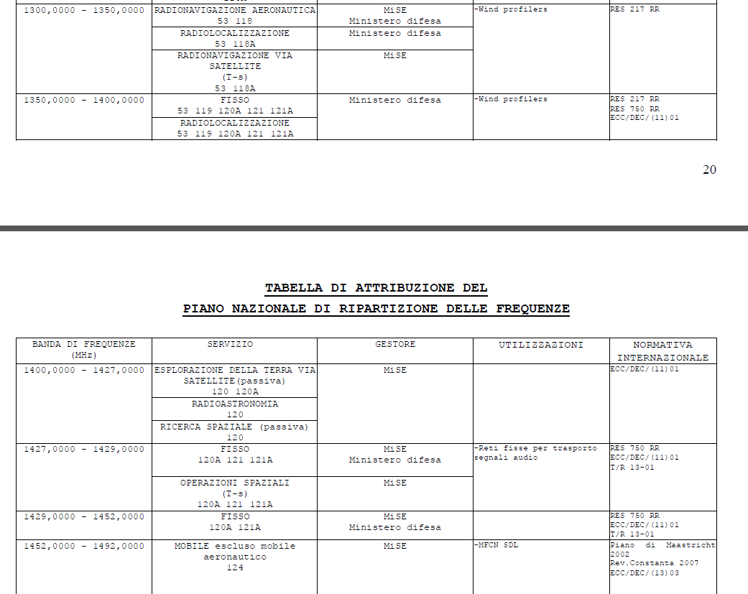
RA is a stakeholder of the radio spectrum
MISE
5.340 All emissions are prohibited in the following bands: ….
5.149 In making assignments to stations of other services …. administrations are urged
to take all practicable steps to protect the RAS from harmful interference.
Notes:
Ministry of economic development
Italian Frequency plan

Slide 6
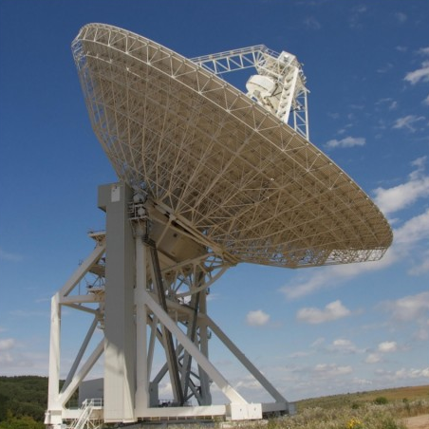
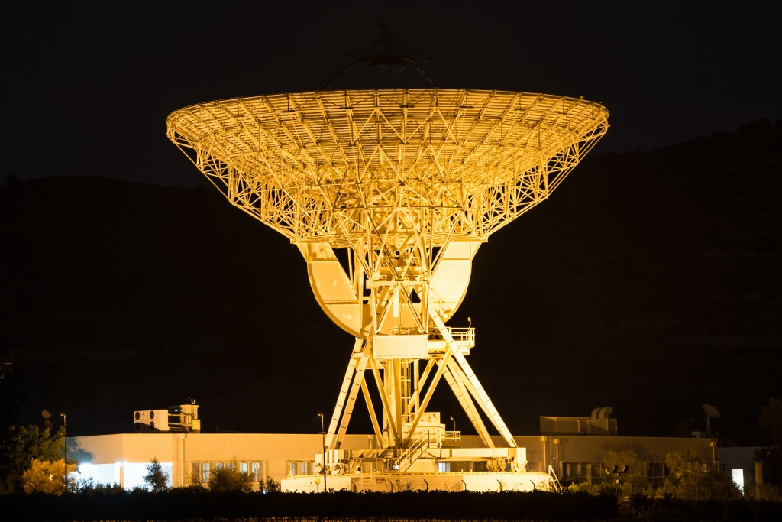
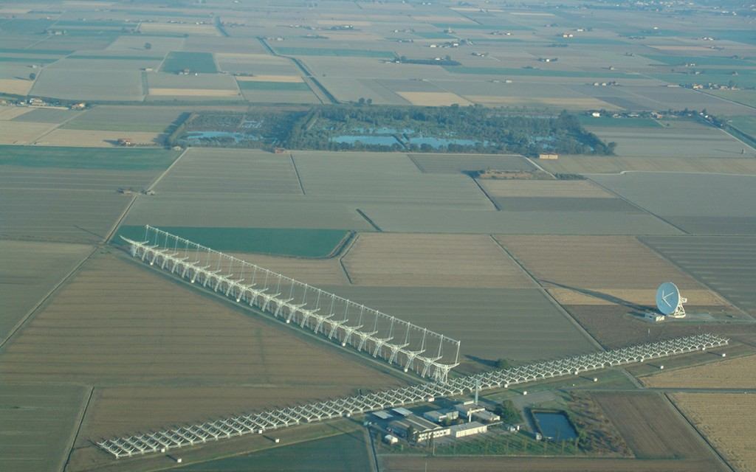
INAF Radio telescopes
Site | San Basilio | Medicina |  | Noto
Instrument | 64-m SRT | 32-m MRT | Northern Cross | 32-m NRT
Antenna | Gregorian antenna | Cassegrain antenna | Two arms of cylindric-parabolic antenna | Cassegrain antenna
Frequency range | 0.3 – 116 GHz | 1 – 26.5 GHz | 400 – 416 MHz | 0.3 – 86 GHz
ITU registration | YES | YES | YES | YES
Date of bringing into use | 01.01.2005 | 01.01.1983 | 01.01.1964 | 01.01.1988
Notes:
For having a legal status, it is fndamental to register the station in the ITU data-base.
The date is also important as firt come first served basis

Slide 7
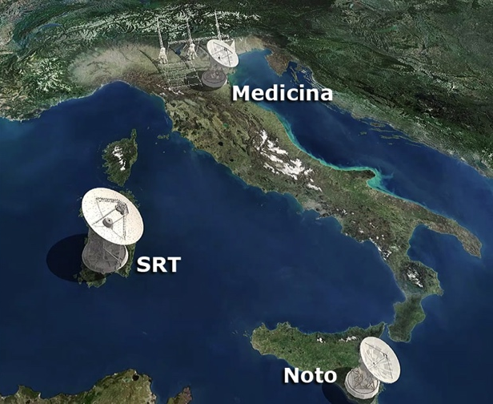
Rfi team
Territorial departments, MISE
RAS, Italy
IT Em. Rom.
C. Bortolotti
M. Roma
National administration, MISE
Other Italian stakeholders (army, radio operators …)
IT Sardinia
P. Bolli
R. Ambrosini
F. Gaudiomonte
G. Serra
EU RAS, CRAF
IT Sicily
G. Nicotra
L. Nicotra
Notes:
Ministry
Bi-directional to assist the local department when high sensititvytu is required

Slide 8
Approaches to minimize the rfi impact
Mariotti’s talk
tomorrow at 11.30
Serra’s talk
tomorrow at 10.00
Political
HW/SW research
Experimental
Spectrum management
Robustness of receivers and state-of-the-art design
Selection of the site
Establishing Radio Quiet Zones
Mitigation techniques
Spectrum monitoring
Relations with territorial departments of MISE
Use of devices «compliant» with RAS
Feedback from astronomical observations
Notes:
International coordination with different services
Medicina2 km radiusThe zone has been established by the Medicina Municipality
Noto no regulatory quiet zone since station is surrounded by hills
Sardiniastation under construction: no quiet zone defined yet

Slide 9
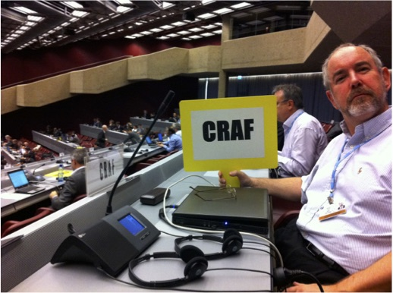
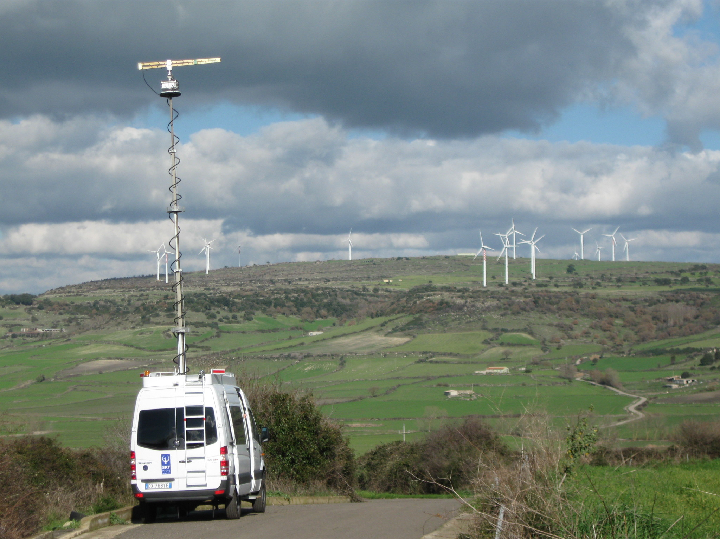
Example of inTerconnection between different activities
Spectrum management at ITU & CEPT level
International
bottom-up top-down
Spectrum monitoring
Future development of RA receivers
Local

Slide 10
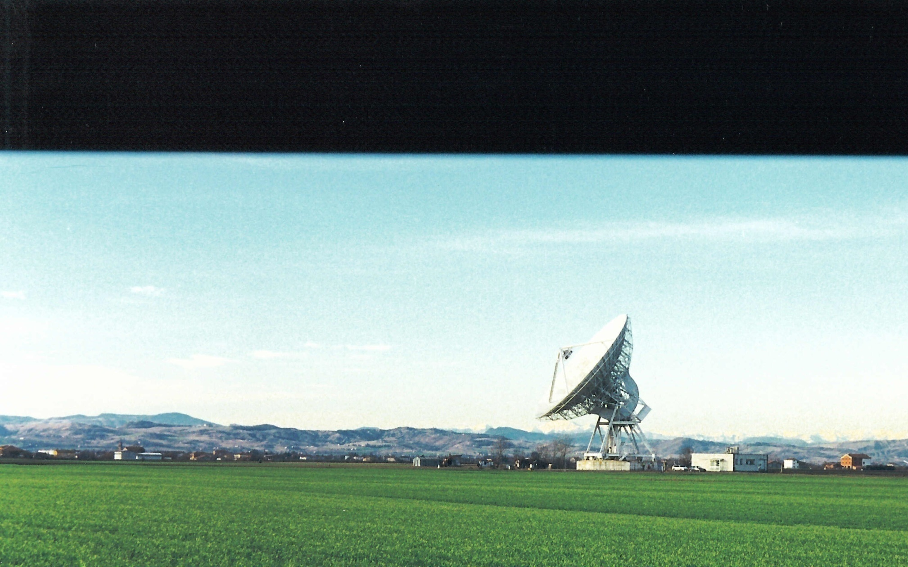
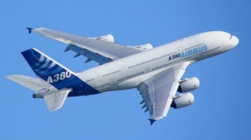

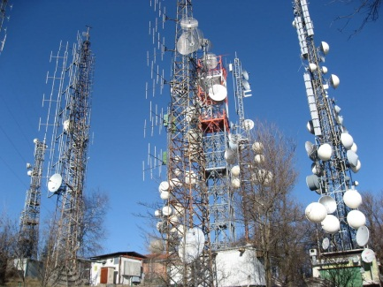
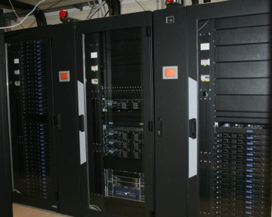
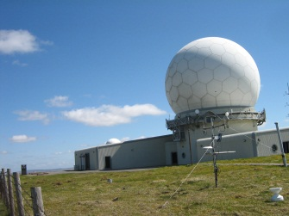
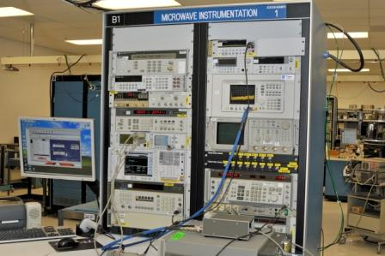
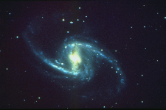
Active services & RFI MECHANISMS
The source is a non-compliant radio device
The source is a compliant radio device, but is used w/o a license
The source is a compliant and licensed device that operates exceeding radio licence parameters
The source is faulty radio equipment
EMC issues from non-radio devices (electric appliances)
Other reasons
Notes:
From a formal point of view. We can recognize several different causes of interefence
The source is a non-compliant radio device : equipment that are imported from abroad and that are not compliant with the relevant standards → ILLEGAL
The source is a compliant radio device, but is used without a license: devices not allowed in a given country or devices that are not licensed. For example FM transmitters used without a license
The source is a compliant and licensed device that operates exceeding radio licence parameters: devices that operate exceeding license parameters. For example, FM transmitters that exceed the licensed power limits.
The source is faulty radio equipment: equipment that has some malfunctioning. For example, uncontrolled oscillations, non-linear phenomena, etc. in an uncontrolled portion of radio spectrum;
Intermodulation issues or EMC incompatibility appearing from radio or non-radio devices (electric appliances): electric equipment, including domestic ones, which do not apply to immunity standards, have the potential to produce interfering radiofrequency energy. Radio-communication sites with a high density of transmitters have a great potential to produce interfering radio energy by non-linear phenomena.
Other reasons: Other reasons not identified in items 1 to 6 above.

Slide 11
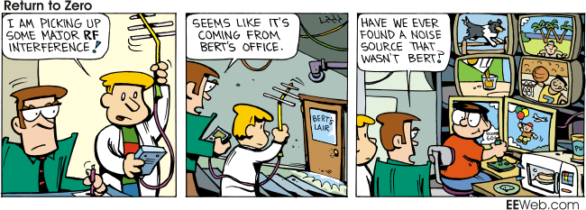
The internal «enemY»
Notes:
I told you about the «external enemies», but we have to admit that very often the source of our problems is ourself.
We don’t have any Bert, but we have a lot of electrical and electronic equipment close to our ra site

Slide 12
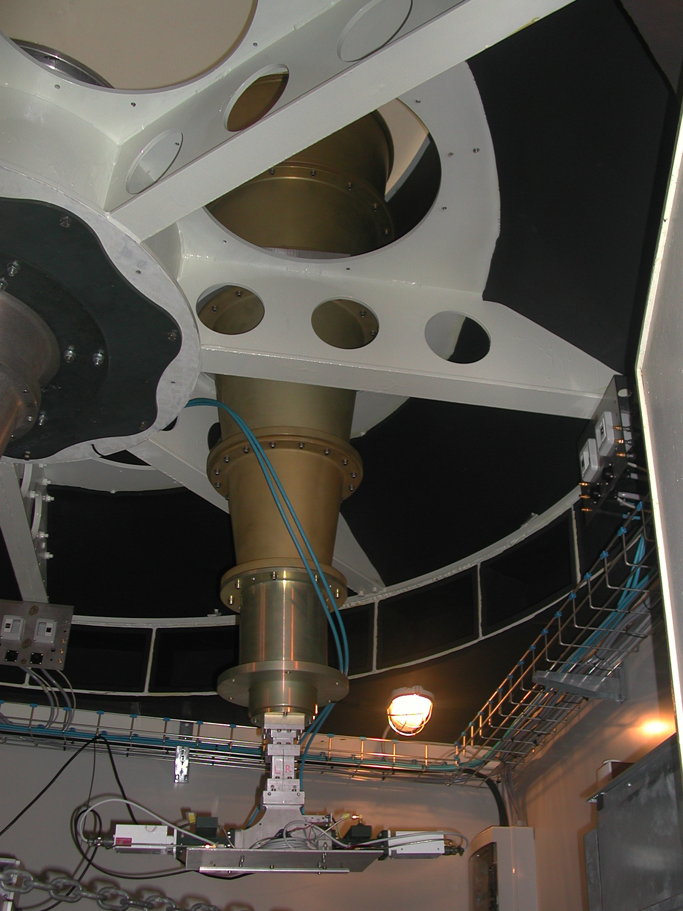

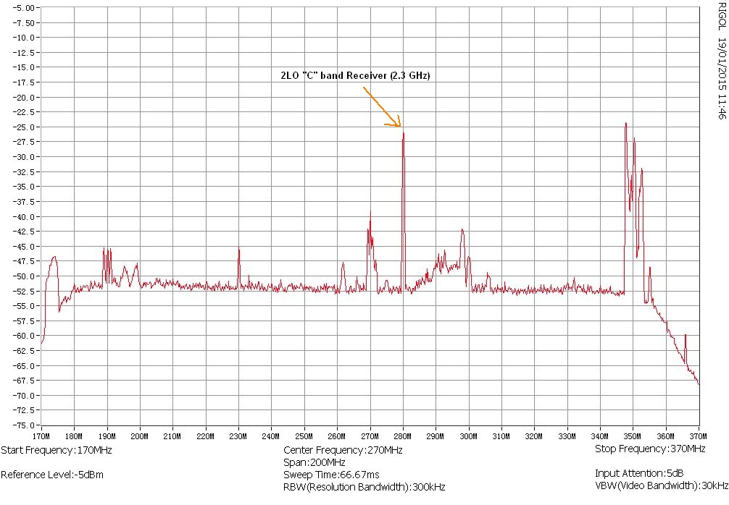
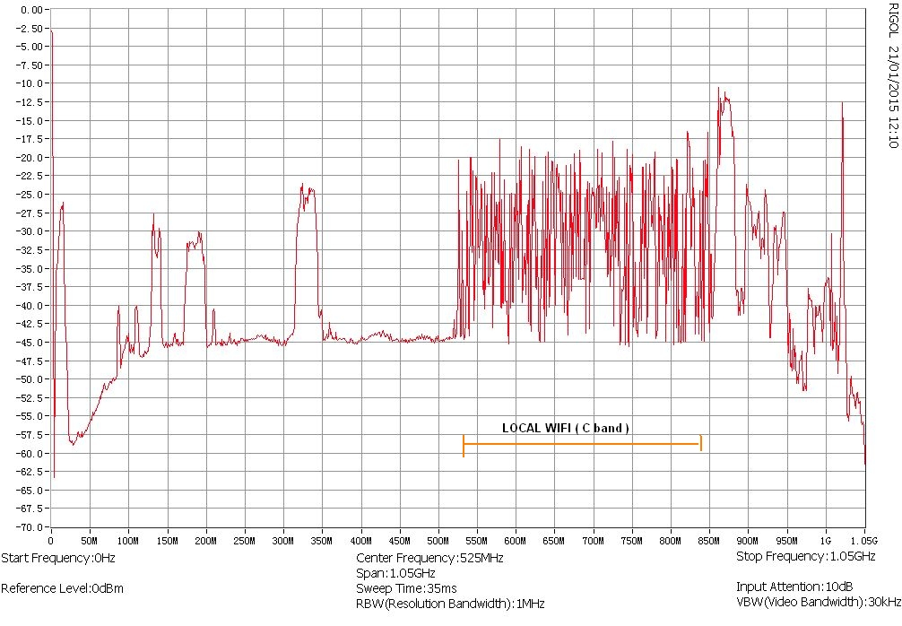
Examples of auto-interference
S-band (2.2 – 2.4 GHz)
C-band (4.6 – 5.6 GHz)
Notes:
Ricevitore banda C LO 4600. Banda nominale 4600-5600 MHz
Ricevitore banda S: Banda nominale : 2200-2400 MHz → wifi (IEEE-A) smartphone

Slide 13
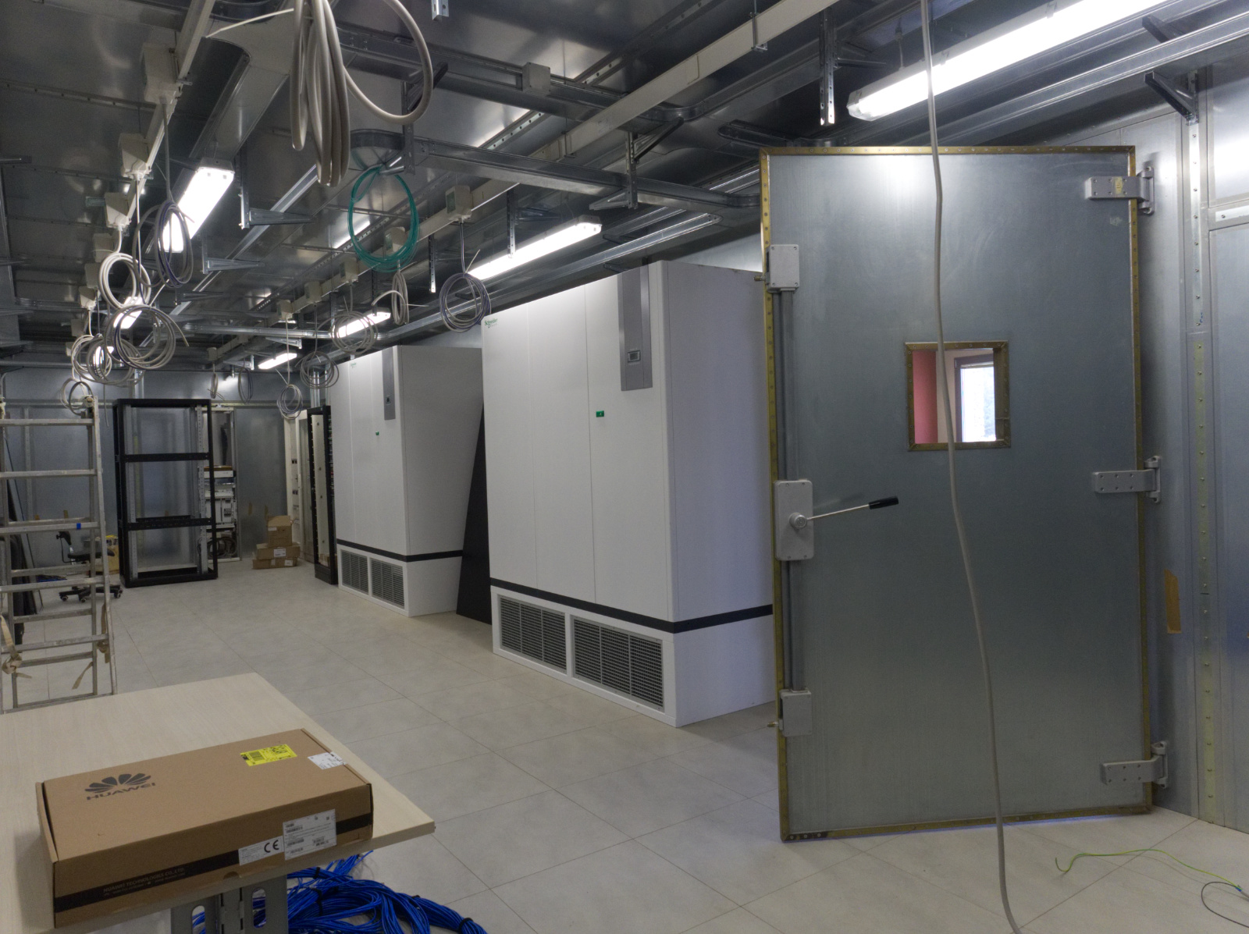
The faraday room at srt
The expected self-generated RFI levels from the data centre exceed by about 60 dB the thresholds given in Recommendation ITU-R RA.769-2 as detrimental to radio astronomical observations
The lower frequency bands (below about 1 GHz) were found to be the most contaminated
In 2010, the Board decided to equip SRT with a Faraday room
Notes:
After several investigations of the power levels emitted in the data center of the OAC, i
Scenario 1: All devices switched off.
• Scenario 2: Scenario 1 + UPS switched on.
• Scenario 3: Scenario 2 + LAN services switched on.
• Scenario 4: Scenario 3 + CPU cluster switched on.

Slide 14
Rfi monitoring: strategy
The cost for operating the radio telescopes is high
Loosing astronomical data because of the RFI presence has a major financial impact
Using radio telescope for monitoring the RFI has a financial implication as well
The Italian radio telescopes have been equipped with dedicated fixed and mobile RFI stations
Notes:
300 euro all’ora!

Slide 15
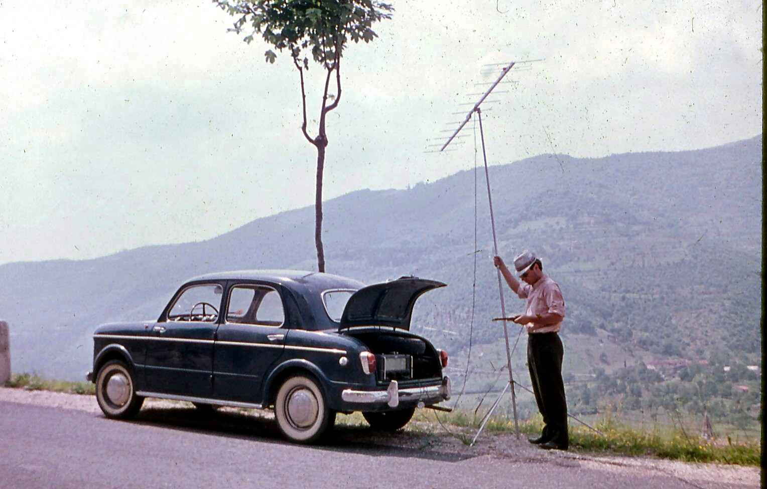
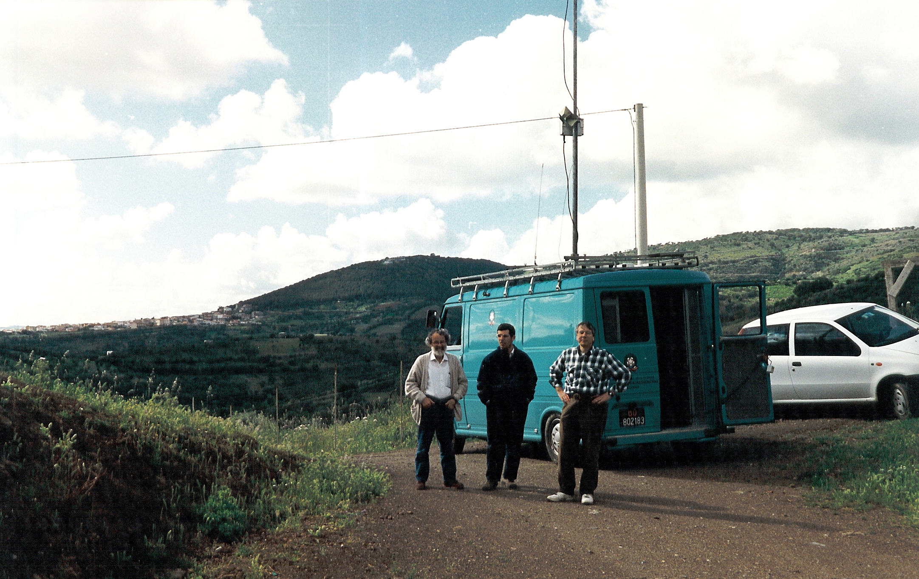
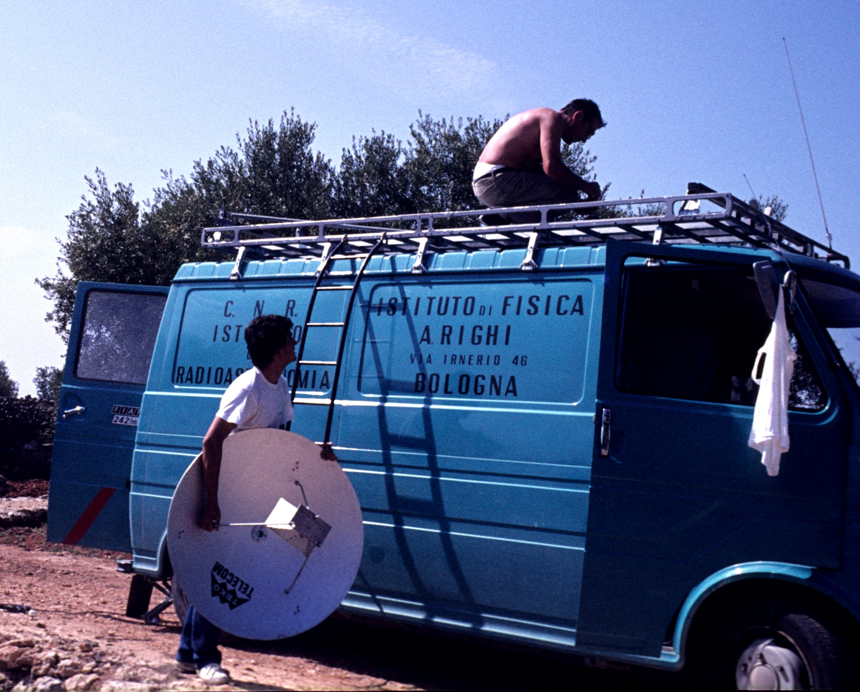
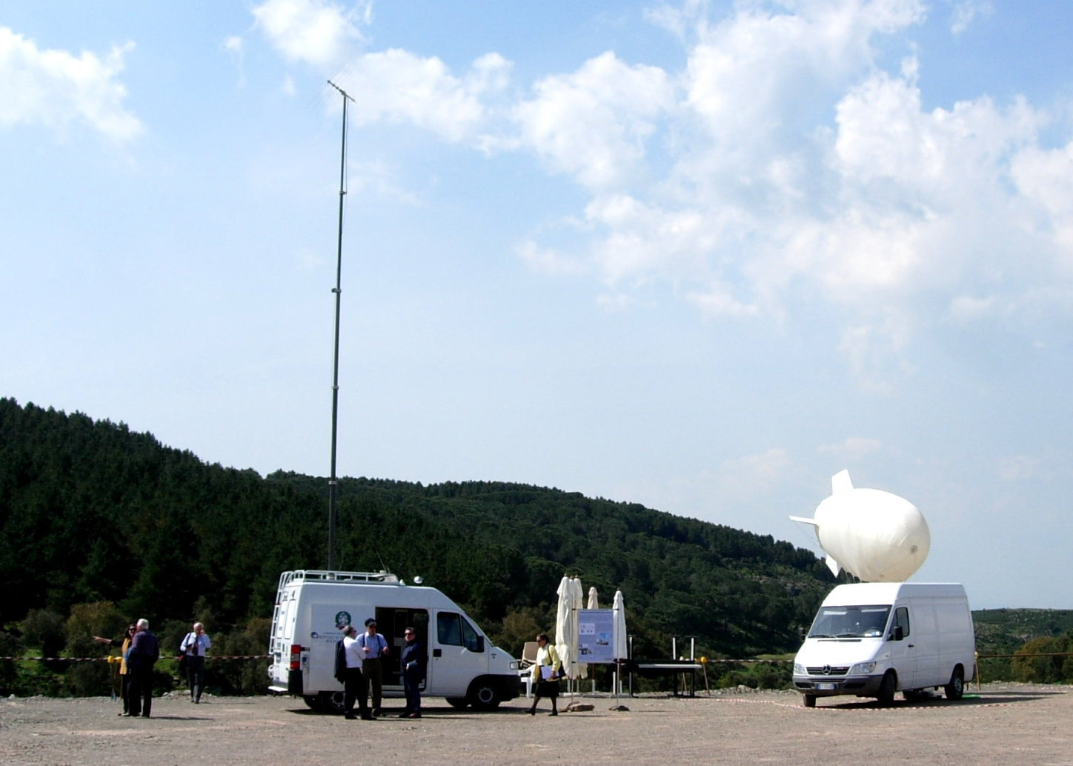
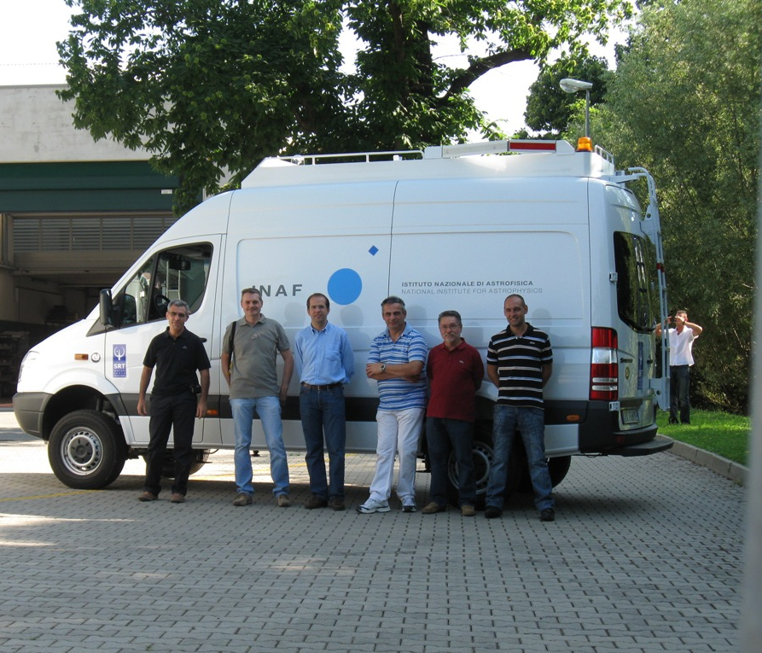
Notes:
Prima foto: Luciano Baldeschi. Technician. Fisrt survey to identify RFI around 400 MHz. Close to Verona, early sixites
Seconda foto: Morsiani e Tomasetti, Sicily, 1980
Terza foto: Ambrosini, Grueff, Porceddu, SRT, 1990
Quarta foto. D’Amico, Ambrosini, Messina, Open day, 2006

Slide 16
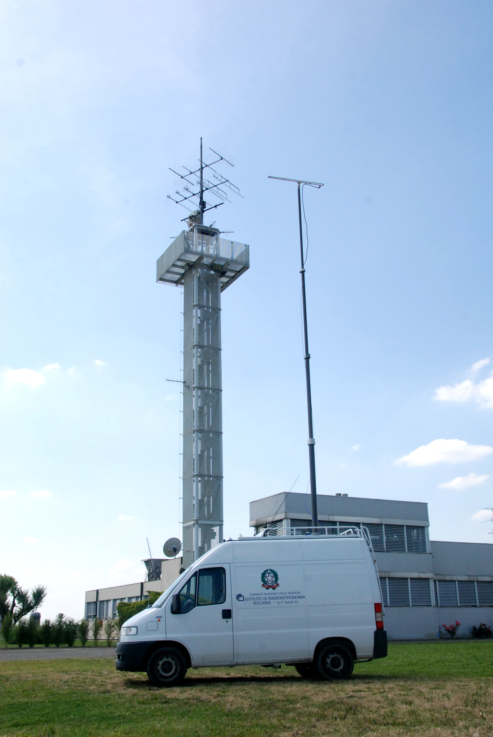
Why fixed? Why mobile?
FIXED STATION | MOBILE STATION
Acquisition system for automatic data analysis and continuous monitoring | Monitoring from locations with better Signal-to-Noise Ratio
Higher gain antennas with narrow beam for the localization of the RFI direction | Precise localization, also through triangulation, of the RFI transmitter
Detect the main characteristics of the RFI:
type, bandwidth, modulation, duty-cycle, direction, “identity” etc.
Out-of-RAS-band
In-RAS-band
Negotiation with TX, RA receiver design, mitigation techniques
Submit proper reports to the local/national authority

Slide 17
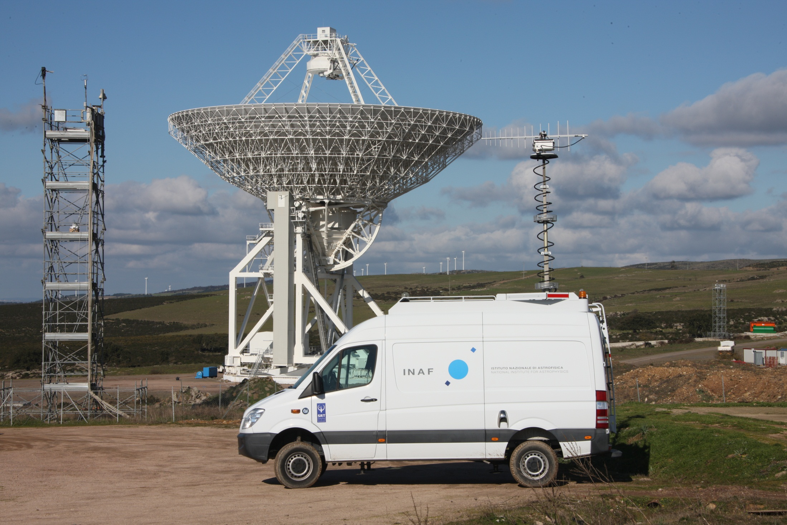
Rfi monitoring systems
 | Medicina |  | SRT |  | Noto
Station | Fixed | Mobile | Fixed | Mobile | Fixed | Transportable
Type of RFI | Terrestrial and space-born | Terrestrial | Terrestrial | Terrestrial | Terrestrial | Terrestrial
Antennas | 2 LPDA: 80-500 MHz 2 LPDA: 0.5-1 GHz 2 Yagi Uda: 320-333 MHz 2 Yagi Uda: 400-416 MHz 2 Yagi Uda: 600-614 MHz 1 dish (1.2 m): 1.3-12 GHz 1 Yagi Uda: 400-416 MHz 1 dish (1.5 m): 1.2-12 GHz | 1 LPDA: .13-1.3 GHz 1 LPDA: 310-620 MHz 1 LPDA: 1200-2400 MHz 1 Flat panel: 4.9-6 GHz 1 Horn: 1-18 GHz 1 Horn: 18-26.5 GHz 1 Horn: 26.6-40 GHz 1 dish (0.3 m): 22-23.6 GHz | 2 LPDA: 300-600 MHz 2 LPDA: 1200-3400 MHz | 1 LPDA: 290-450 MHz 1 LPDA: 1200-3300 MHz 1 LPDA: 100-1300 MHz 1 Horn: 1-18 GHz 1 Horn: 18-40 GHz 1 Horn: 18-26 GHz 1 Horn: 26-40 GHz | 2 LPDA: 100-1350 MHz 2 LPDA: 1350-2350 MHz | 1 LPDA: 300-3000 MHz 1 Horn: 1-18 GHz 1 Horn: 18-26 GHz
Backends | HP 8562EC ICOM IC-R9000 | HP 8562A ICOM IC-R9000 | Agilent PSA E4446A ICOM IC-R9500 | Agilent PSA E4446A ICOM IC-R9500 | Agilent E4408B (shared) and ICOM IC-R9000
Status | In operation | In operation | Currently dismissed due to low sensitivity & multiple reflections | In operation | Mast currently out of order for maintanance | In operation

Slide 18
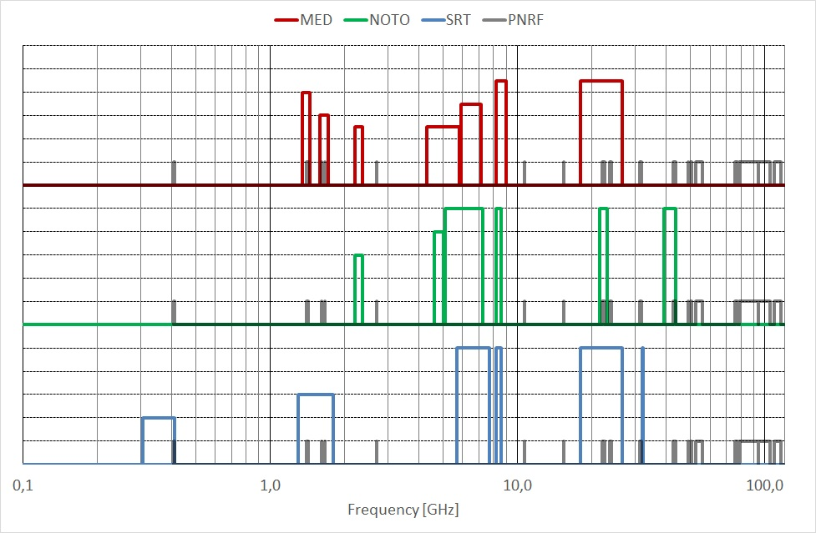
Frequency bands currently observed by italian RTs
*****: Fully clean:<10%
****: Almost clean:>10%,<25%
***: Partially clean:>25%,<50%
**: Moderately polluted: >50%,<75%
*: Strongly polluted: >75%
Notes:
Ras used bands

Slide 19

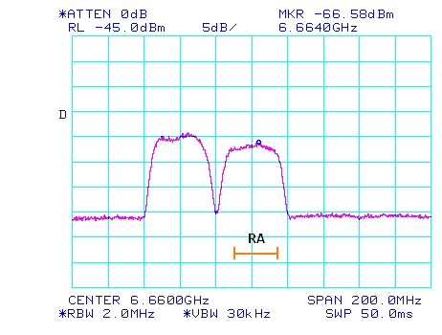
Medicina: RAI LINK
Digital radio link at 6660 MHz + a second channel at 6620 MHz
Band RAS = 6650 – 6675.2 MHz (secondary status)
Band EVN = 6613 – 6700 MHz (not-protected)
6660 MHz (BW 30 MHz)
6620 MHz (BW 30 MHz)
7000 MHz
6960 MHz
PFD = 70 dB higher than Rec769
Oct. 2016
RAI: «Despite our best intentions, we have analysed the issue several times and we have not found any feasible technical solution»
Radio astronomers: No much interest for this frequency range
6600
6620
6640
6660
6680
Notes:
Logo rai

Slide 20
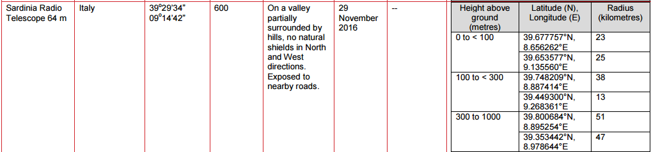

heliborne surveillance radars
The ECC Decision 16(01) contains an annex with the RAS sites.
We produced together with Airbus the exclusions zones around SRT and Noto, using the Path Profile tool.
300 m
1000 m
Notes:
Airbus

Slide 21
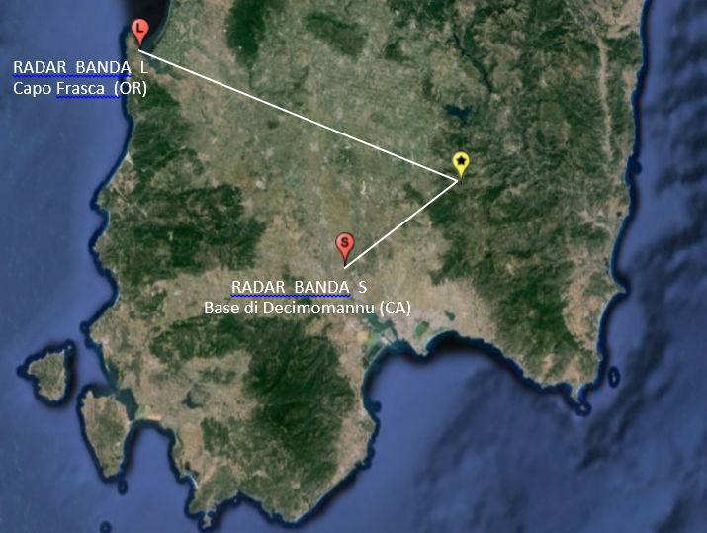
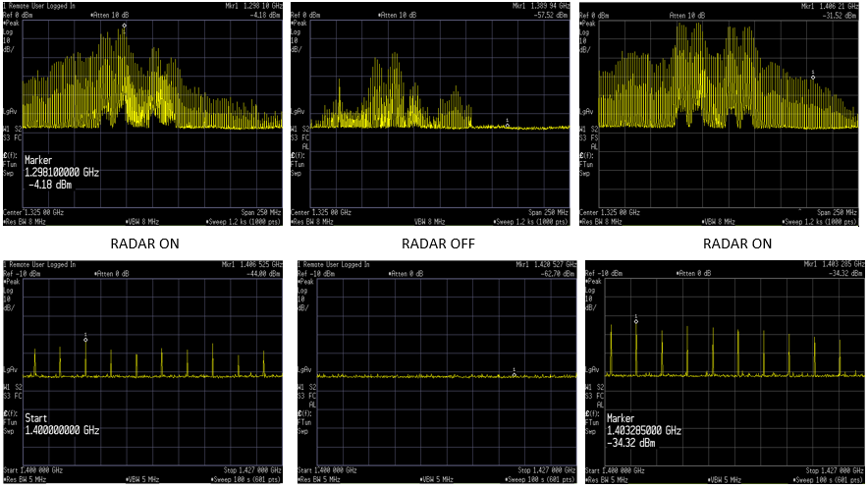
Srt: military radar
4 CARRIERS BETWEEN 1280 AND 1342.5 MHz
1200 – 1450 MHz
1400 – 1427 MHz

Slide 22
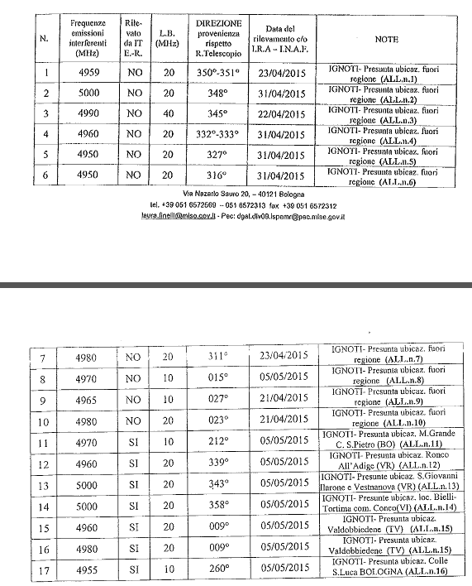
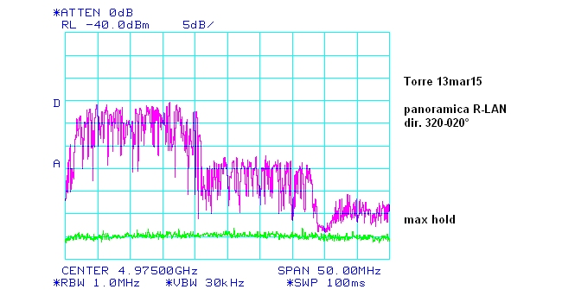
High Performance Radio LAN
MEDICINA (SRT and Noto): Hiperlan (allocated at 5150 – 5350 MHz (indoor) & 5470 – 5725 MHz (outdoor)) also in the 4950 – 5000 MHz where RAS has a secondary status (primary for military service)

Slide 23
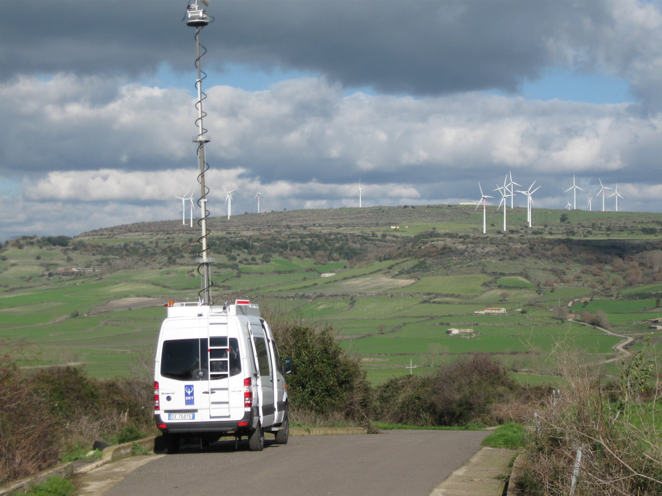
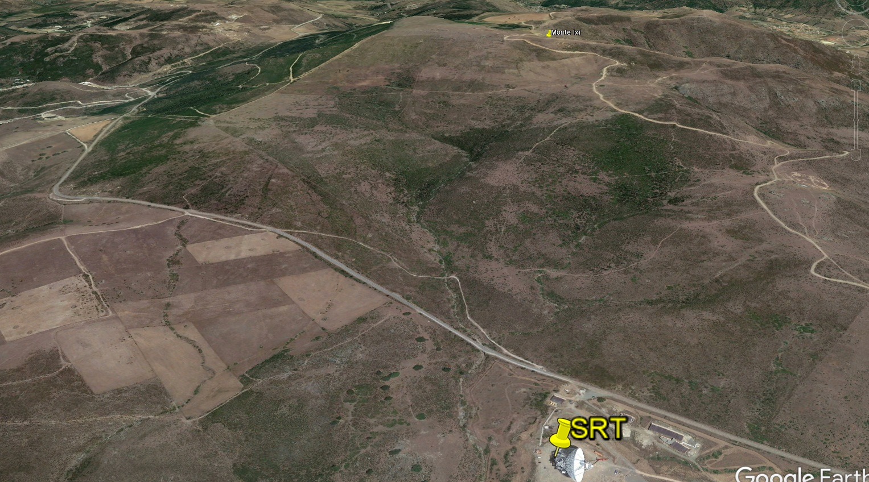
Radio quiet zones
So far, only the town planning (“piano regolatore”) of the Medicina municipality has established that for new industrial and civil buildings within a radius of 3 km from the RT, a technical opinion from INAF is required.
We are currently working with MISE to establish some sort of RQZ around the Italian RTs
The installation of a TETRA (TErrestrial Trunked RAdio) network is under construction in Sardinia. The closer node to SRT will be built before June at 2 Km from SRT in the line-of-sight (UHF, 380-395 MHz and microwave link)

Slide 24
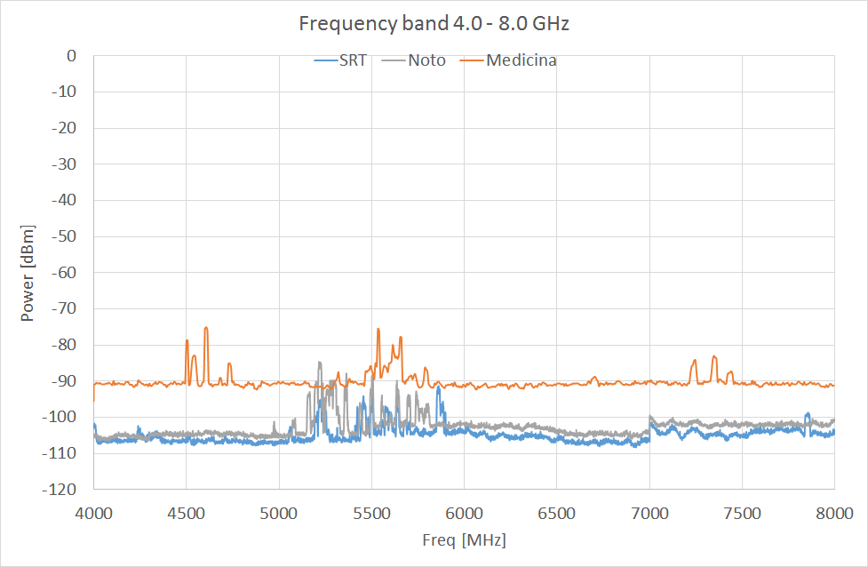
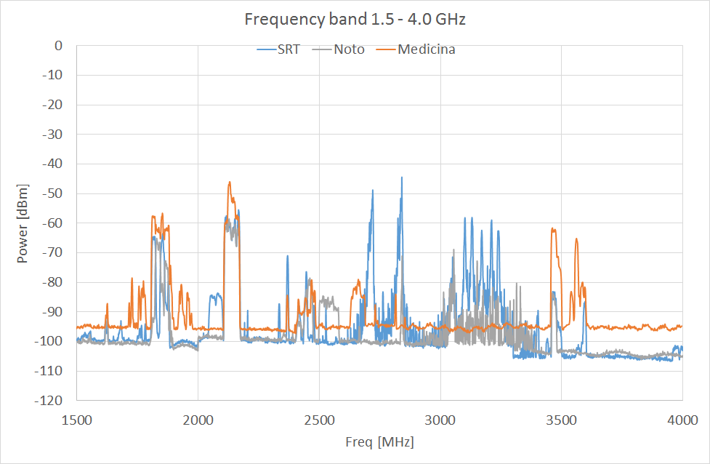
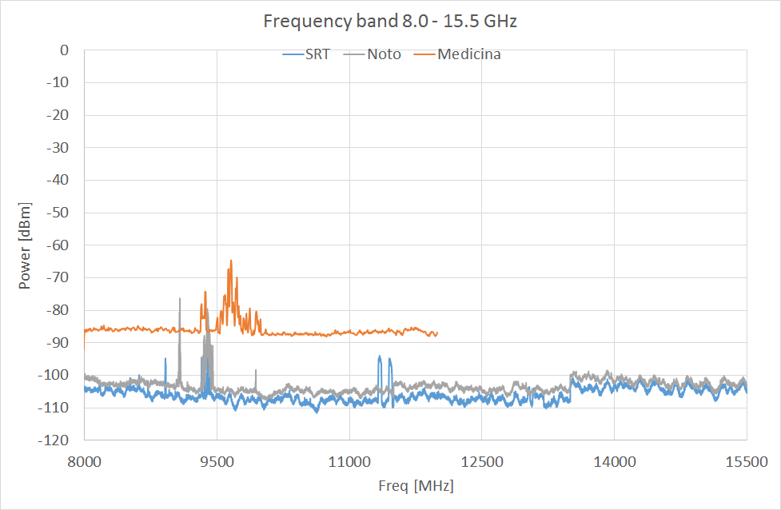
Observations in BRAND band
Levels refered to ISO antenna, dBm / 2-3MHz
Assuming a -70 dBm (0 dBi) threshold for linear regime

Slide 25
The RFI group is at service of RA, However ….
Notes:
At the same, we made efforts to give value to our results like publishing when possible the most relevant results as: ….

Slide 26
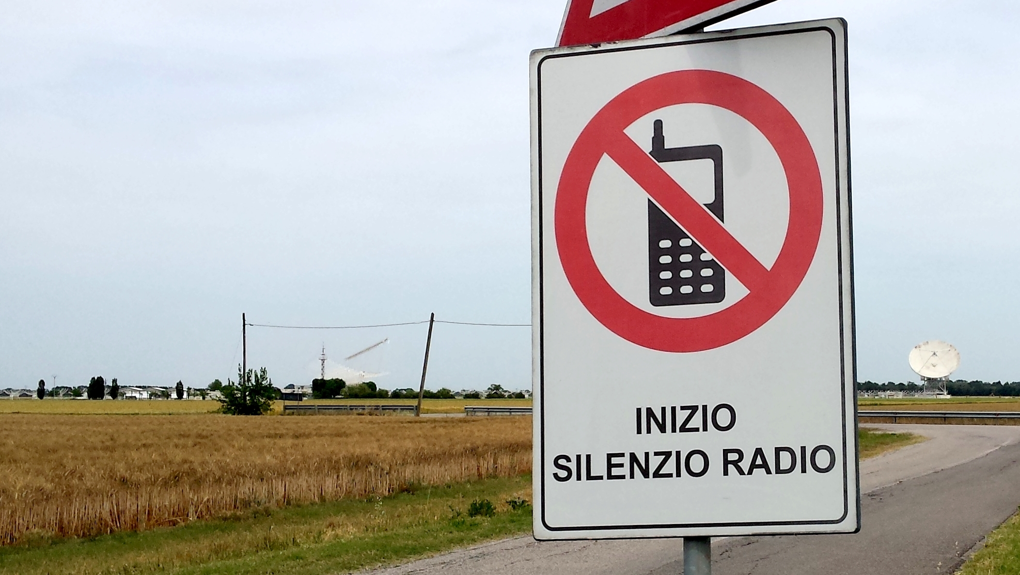
THANKS! QUESTIONS?

Slide 27
