Slide 1
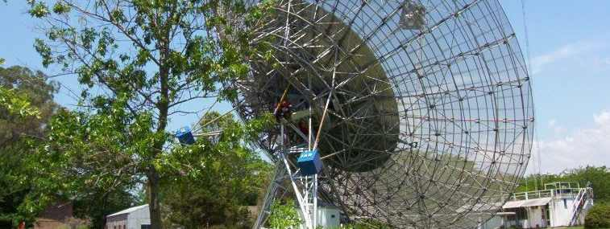
RFI Measurements at the
Argentine Institute of Radioastronomy
Detection and measurement of RFI in radio astronomy
Yebes Observatory (IGN, Spain)
June 8-9, 2017

Slide 2
Outline
IAR, Brief introduction
Equipment & measurements for RFI-SKA campaign, 2005
Equipment & measurements for RFI-TIGO campaign, 2012
RFI equipment & measurements, IAR development, 2013
RFI data processing and study.

Slide 3
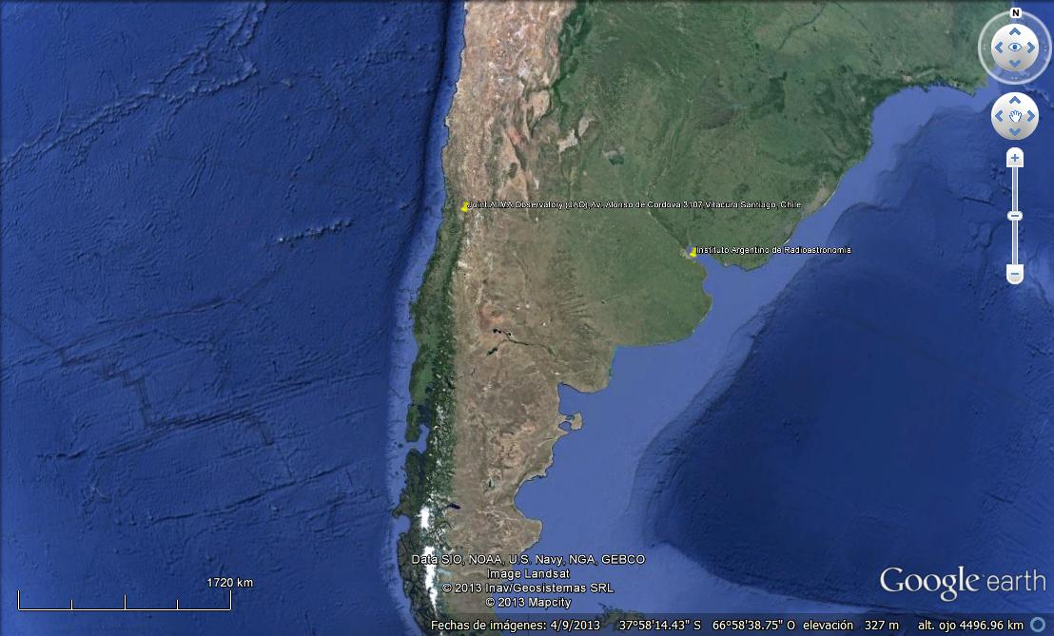
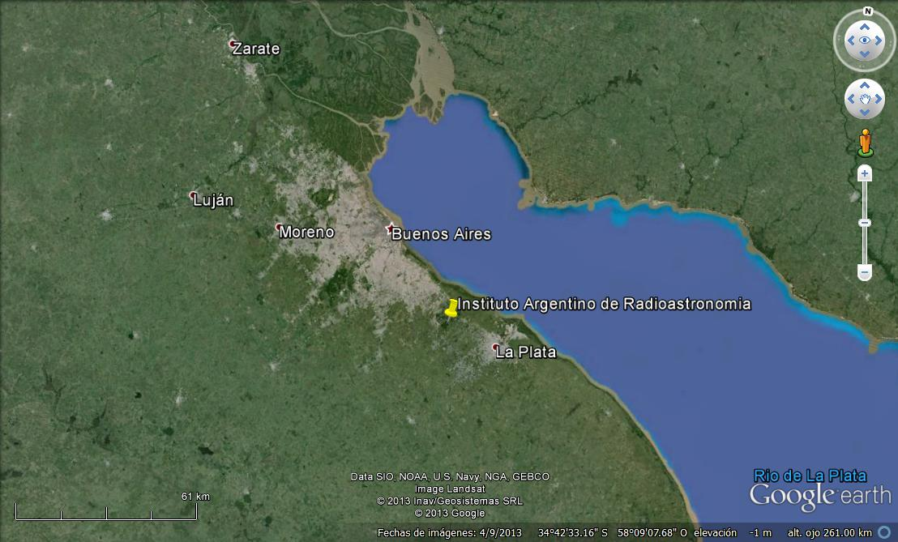
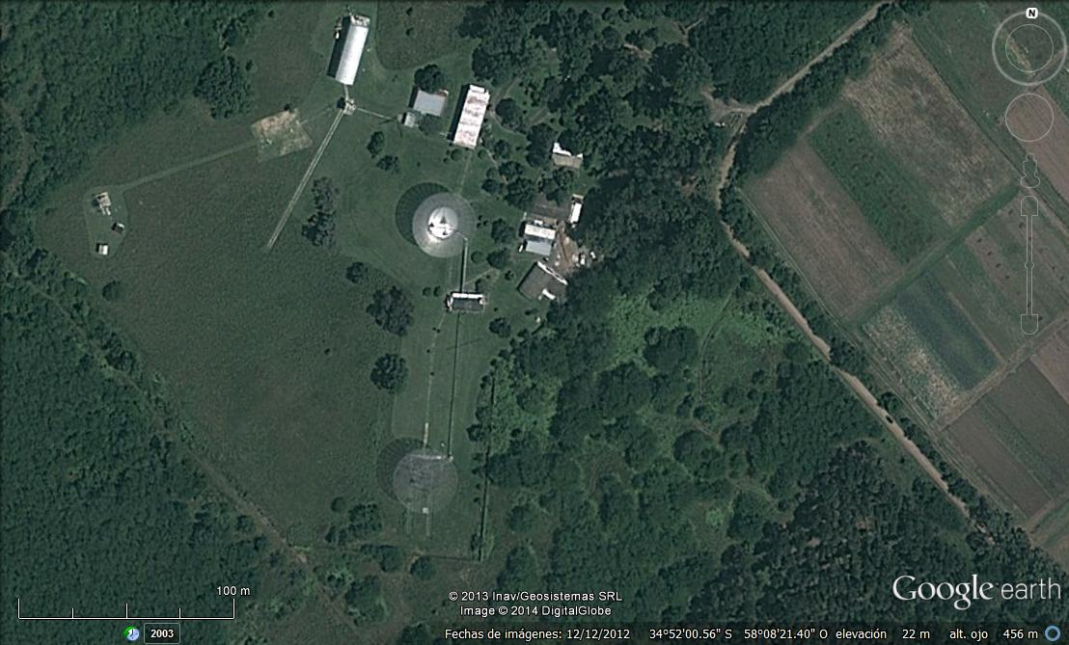
Brief introduction to IAR
Instituto Argentino de Radioastronomía (IAR)
Consejo Nacional de Investigaciones Científicas y Técnicas (CCT La Plata - CONICET)
- Director: Dr. E. Marcelo ARNAL
-Commitment for creation agreement: 30/10/1962
Primary Objective
Scientific research on frequency bands corresponding to hydrogen.
-First Observation: 24/3/1966
-Creation agreement : 10/12/1969 (CICPBA, CONICET, UBA, UNLP)
-12/11/85 -> Depends only on CONICET.
Latitude : -34° 51' 57".35 Longitude : 58° 08' 25".04

Slide 4
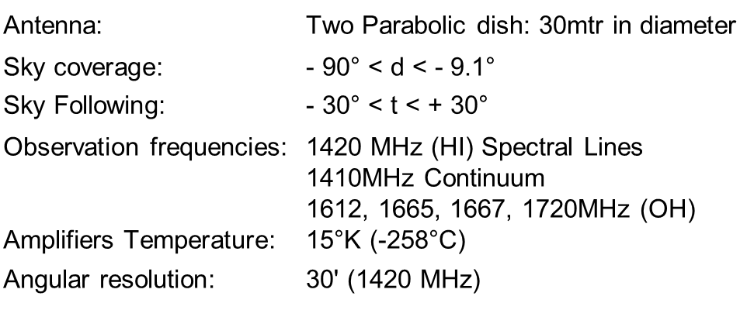
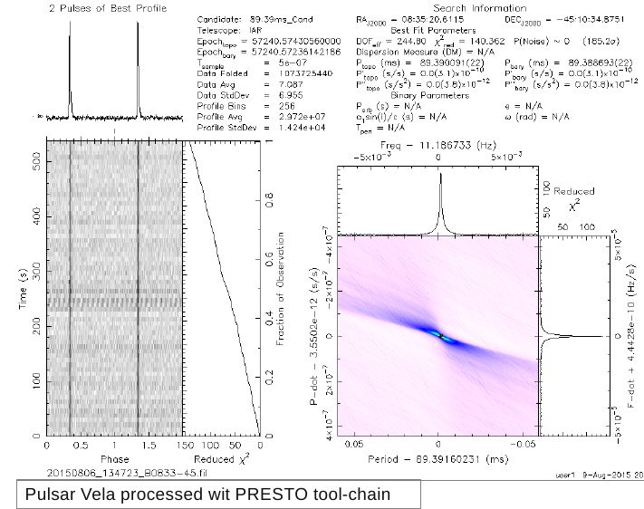
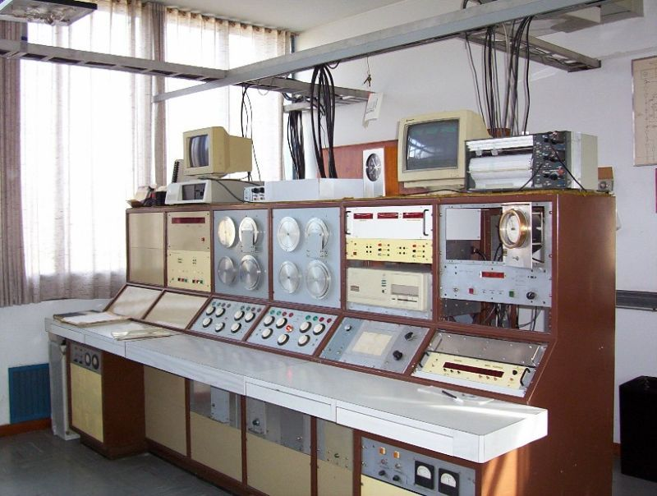
Brief introduction to IAR
Current Instrumentation
As a new development we are updating the Front-End and Back-End for PULSAR observations
With the aim to continuous Monitoring of known Pulsars, as a collaboration to the NanoGrav Project.

Slide 5
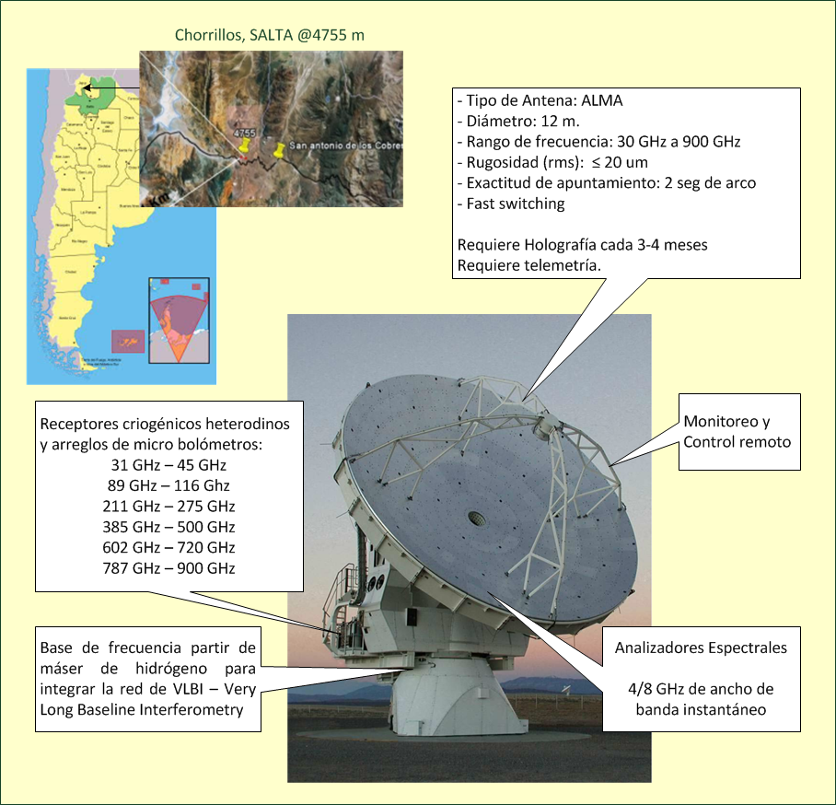
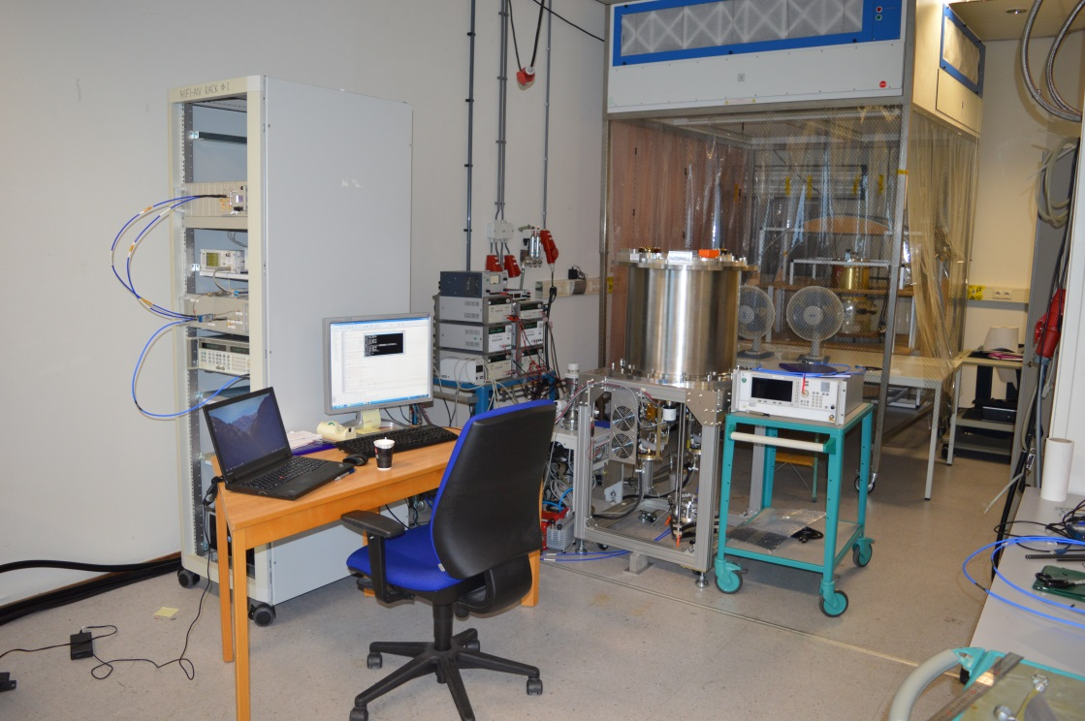
Brief introduction to IAR
New Sub/millimeter Instrumentation Development
Integration of the LLAMA Cryostat at NOVA, Kapteyn Astronomical Institute at the University of Groningen, with Band 5 (167GHz) & Band 9 (602GHz)
“LLAMA (Long Latin American Millimeter Array )”

Slide 6
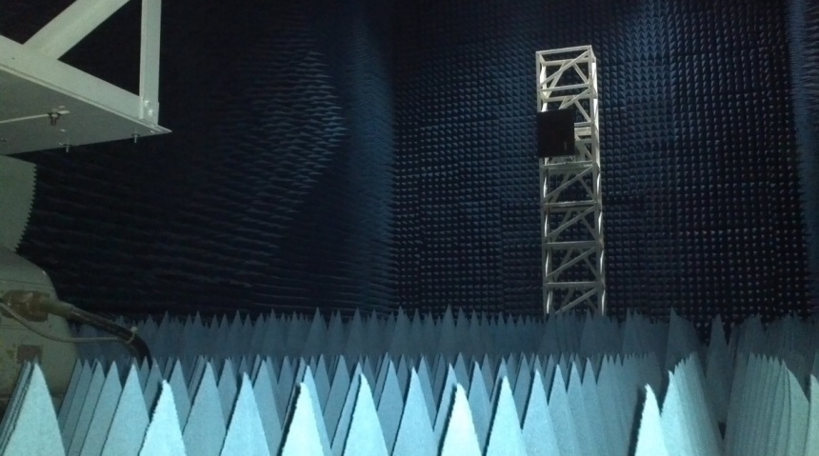
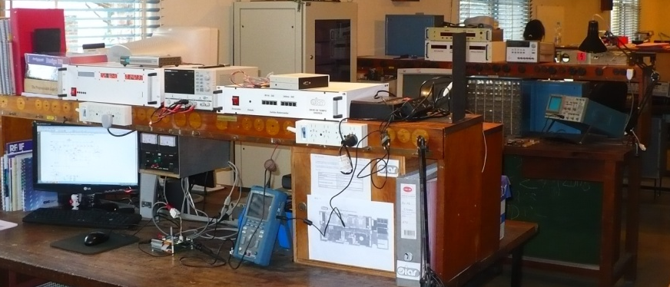
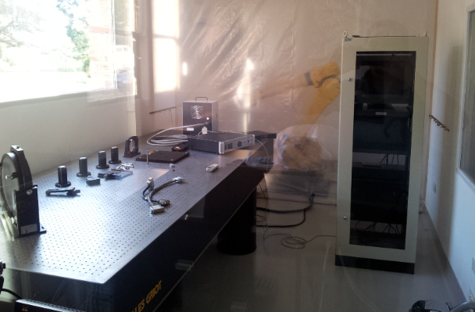
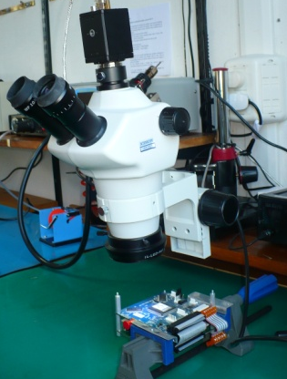
Brief introduction to IAR
Technological Facilities
Anechoic Chamber
Electronics Laboratory
Infrared Characterization Laboratory
Electronics Assembly Laboratory
Open Field Antenna Measurement
Notes:
6

Slide 7
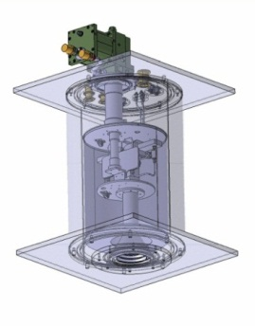
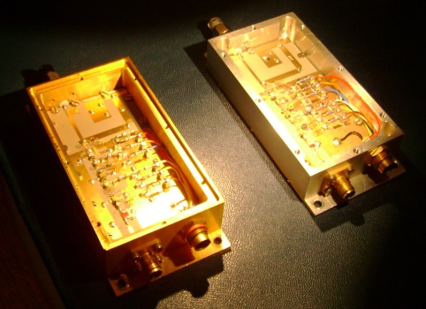
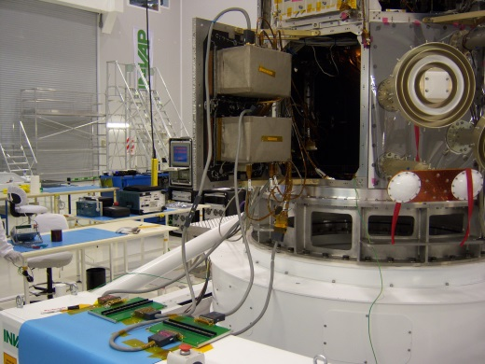
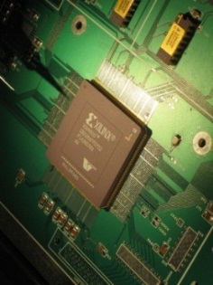
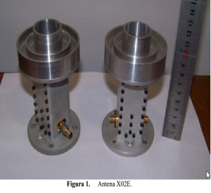
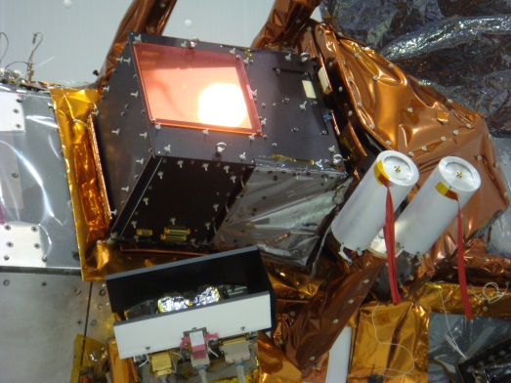
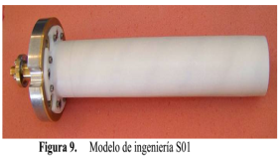
Brief introduction to IAR
Technological Developments
Satellite Instruments
RF Design
Radiometers
MWR, Microwave Radiometer 23&36GHz
Pad, Data Acquisition computers
Digital Design
Antenna Design
NIRST, New Infra Red Sensor Technology

Slide 8
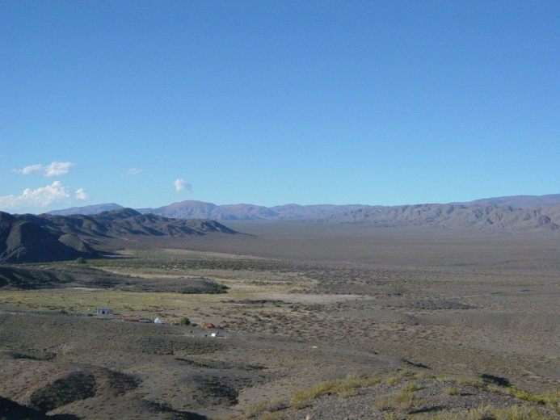
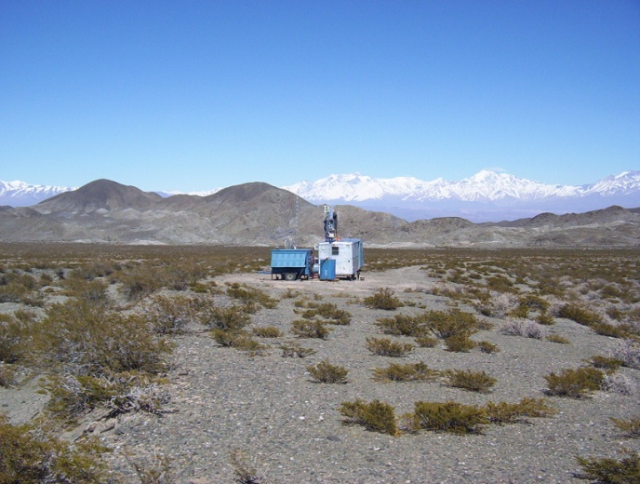
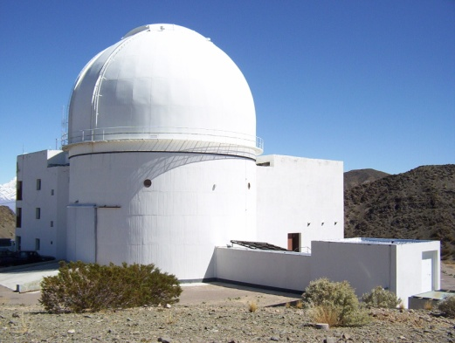
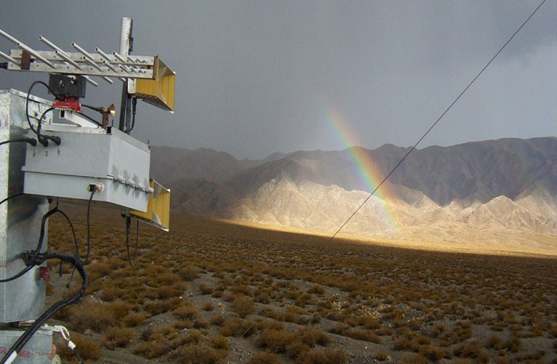
RFI-SKA campaign, 2004
First Experience on Long Period RFI Measurements for the SKA-Site Characterization.
Located on “Pampa del Leoncito” in San Juan,
from February 2005 to March 2006.
RFI Measurements :
LNA’s from 100Mhz to 22GHz.
Single Pol Antennas with mechanical Pol change.
Automated acquisition for 24/7 measurements.
RFI Measurements Results:
Poor site for SKA-low and SKA-mid band (.07-3GHz).
Excellent Site for SKA-High bands (3 GHz or higher to 25-50 GHz)
Still an Excellent Site on High bands for Future Instruments

Slide 9
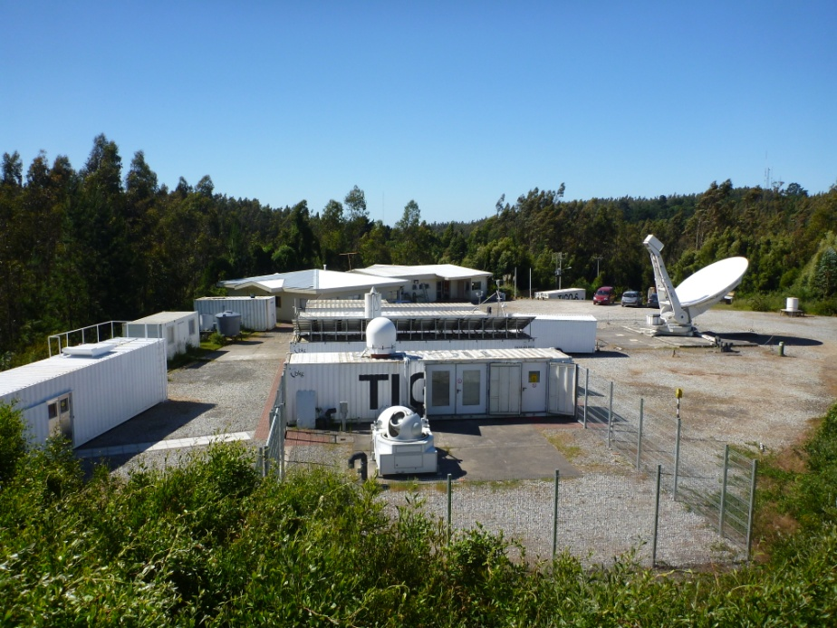
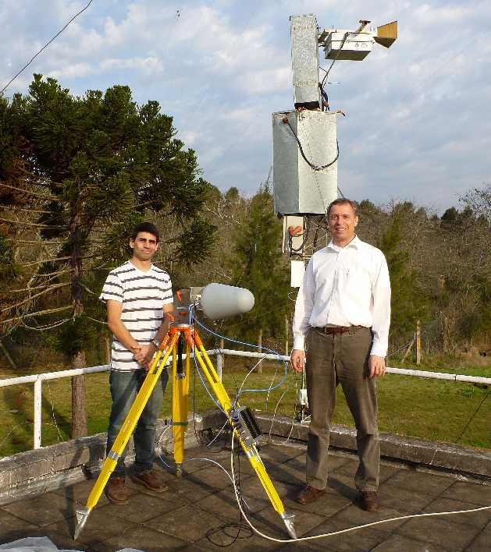
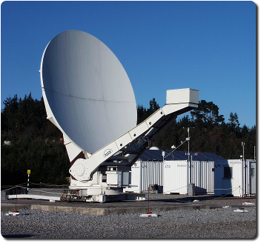
RFI-TIGO campaign, 2012
TIGO, as part of the geodetic VLBI network, owns a 6mts antenna with a cryogenic receiver working in two bands:
S (2.2-2.4 GHz) & X (8.0-9.0 GHz)
For their RFI concern on the new location near the IAR, a two stages of RFI measurements where conducted:
Stage 1: one month survey with IAR-RFI Equipment.
Stage 2: one month survey with BKG-RFI Equipment.
Transportable Integrated Geodetic Observatory
Concepción - Chile
Dr. Hayo Hase Director of TIGO

Slide 10
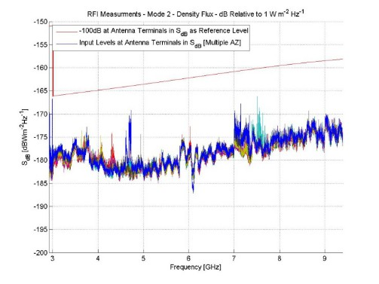
RFI-TIGO campaign, 2012
Developed for SKA site finding in Argentina
in 2005, quickly reconditioned in 2012 for TIGO
Stage I: RFI Equipment Design & Test April 25 @ June 1st
Start Campaign By June 11 (one week of delay)
Stage 1
Dual ridge horn antenna
Frequency range: 1 - 18 GHz.
polarization change mechanically.
359° spatial coverage 5° resolution.
Antenna box
3 LNA from Miteq, 2 - 8 GHz (!)
relays for 50 ohm reference load used for periodic Calibration.
HP9583E Spectrum Analyzer
Tsys: ~700°K
Data logging:
Custom software for automated measurements.
overall gain: 75dB at 2 GHz
incl. ~8dbi at 2 GHz antenna directivity

Slide 11
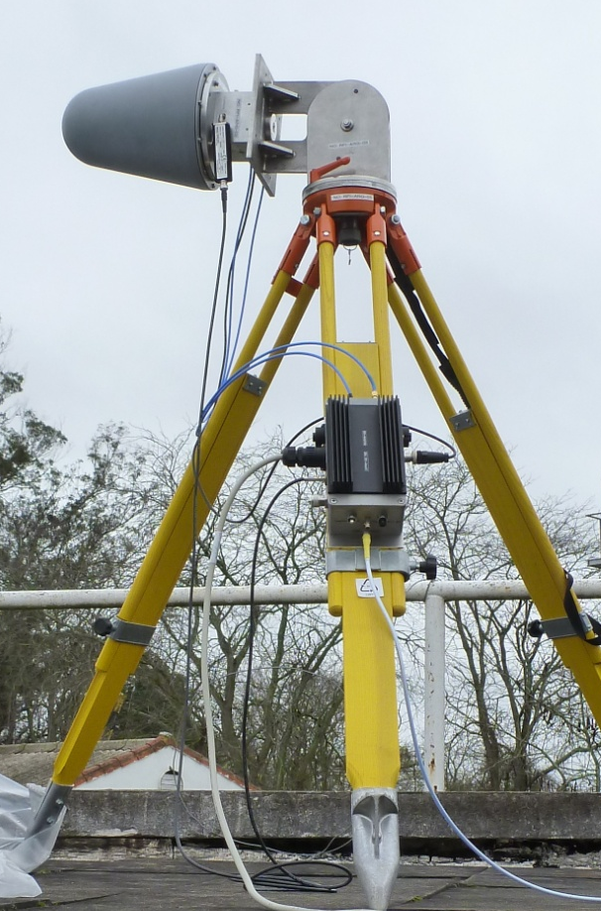
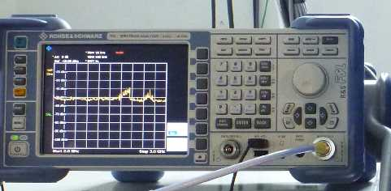
RFI-TIGO campaign, 2012
Stage 2-a
Stage 2-b
Combination of RFI-monitoring systems
BKG Wettzell and IAR La Plata
Rohde&Schwarz-Antenna HL024A1
Frequency range: 1-18 GHz,
input signal: horizontal + vertical polarization
Antenna box
1 LNA for each polarization
relais for noise cal injection
noise cal diode NC346B
Receiver Box
power combiner for both polarizations
amplifier
Rohde&Schwarz SA FSL18
Tsys: ~300°K
Data logging:
Notebook PC
One week of measurements
Measurement
30kHz resolution bandwidth
2-14 GHz range divided in 1GHz bands
each 1GHz band requires 2.5s sweeptime (12 bands = 30s)
8 directions (N, NE, E, SE, S, SW, W, NW) + 1 Cal. = 15min
=> 96 azimuth scans/day
=> 768 images/day
After 30 days of measurement (14.09.-14.10.2012):
=> 21776 images of the spectrum analyzer recorded
Manual pointing
most dense RFI data set
known to the IVS
overall gain: 70dB at 2 GHz
incl. ~7dbi antenna
1 image = 9600 amplitude data points spaced by 1.25 MHz. => 209 million data points.

Slide 12
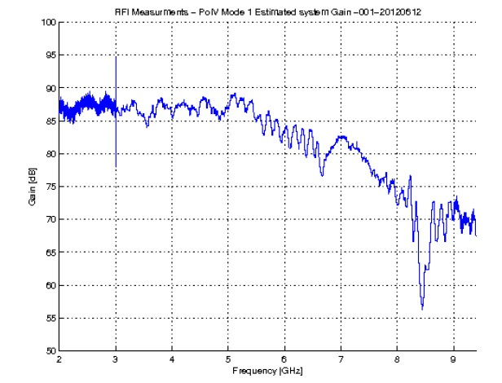
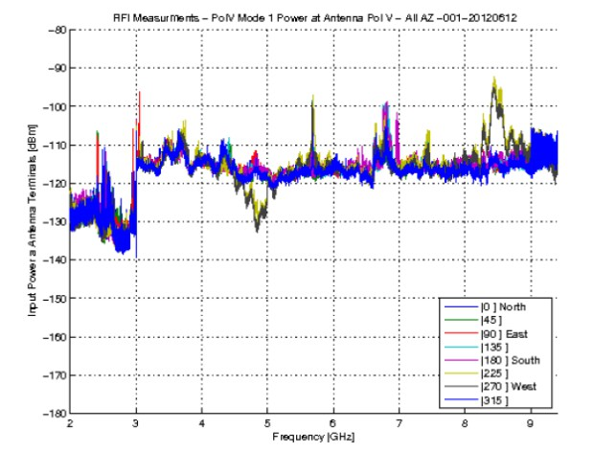
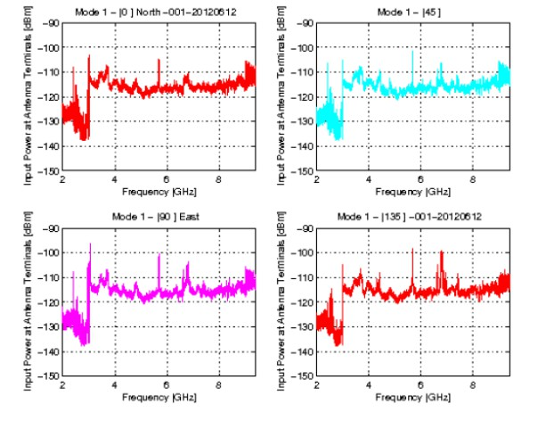
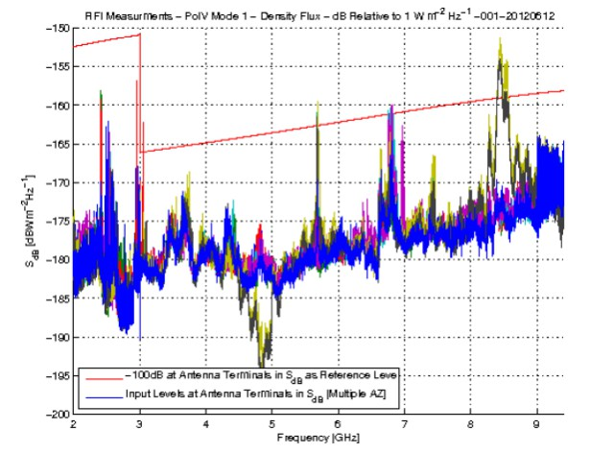
RFI-TIGO campaign, 2012
Stage 1 - IAR

Slide 13
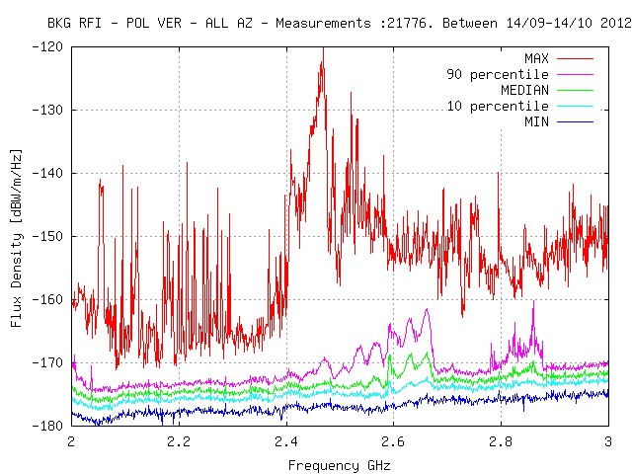
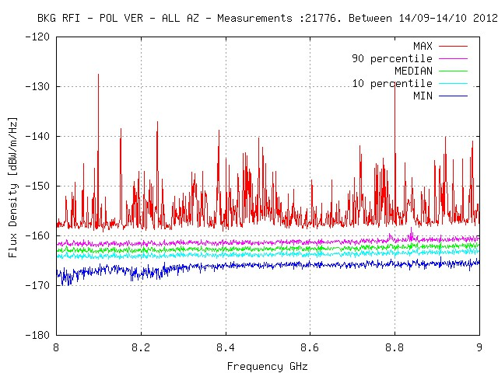
RFI-TIGO campaign, 2012
Stage 2 - BKG
TIGO VLBI FREQUENCY BANDS

Slide 14
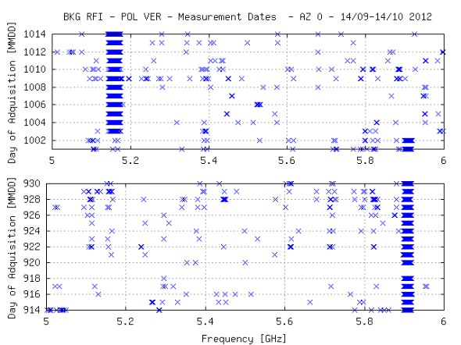
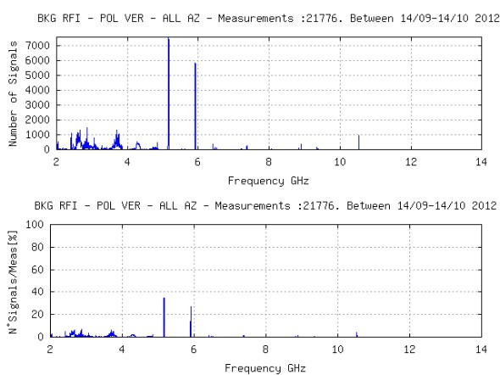
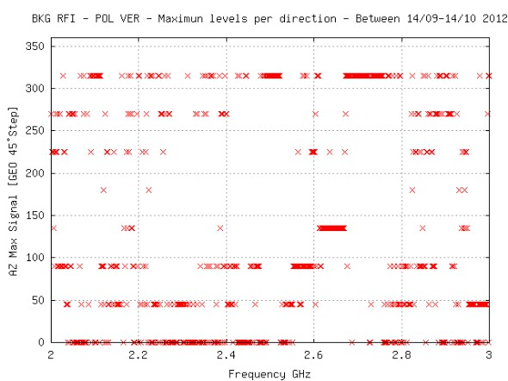
RFI-TIGO campaign, 2012
Stage 2 - BKG

Slide 15
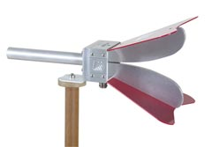
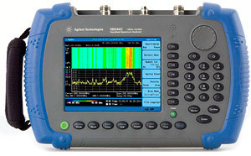
IAR New Development, 2014
With the need to expand frequency and obtain a better S/N ratio.
NEW Dual ridge horn antenna EST-Lindgren 3117
frequency range: 1 - 18 GHz.
HPW 85°@2GHz – 40°@18GHz (E-Plane)
Antenna box
New 2 LNA from Miteq, 1 - 18 GHz!
relais for 50 ohm reference load used for periodic Cal.
NEW Spectrum Analyzer
Agilent N9344C better DANL (display average noise level) of spectrum analyzer.
NEW Antenna Rotor
Improved mechanics.
polarization change mechanically.
359° spatial coverage 5° resolution.
Data logging: PC (or SBC) with custom software for automated measurements.
RF-BOX
RF-TLMY
PDU
System Gain: 70dB~60 dB.
~3-10dBi from Antenna.

Slide 16
IAR New Development, 2014
Software Description
Controls the PDU unit, RF-Ctrl Unit and Rotor Unit
Configure and reads the Spectrum Analyzer
Web page for monitoring system status
Measurements configuration from external file
Run's on Linux PC or Linux SBC (like BeagleBone)
BeagleBone SBC present a Smaller size then PC (CreditCard Format).
More sensitive to loss of power (OS stored in uSD).
#Configuration Sample File
2.0 3.0 30 0 0 0 52 2 8
3.0 4.0 30 0 0 0 52 2 8
…………………………
17.0 18.0 30 0 0 0 52 2 8
# End of File
http://www.iar-conicet.gov.ar/~ggancio/rfi/rfi_stat.html
16

Slide 17
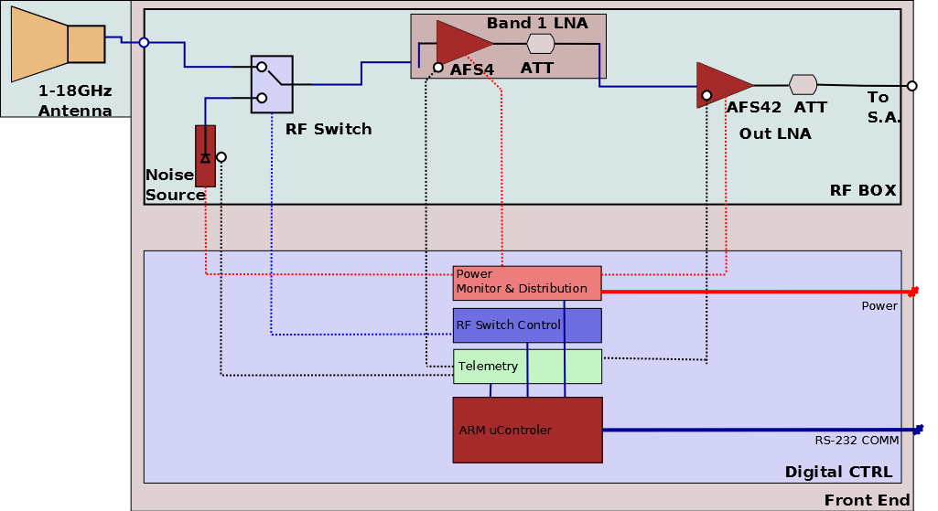
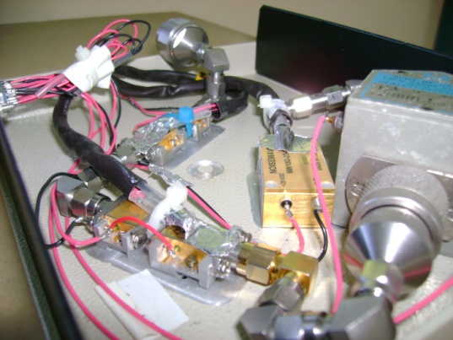
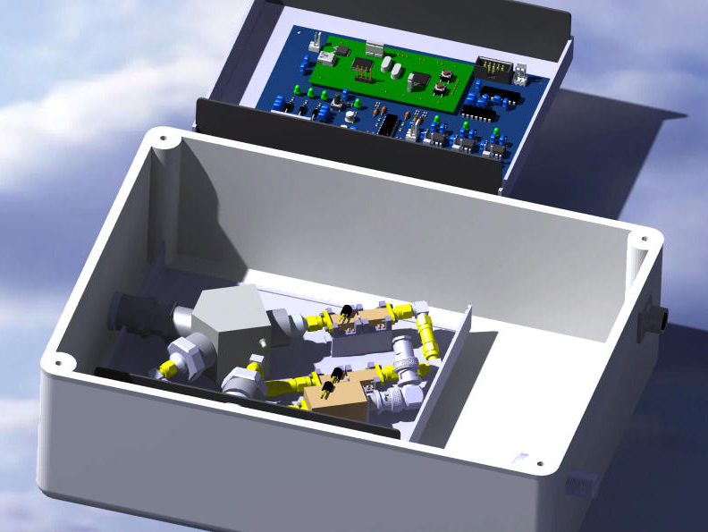
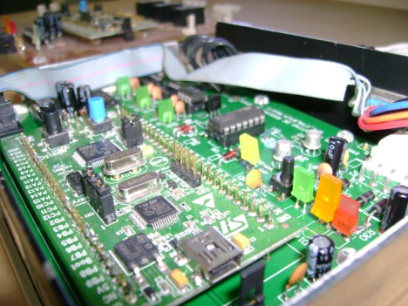
IAR New Development, 2014
System Block Diagram
x2 LNA ~38dB Gain NF~2.5dB
RF Switch
Noise Source NoiseWave ENR23dB + 20dBAT
Voltage & LNA Temperature measurements.
RF-Switch & Noise Source Control.
RS-232 Communication.
Estimated Values @2GHz
17

Slide 18
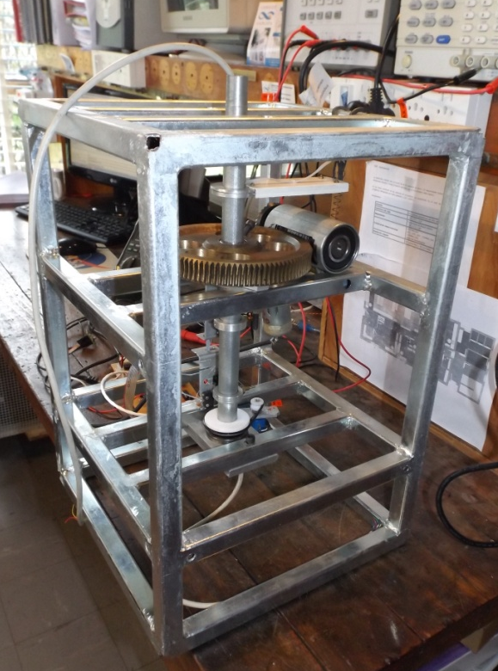
IAR New Development, 2014
Custom Antenna Rotor
Custom Design
Robust.
Small Size – (..Almost Lightweight..).
Simple Installation.
Easy to disassemble for repair / verification.
Spatial Coverage
355° in Azimuth with ~5° resolution.
0° to 90° for Mechanical Polarization change.
Remote Control
Serial Interface
Position measurement with magnetometer & Potentiometer.
RF signal thru RF rotary Joint

Slide 19
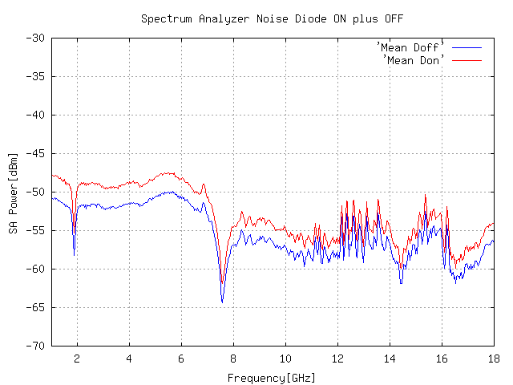
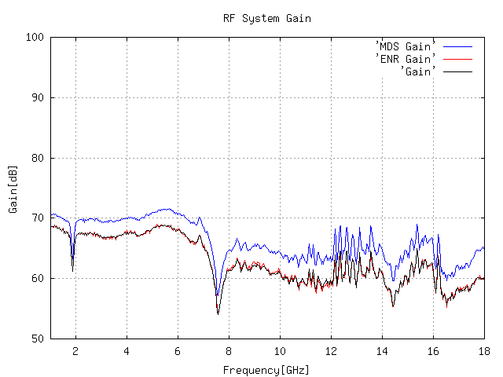
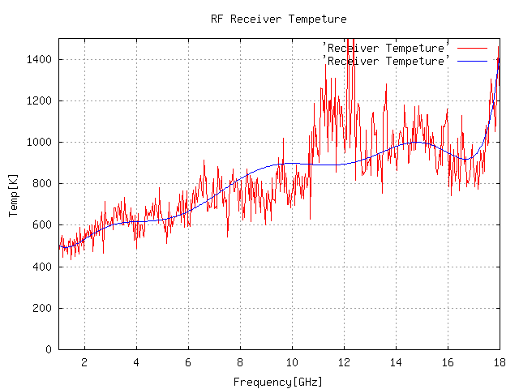
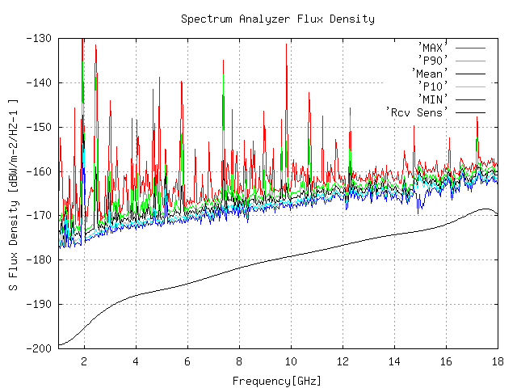
RFI data processing and study
Off-Line Process Math's with Octave Scripts
Analysis thru direction of measurement.
Peaks above noise floor.
Percentage thru time of measurement.
References:
SSSM System Design Considerations (R.P. Millenaar – Astron)
SKA site Spectrum Monitoring (Boonstra / Millenaar – SKA)
1-14GHz TIGO RFI Monitoring System (Gancio / Larrarte – IAR)

Slide 20
RFI data processing and study
Radio Astronomy uses frequency spectra to study astronomical phenomena.
The signals under study are:
Very Low Power – Noise Like – Bandwidth dependent.
According to the phenomena different frequencies and bandwidth are used, e.g.:
IAR 1420MHz@5MHz
TIGO 227MHz@150MHz & 8500MHz@1000MHz
SKA 100MHz-20000MHz@4000MHz
When RF Interference appears….
Mask the phenomena under study.
Saturates low noise amplifiers affecting linearity,
possible damage to receiver.
As a result:
Loss of Sensitivity.
Loss of astronomical data.
Loss of observation Time.
“Mediciones de contraste, Radiometro Antena I, M.Salibe, D.Perilli, J.J.Larrarte.”

Slide 21
RFI data processing and study
RFI Identification for Radio observatories:
Local Interference
Self Generated RFI, Computer, Networks, Power Lines, etc.
External Interference
Radio Links, Cell Phone Masts, TV, FM, Radar, etc.
Study of Interference
Power Spectra – Frequency – Bandwidth – Modulation. Duration over days:
Continue – Random.
Work with the Communications Agencies of Governments.
Spectrum Allocation, Radio Quiet zones.
IAR was present at the WRC-15

Slide 22
Thanks for your attention!
Some Links of interest…
Instituto Argentino de Radioastronomía
http://www.iar.unlp.edu.ar/proyectos.htm – ggancio@iar-conicet.gov.ar
RFI Monitor System web page (English)
http://www.iar.unlp.edu.ar/rfi-eng.htm
Online Data
http://www.iar.unlp.edu.ar/~ggancio/rfi/rfi_stat.html
22

