Slide 1
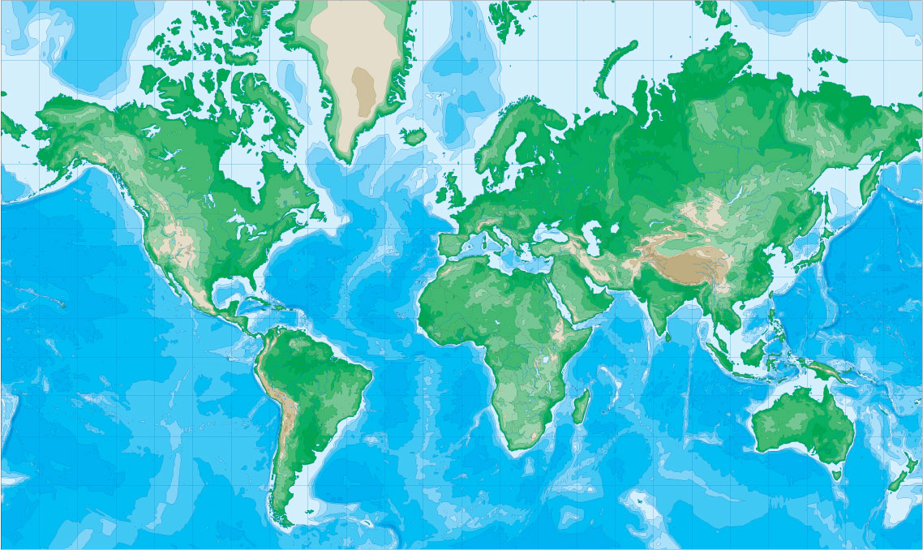

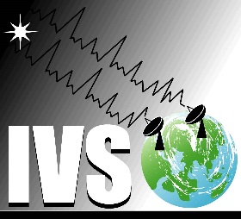

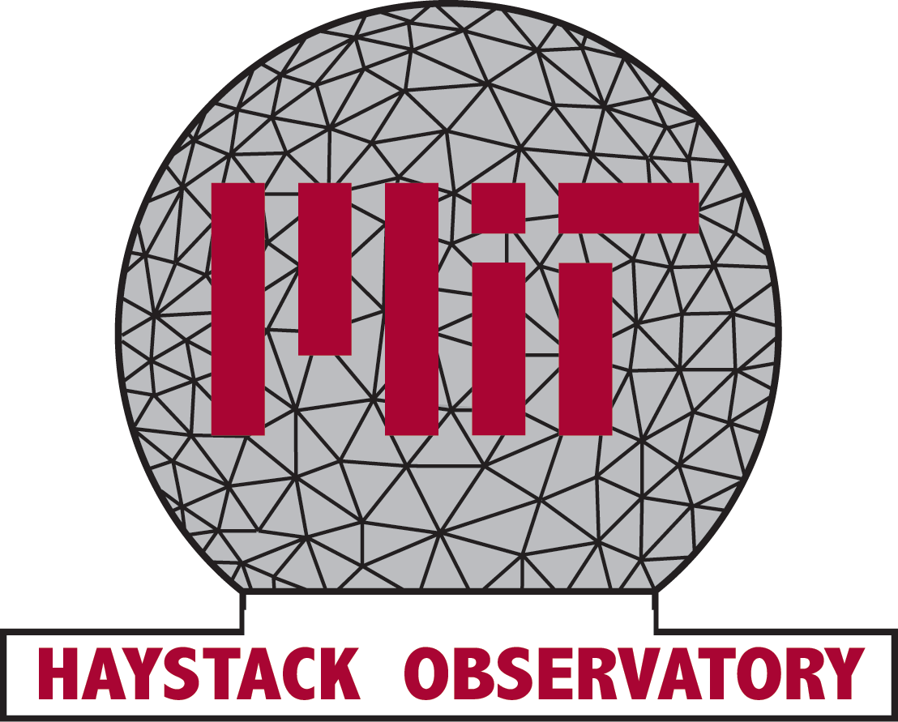


RFI Mitigation and Testing Employed at GGAO for NASA’s Space Geodesy Project (SGP)
¹L. M. Hilliard Lawrence.M.Hilliard@NASA.gov
²Ganesh Rajagopalan ganesanr@mit.edu
¹Charles Turner charles.j.turner@nasa.gov
Thomas Stevenson thomas.r.stevenson@nasa.gov
Berhanu Bulcha berhanu.t.bulcha@nasa.gov
1NASA Goddard Space Flight Center, Greenbelt MD, USA
2 MIT Haystack Observatory, Westford MA, USA
Notes:
Space Geodesy Project (SGP) Colocation considerations and Radio Frequency Interference (RFI) Mtigation Techniques
· Abstract text
This paper describes the initial characterizations of the GGAO environment. At the Goddard Geophysical and Astronomical Observatory (GGAO) in Greenbelt Maryland all four geodetic techniques of Very Long Baseline Interferometry (VLBI), Next Generation Satellite Laser Ranging (NGSLR), Global Navigation Satellite System (GNSS), and Doppler Orbitography and Radiopositioning Integrated by Satellite (DORIS) are represented. This creates a number of conflicting requirements. The Space Geodesy Project (SGP) is an effort to tie together independent measurements of Earth orientation parameters to attain precise calibration of the terrestrial reference frame. It is important that all four techniques share local environmental conditions so one of the goals of SGP is to prototype a station at GGAO. A spectrum conflict arises among three techniques that share the bandwidth recommended for VLBI2010 by the International VLBI Service for Geodesy and Astrometry. The VLBI2010 development system is designed to receive 2-14 GHz with a 12-meter antenna observing over the full sky.
The DORIS technique transmits to DORIS receiver equipped satellites at 2036 MHz with an omnidirectional antenna pattern and a 10 Watt transmitter. The Laser Hazard Ranging System (LHRS) radar used with the NGSLR operates at 4 kiloWatts peak power at 9.4 GHz, which is also in the VLBI 2010 broadband frequency range. In the case of MOBLAS7 (another LHRS at GGAO), the radar standoff range to VLBI is 160m and that of the NGSLR radar is 200m.
Several types of analysis and tests have been used at GGAO to characterize the geodetic measurement systems. Antenna side lobe gain is an important modeling assumption that has recently been calibrated by our tests. From the calibrated side lobes it has been possible to improve our RFI susceptibility models. Characterizing the DORIS beacon at low elevation angles has been shown to agree with the modeling. The LHRS radar is less predictable in the presence of metallic safety rails, however its emission agrees well with the model when the rails are removed.
Current work continues on the side lobe analysis and methods of absorbing and shielding the transmitting antennas at low elevation angles. Operational masks for the radar and the VLBI field system have given the two techniques a temporary workaround and high pass filters have been introduced to isolate RFI at frequencies below 3.5 GHz from sensitive broadband components. This filtering has limited our ability to measure the susceptibility of the VLBI 2010 receivers to frequencies near the DORIS frequency.
Design solutions that match gain and sensitivity for the entire VLBI 2010 band are under development.

Slide 2

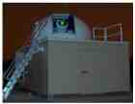
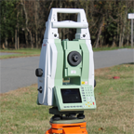
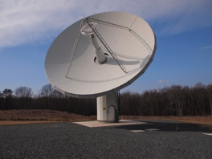
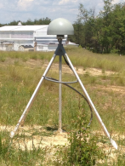
The Space Geodesy Project
VLBI | NGSLR | GNSS | Vector Tie
Establish and operate a prototype next generation space geodetic station with integrated next generation SLR, VLBI, GNSS (and DORIS) systems, along with a system that provides for accurate vector ties between them.
Develop a Project Implementation Plan for the construction, deployment and operation of a NASA network of similar next generation stations that will become the core of a larger global network of modern space geodetic stations.
NRC Recommendation: “In the near term, the United States should construct and deploy the next generation of automated high-repetition rate SLR tracking systems at the four current U.S. tracking sites: Haleakala, Hawaii; Monument Peak, California; Fort Davis, Texas; and Greenbelt, Maryland. It also should install the next-generation VLBI systems at the four U.S. VLBI sites: Greenbelt, Maryland; Fairbanks, Alaska; Kokee Park, Hawaii; and Fort Davis, Texas.”

Slide 3
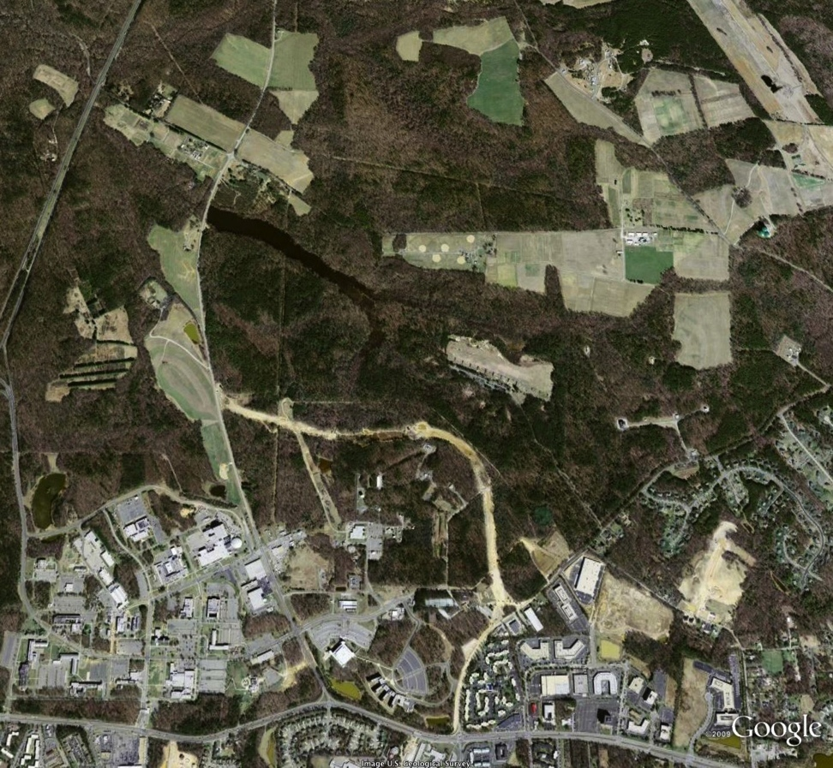
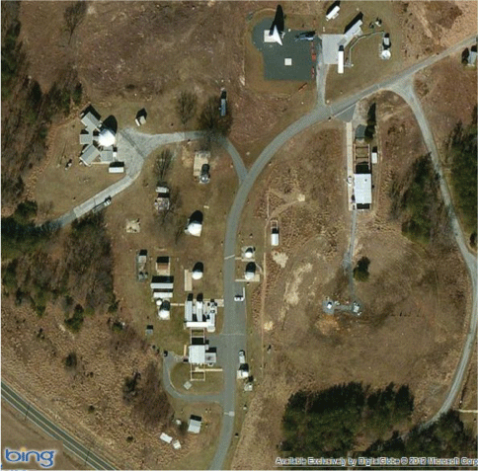
Prototype Geodetic Station at GGAO
Goddard Geophysical and Astronomical Observatory (GGAO) is located 5 km from Goddard Space Flight Center in the middle of the Beltsville Agricultural Research Center. GGAO is one of the few sites in the world to have all four geodetic techniques co-located at a single location.
_{VLBI2010}
_{MV-3 VLBI}
_{GGAO}
_{Legacy GNSS}
_{48”}
_{Reference mark}
_{New GNSS}
_{GSFC}
_{MOBLAS-7}
_{NGSLR}
_{DORIS}
_{REGINA} _{GNSS}

Slide 4
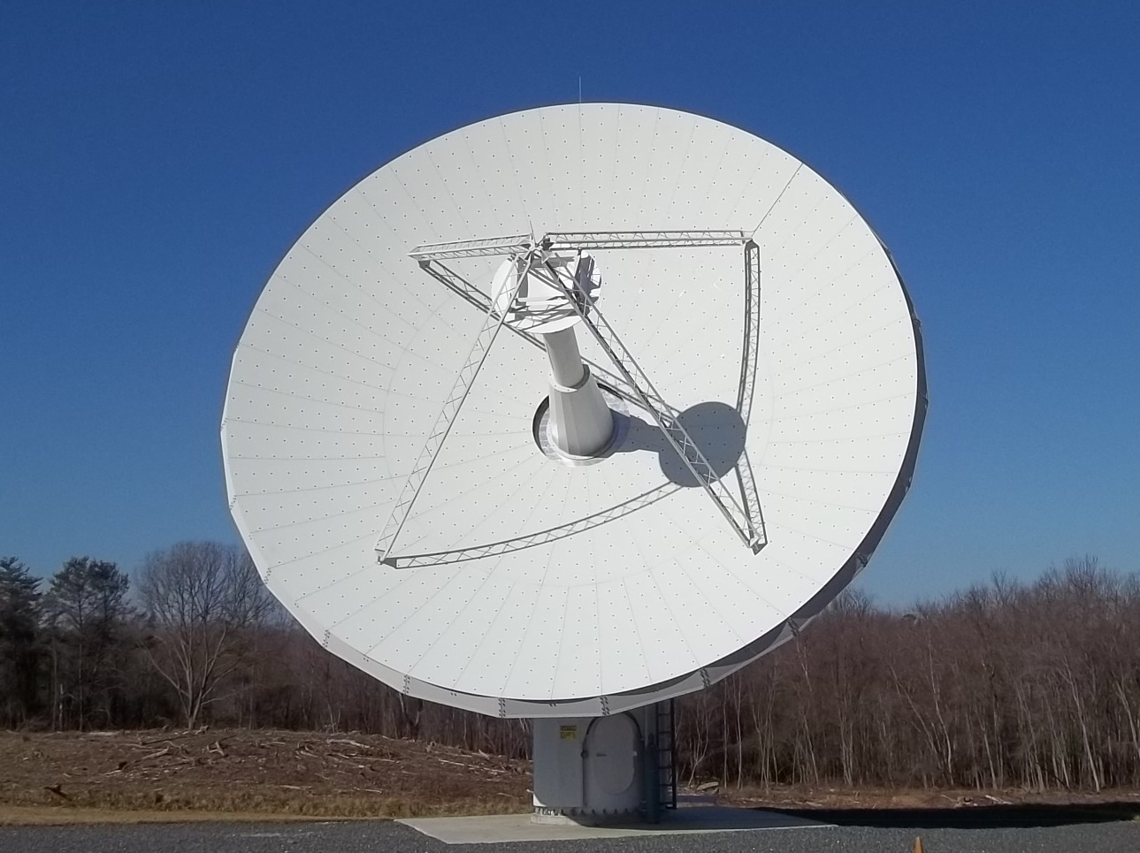
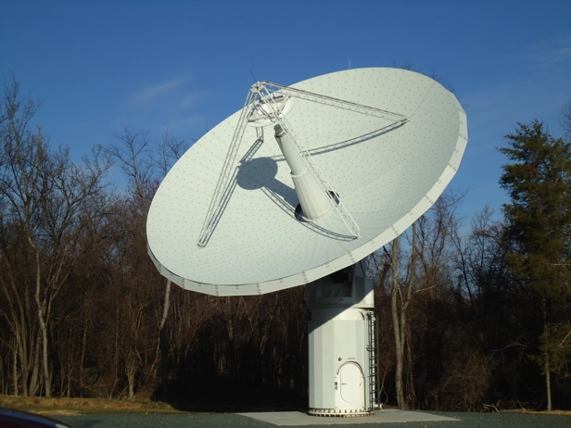
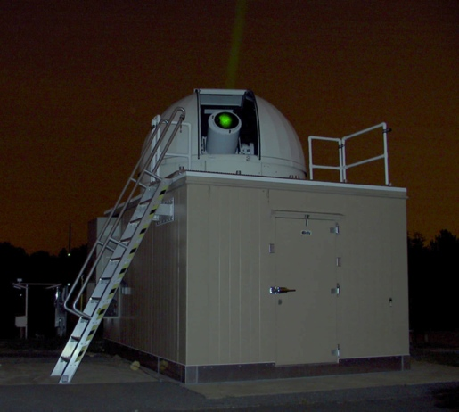
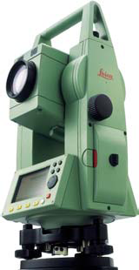
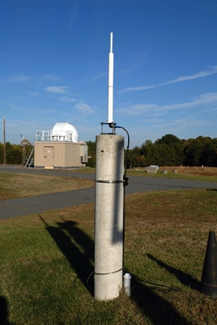
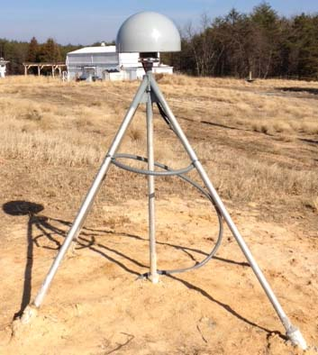
Vector Tie System (VTS)
Accurate measurement of inter-station vectors is an essential aspect of an integrated space geodesy site.
Measurements provide closure between terrestrial reference frames derived from different space geodesy techniques.
Tests of technologies and currently available systems underway at GGAO.

Slide 5
Space Geodesy Project (SGP) and RFI
Modeling the GGAO environment and VLBI2010 susceptibility before & after the trees came down
Measuring the DORIS Beacon, and the NGSLR radars in South , radar masks & DORIS path loss provide mitigation
Measuring 12m side lobes with a standard gain horn simulator >100m away
Mitigate RFI with masks, filtering, and shielding
Measure the effectiveness of an all-weather blocker to reduce the RFI of a DORIS Test Transmitter placed 136 meters away
Measure the multi-path effects of the blocker on DORIS
  Different distances and heights of blocker
  Different angles of blocker

Slide 6
S-Band Filtering
S- Band (2-5 GHz) is transferred separately to avoid saturation from RFI in the fiber optic link

Slide 7
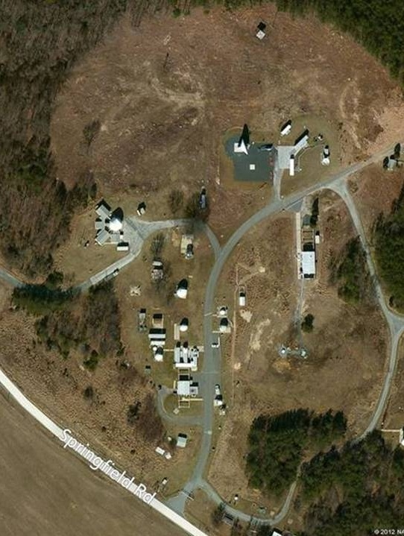
RF Compatibility Methodology
Measurement of Transmitter Radiation Properties in 2010-2011
MOBLAS 7 Summary
Location | Expected Power (+/- 2 dB) | Measured Power
 |  | No Obstruction | Radome | Railings | Radome-Railings
Loc #2 | -4.1 dBm | -4.9 dBm | -7.0 |  | -0.7
GODEW | -1.0 dBm | -0.8 dBm | -5.9 | 8.1 | 2.4
NGSLR Summary
Location | Expected Power (+/- 2 dB) | Measured Power
 |  | No Obstruction | Radome
Loc #2 | -3.0 dBm | -3.6 dBm | -0.7
DORIS Summary
Location | Expected Power | Measured Power
DORIS Pad | -1.3 dBm | -1 dBm
Observatory Pad | -29.5 dBm | -27.6 dBm
DORIS and SLR radar power levels were measured using S and X-band standard gain horn antennas
SLR Radar Power Level Measurement Memo:
http://www.haystack.mit.edu/geo/vlbi_td/BBDev/037.pdf
Notes:
Purpose
Based on the numerical study[1], the VLBI technique will lose significant sky coverage if the transmitting techniques are placed within 100m of the VLBI antenna. For this reason, an comprehensive electromagnetics analysis of physical barriers/blockages has been undertaken to mitigate the offending signal levels and provide the VLBI technique satisfactory sky coverage at GGOS stations. The barrier is expected to have little impact on the SLR radar, however, considerations in the barrier design are being made to ensure that a DORIS barrier does not introduce significant multipath which is a source of position error to the DORIS technique.
Planned Experimentation
Once the computational barrier analysis have been completed, they will be verified experimentally. The barriers are planned to be tested first with mock-transmitters. This will be minimally instrusive to DORIS/SLR operations and will provide sufficient flexibility to carefully study the results of these experiments. Assuming the results obtained using the mock-transmitters are satisfactory (i.e. barriers provide sufficient shielding), the respective barriers will be deployed to the SLR and DORIS techniques, where the testing process will be repeated. Upon successful installation of the DORIS barrier (as far as VLBI is concerned), the IDS will undergo a one-month trial observation with the new barrier to evaluate its impact on the DORIS observations.

Slide 8
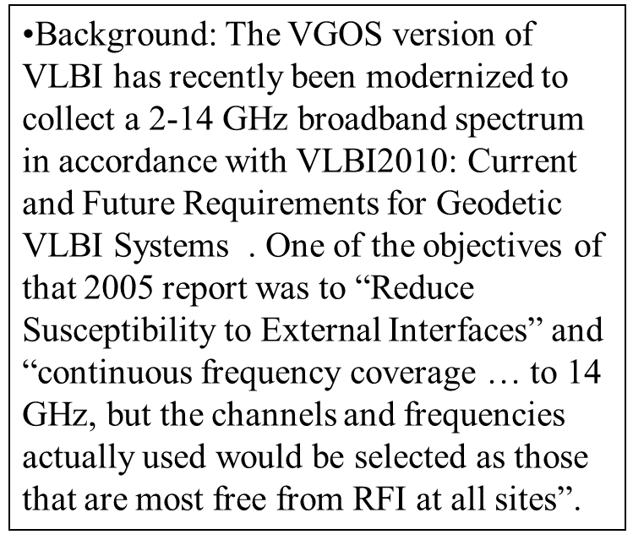
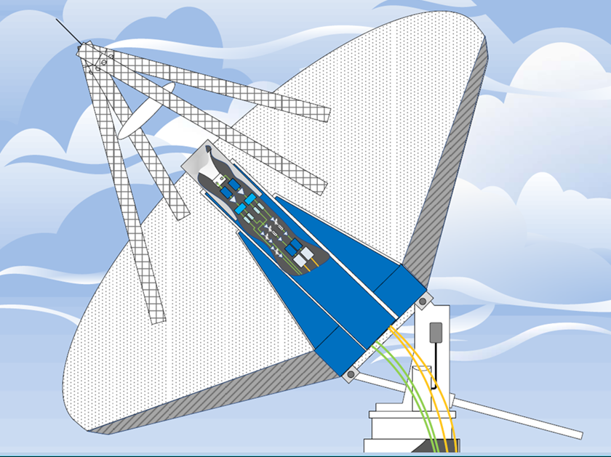
VGOS: Broadband Flexibility /Susceptability

Slide 9
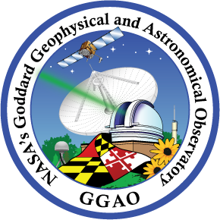



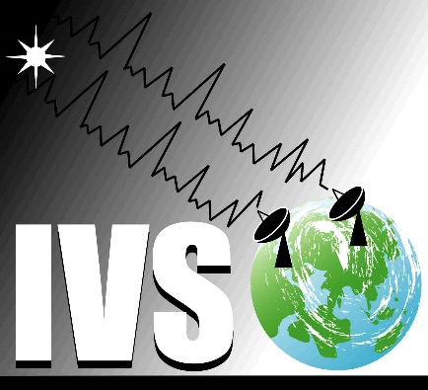

Geodesy Techniques at GGAO – Therefore RFI Mitigation Techniques
Radio Frequency Interference (RFI) Mitigation at Goddard Geophysical and Astronomical Observatory (GGAO) has been addressed in three different ways by NASA’s Space Geodesy Project (SGP); masks, blockers, and filters. All of these techniques will be employed at the GGAO, to mitigate the RFI consequences to the Very Long Baseline Interferometer.
The SGP combines the four geodetic techniques of Global Navigation Satellite System (GNSS), DORIS (Doppler Orbitography and Radiopositioning Integrated from Space), Space Geodesy Satellite Laser Ranging (SGSLR), and the VLBI Global Observing System (VGOS).

Slide 10
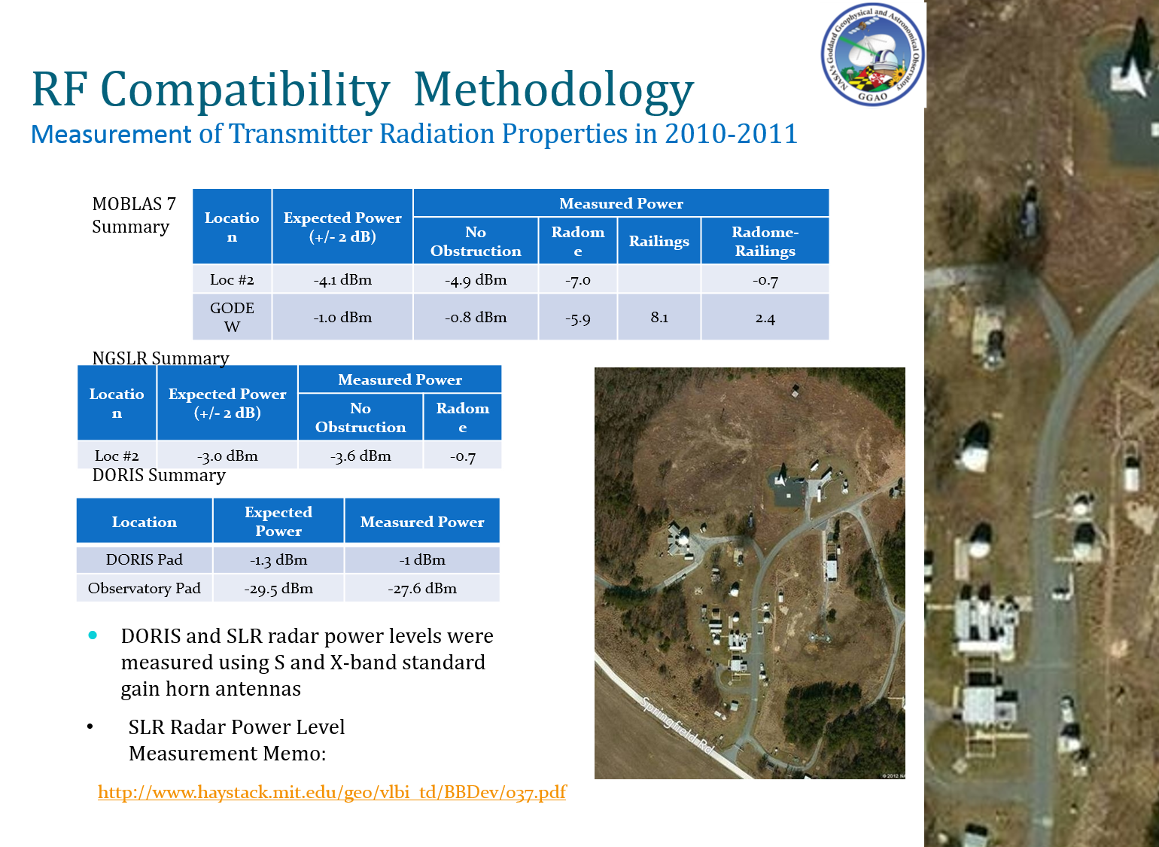
GGAO, and SGP generally, Problem Statement: Competing Requirements
The problem at GGAO, and at the 4-technique geodetic stations of the future being deployed by SGP, is that both DORIS and SGSLR require emissions that are found in the VGOS broadband. For DORIS, path loss and blockage on the GGAO campus reduce the effect of RFI to that of raising the noise floor to a tolerable level. For SGSLR, we have had to introduce low-elevation restrictions or “masks” to both the Laser Hazard Reduction System (LHRS) radars and the VLBI antenna. The VLBI can be damaged by the 4kW peak power output LHRS radar, so the main lobe (-57.1 dBW at VLBI phase center) must be avoided which will destroy the receiver, and the 1st sidelobe saturates the optical link in the receiver chain in effect blinding VLBI from high band (5-14 GHz). In VLBI, low band (2-5 GHz) does not use the same optical link because the low band RFI (e.g. DORIS, wifi, … ) would saturate as well, but can be carried back via coaxial cable.

Slide 11
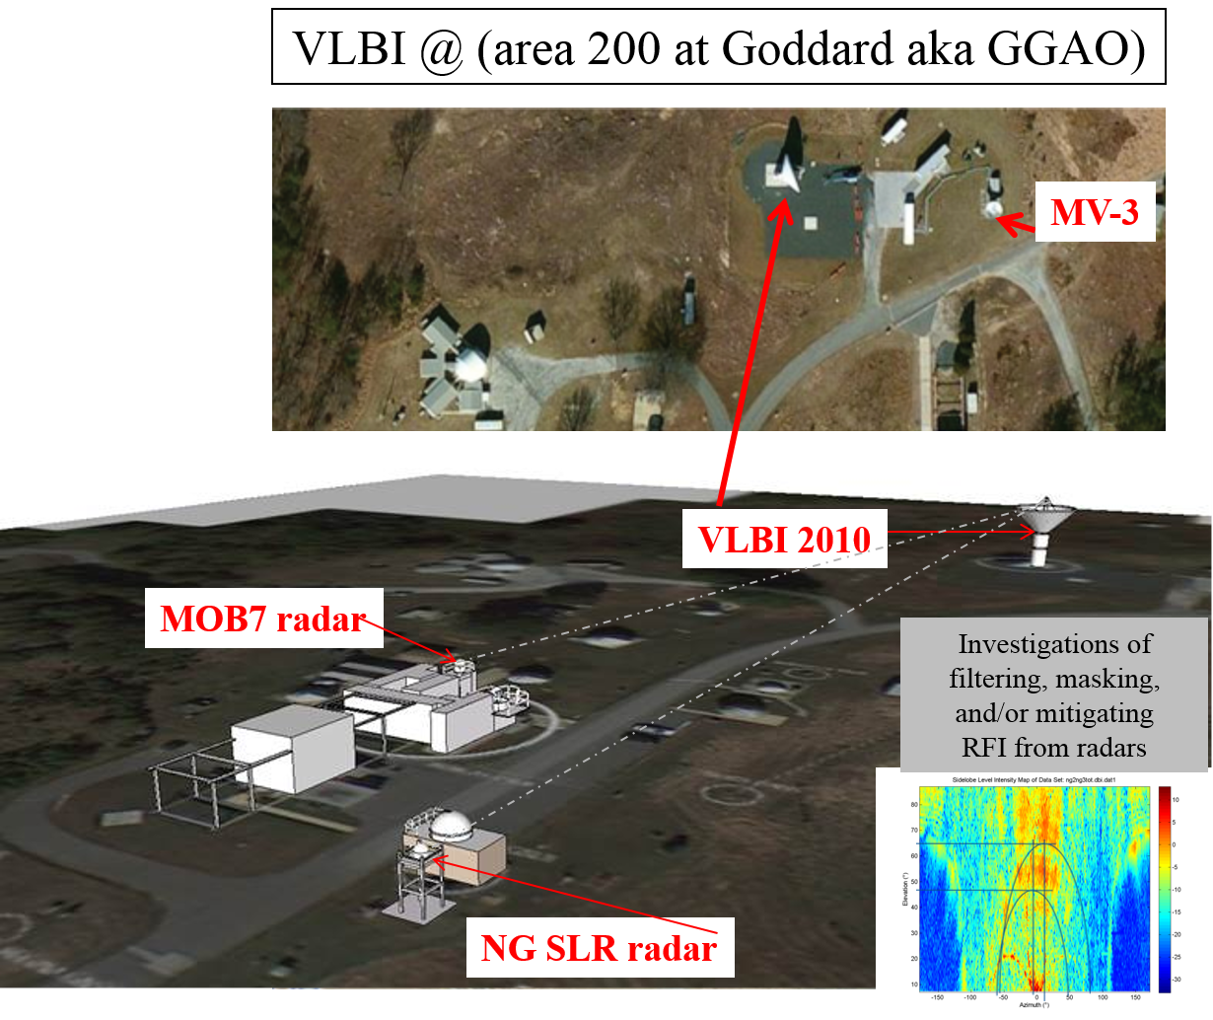
Masks, Loss of Sky Coverage, Characterizing the 12m Sidelobes
In October 2012, at GGAO we conducted two different VLBI tests defining the reduced sky coverage impact of using masks to restrict the viewing angle of both the SGSLR and the VLBI on the GGAO campus. We also ran tests earlier in 2012, characterizing the VLBI antenna beam pattern with 9.41 GHz (sidelobe surrogate(ss)) beacons transmitting from locations near the directional antenna locations used by LHRS. With these tests we recognized hot spots associated with the VLBI subreflector looking right at the LHRS ss beacon.

Slide 12
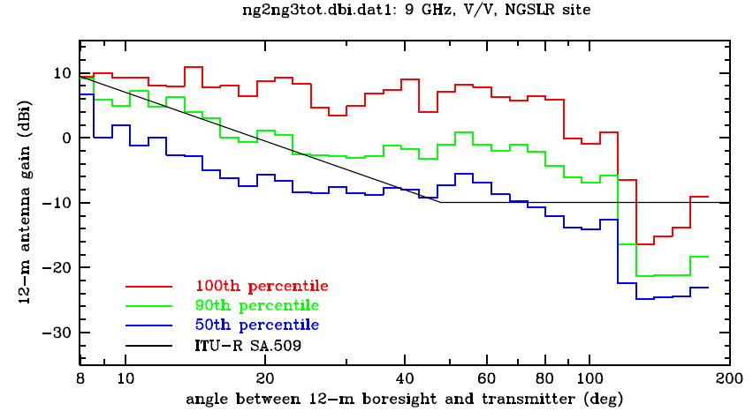
Comparison to ANSI sidelobe envelope
Figure 1: ITU-5009 antenna sidelobe envelope model incorporated in numerical RFI-compatibility studies.
Notes:
Purpose
The sidelobe envelope presented in Figure 1, is assumed to provide a worst-case 12m antenna gain vs. pointing-to-RFI-source. This assumption should be validated experimentally to provide assurance of the 12m antennas gain characteristic which in-turn (combined with other information) will provide confidence in the received DORIS/radar power levels will not exceed the worst-case expectation.
Planned Experimentation
To validate the sidelobe model, a separate field test of the 12m sidelobe envelope is planned. The field test will be carried out with a mobile beacon that is capable of transmitting at the DORIS and aircraft tracking radar frequencies, 2.036 and 9.4 GHz respectively.

Slide 13
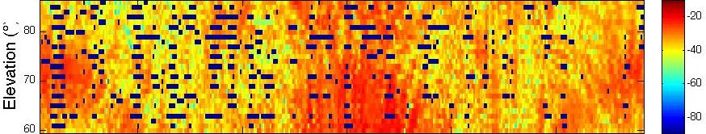
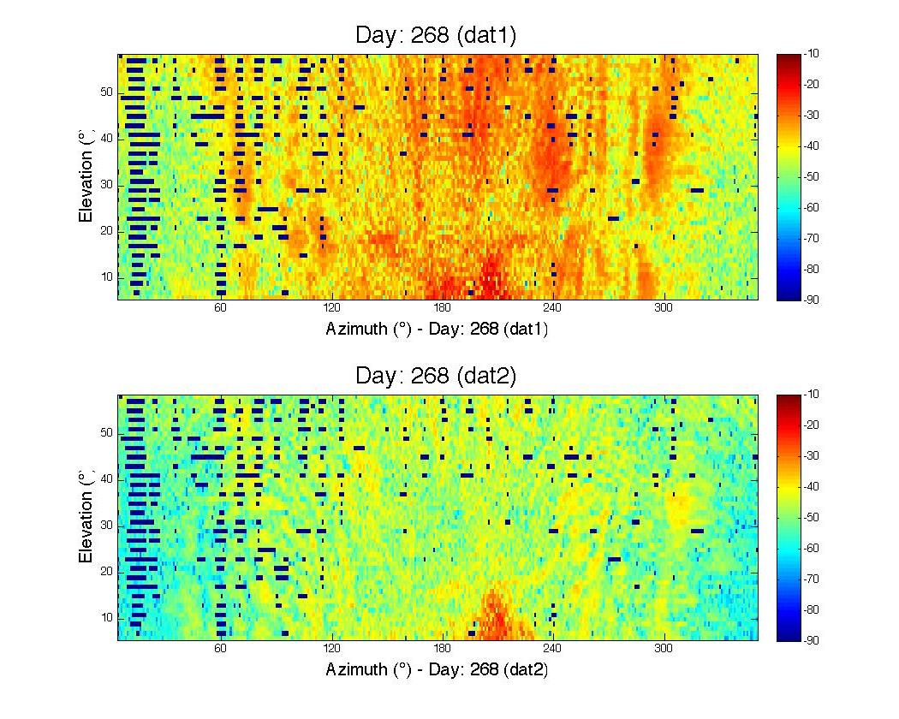
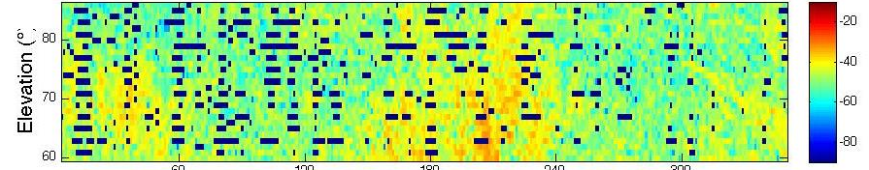
VLBI Sidelobe Tests reveal higher noise floor with radar on/ blanking may be tried to clean up data
Tests above 60 degrees elevation were conducted on October 8th
Tests on September 25th (day 268) were conducted without radars operating
Includes Azimuth angles that are usually masked out below 40 degrees including DORIS test beacon line of sight
Data Dropouts are due to the spectrum analyzer re-calibrating
October 8th tests were conducted with the mask up and the SLR radars likely raise the noise floor

Slide 14
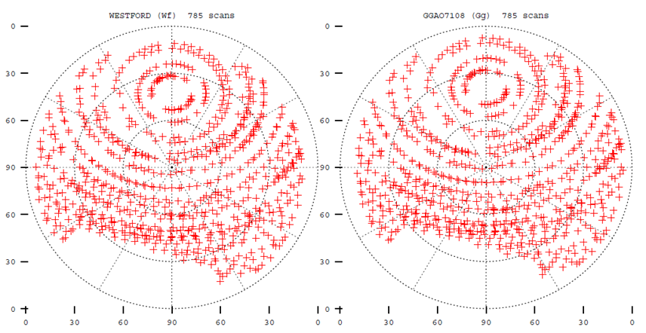
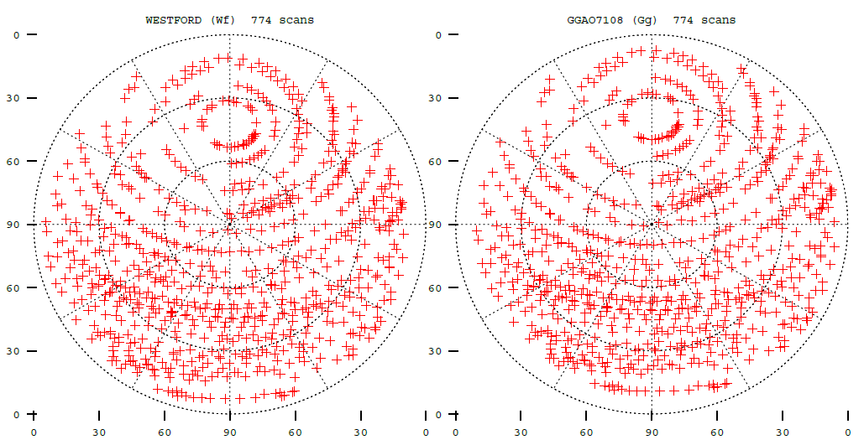
Loss of the Southern sky must be planned around due to radar masks at GGAO
Oct 4th →
These observing plans were specially prepared with knowledge of VLBI mask avoidance
Oct 5th
← These observing plans were opened up to the full sky through coordination with NG SLR and MOB7
Notes:
Data for 10/4 being fourfit’d in LL, RR, and IXY; was sent to GSFC. Data for 10/4 made into databases for analysis. Separate databases for H, V, and I (combined polarizations). Post-fit residuals for all, were about 10 psec. This is a reasonable fit for preliminary analysis. Data for 10/5 fourfit’d, made into database; on first look may not be as clean as 12OCT04.

Slide 15
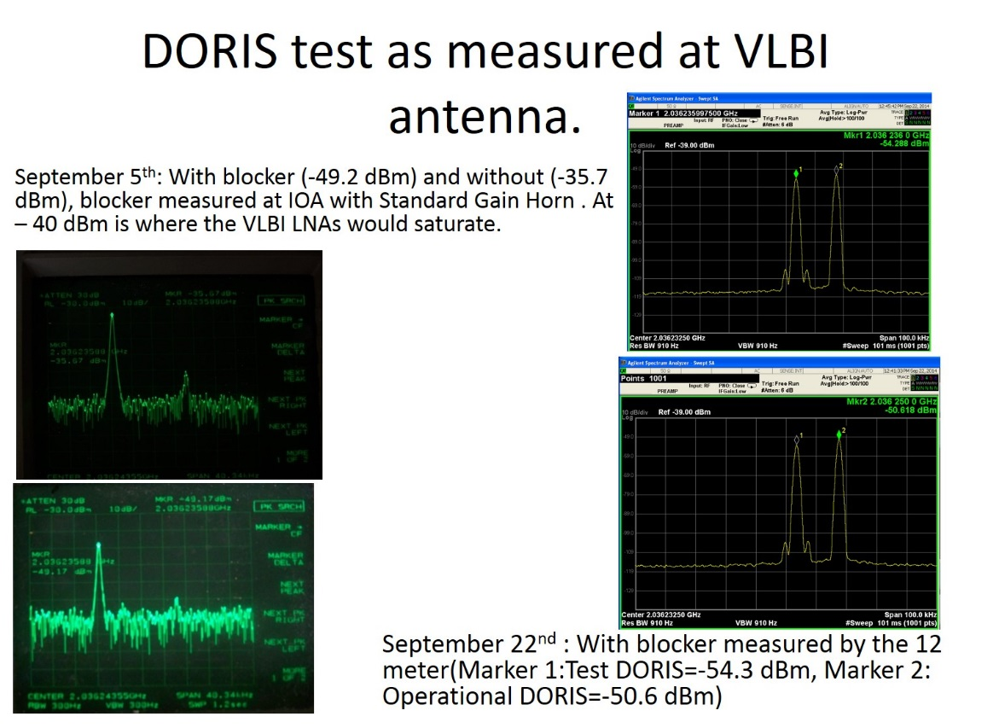
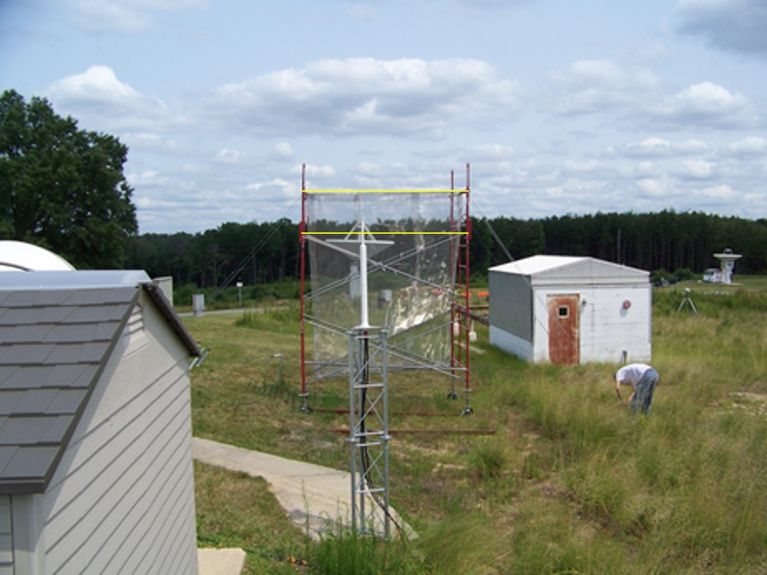
Reflective Blocker: Allowed VLBI to operate/15 dB of attenuation/Wind issues
Reflective Blockers were investigated as well using solid cloth, and stainless steel mesh materials in 2012 and had the effect of 20 dB attenuation when located in the far field between SGSLR and VLBI. In 2014, a test DORIS was loaned to SGP by CNES to conduct similar tests on the blocking effectiveness realized from an unobstructed DORIS (direct line of sight) with less path loss and tuned to a slightly different frequency discernable by DORIS receivers in orbit above GGAO.

Slide 16
RFI Monitor used at GGAO, Texas, Tahiti, Hawaii

Slide 17
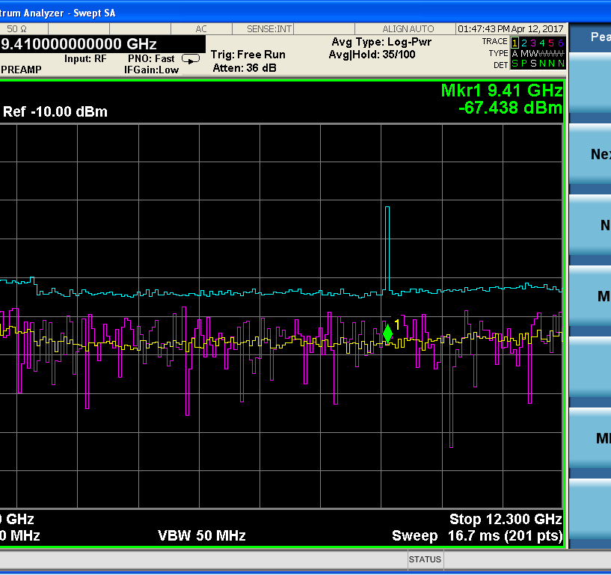
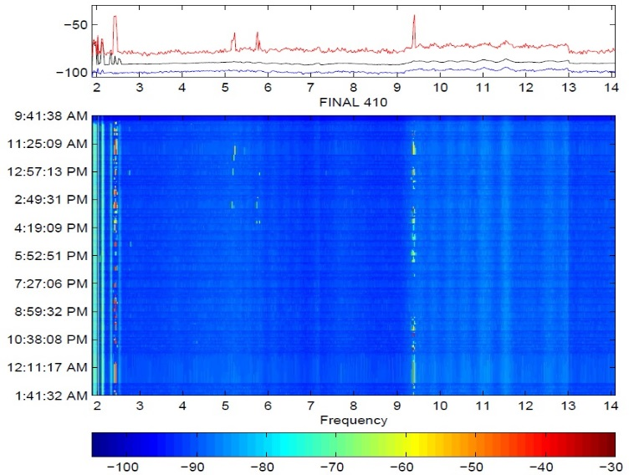
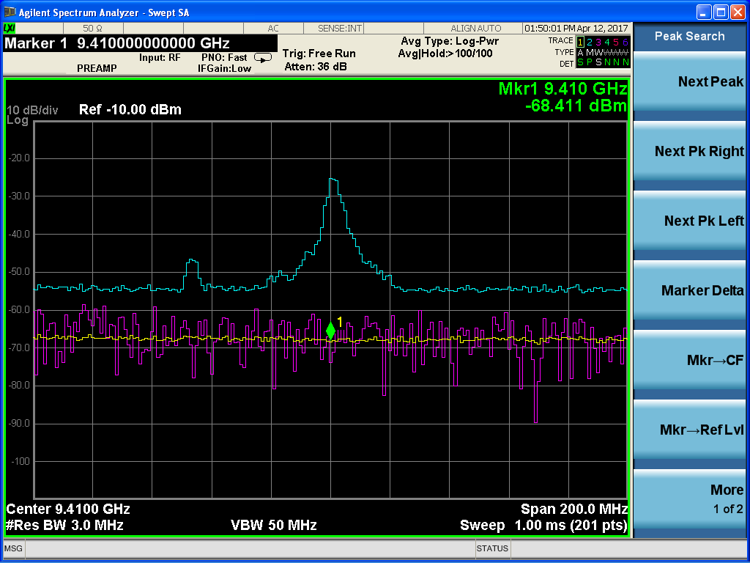
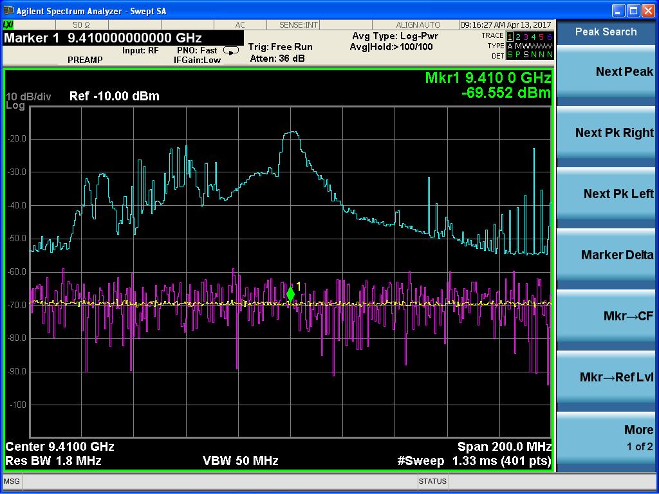
Radar Measurements with 12m and RFI monitor system
These are measurements of the radar through the 12m antenna at GGAO(black screens), and through the RFI monitor system that takes cumulative data with an omni antenna (blue plots). These plots were taken in max hold so a large radar pulse detection would register for 100 sweeps and then the file closes and a new max is found.

Slide 18
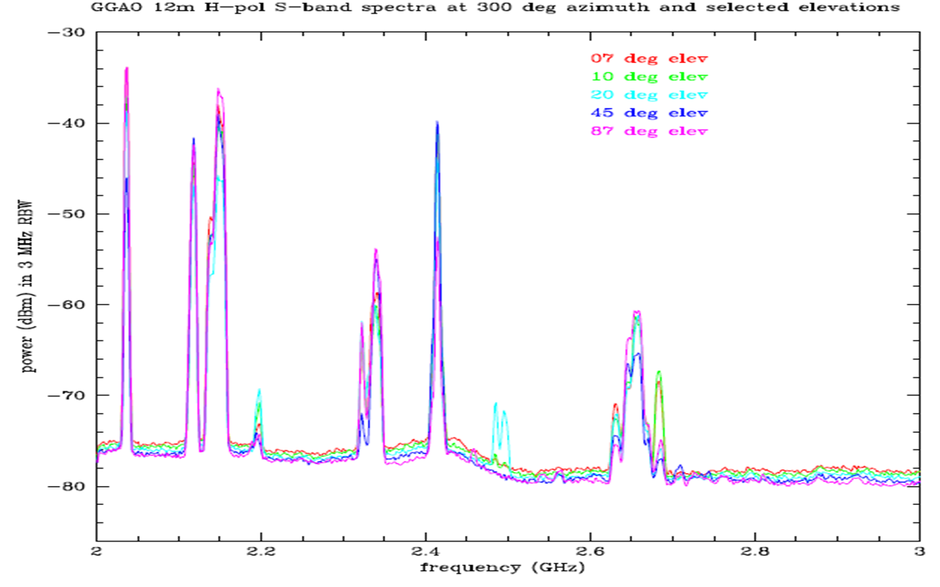
Filters designed to notch out the radar
FILTERING:In 2017, a high pass filter with cutoff between 2.2-2.3 GHz has been tested at Westford Massachusetts VLBI station signal chain after the 1st stage amplifier. This will be tried at GGAO in the near future to mitigate low band RFI.
There is also an HFSS designed model of a high temperature superconductor notch filter that can address the LHRS radar sidelobes and restrict our masks (and their attendant restrictions on sky coverage) to only the radar main lobe. S-parameters from the notch filter model are presented.

Slide 19
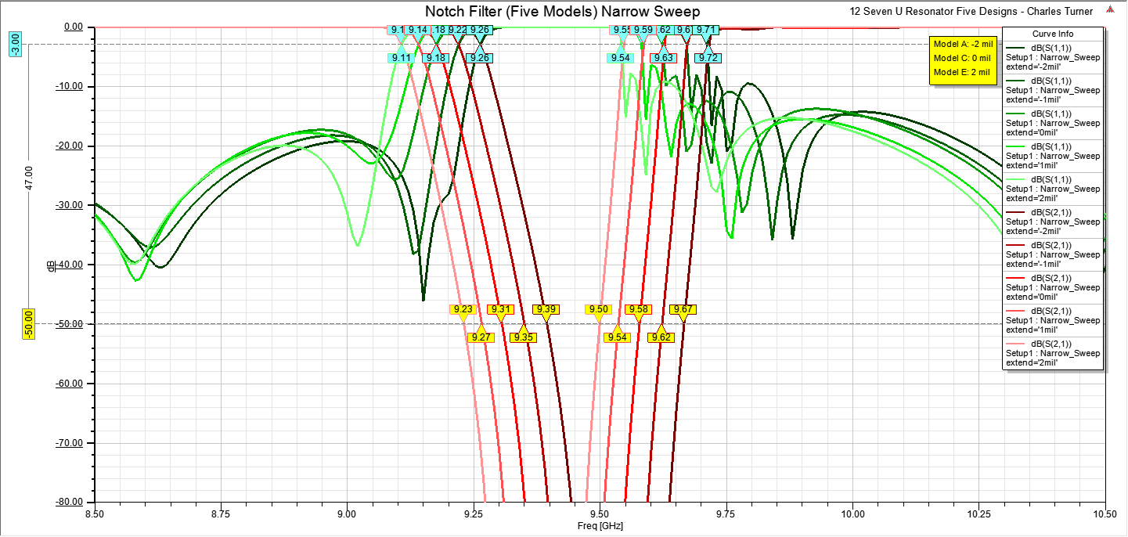
Notch Filter S-Parameters 5 slightly different designs w/o Connectors
FILTERING:In 2017, a high pass filter with cutoff between 2.2-2.3 GHz has been tested at Westford Massachusetts VLBI station signal chain after the 1st stage amplifier. This will be tried at GGAO in the near future to mitigate low band RFI.
There is also an HFSS designed model of a high temperature superconductor notch filter that can address the LHRS radar sidelobes and restrict our masks (and their attendant restrictions on sky coverage) to only the radar main lobe. S-parameters from the notch filter model and LHRS measurements at GGAO taken near the VLBI antenna are presented.
5 different designs were requested of the foundry.
We hedged this because of uncertainty in the material properties and tolerances could cause us to miss the notch we wanted.

Slide 20
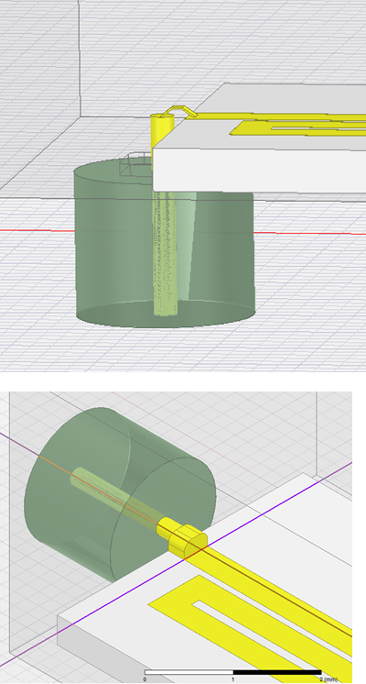
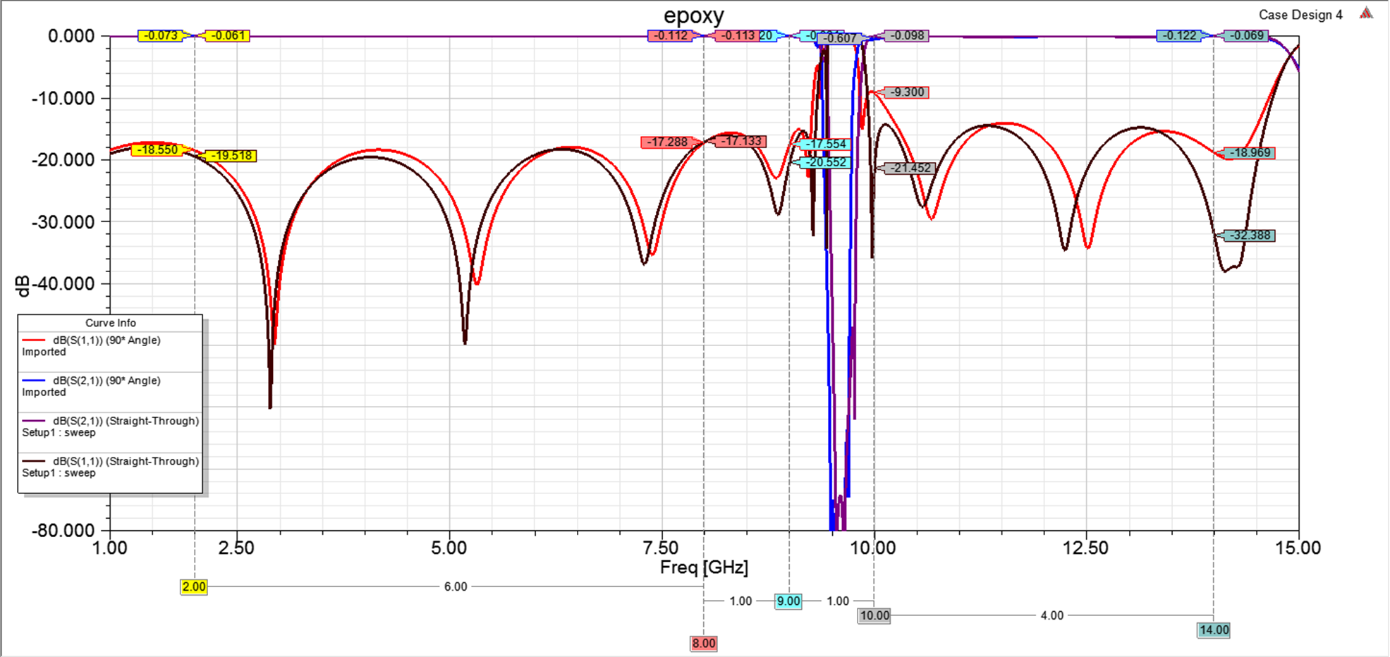
Notch Filter S-Parameters –design 4 with Connectors
The model was given further detail after the foundry run was started to see the effect of connectors
The simulation shows that reflection is less if we use a straight connector versus a 90 degree bend

Slide 21
FE RF Design - Schematic

Slide 22
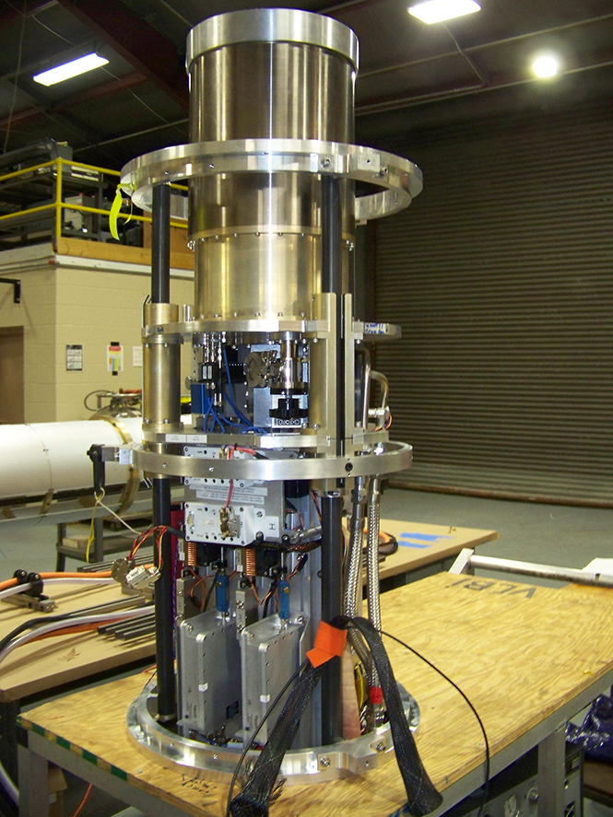
Location of couplers (and filters)

Slide 23
For more information on geodetic VLBI please go to: https://space-geodesy.nasa.gov/ https://ivscc.gsfc.nasa.gov/
Upcoming Technology Proposal
NOI Title : Broadband self-calibrating cryogenic radiometer with integrated RFI mitigating frontend and “Digitize-at-RF” demonstrator for Space Geodesy
Ganesh Rajagopalan of Haystack Observatory is PI
Stephen Merkowitz is co-PI from Goddard

Slide 24

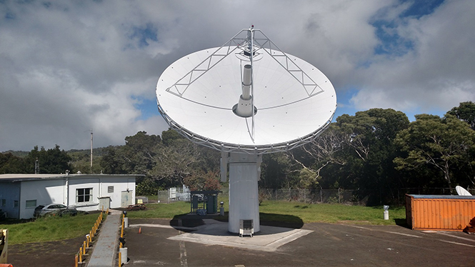
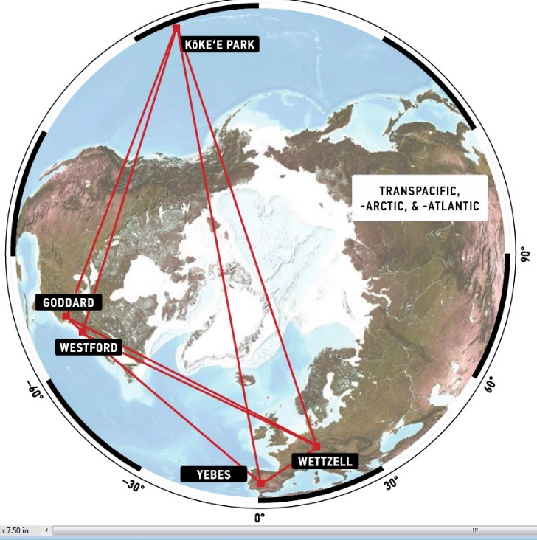
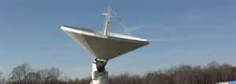
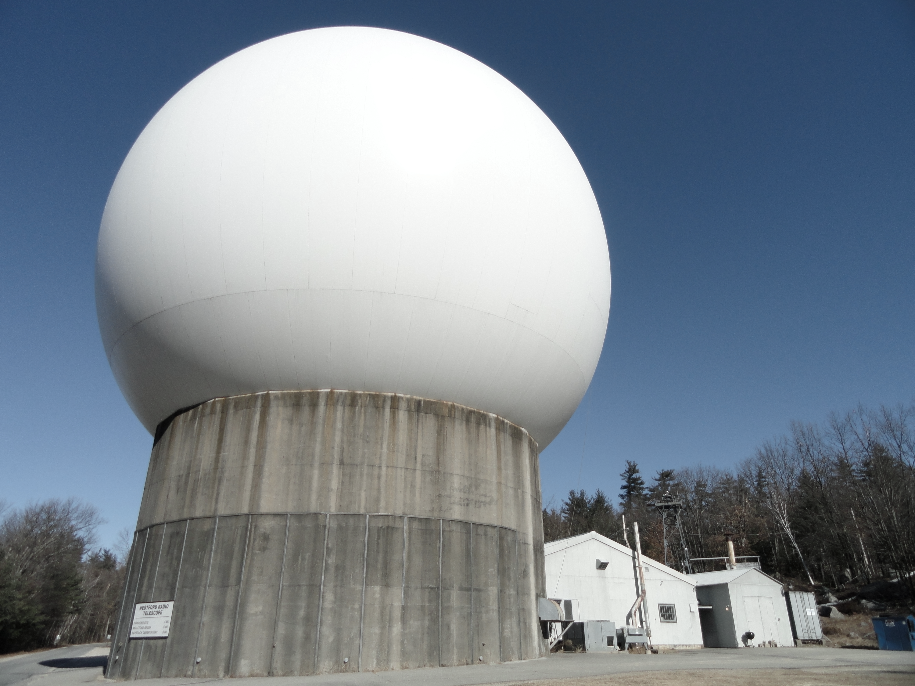
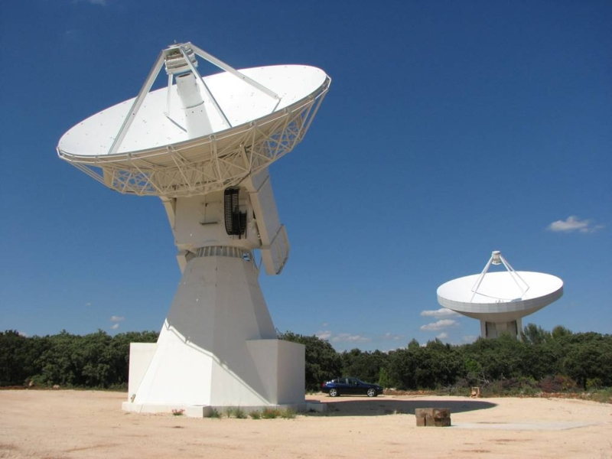
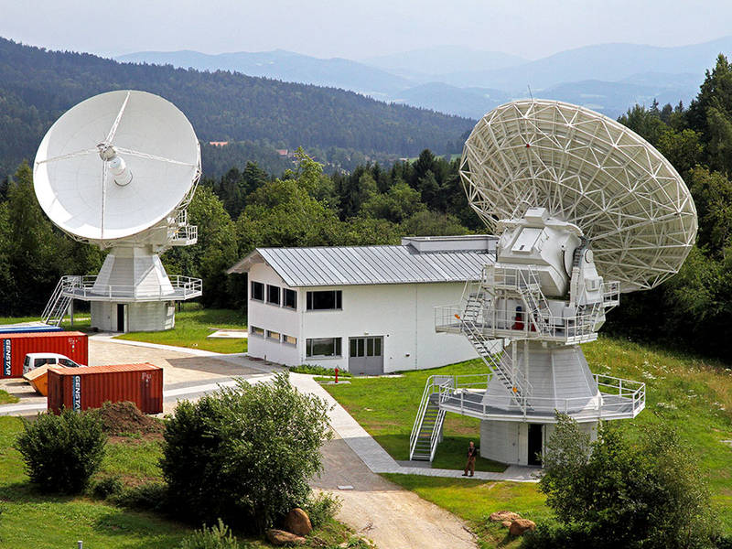
RFI mitigation tests conducted at GGAO.
Lawrence M. Hilliard (NASA, USA)
Lawrence.M.Hilliard@NASA.gov

