Slide 1
Solutions for detection and measurement of RF & uW spectrum using
Real-time Spectrum analyser solutions
Andrew Benn
Keysight Technologies

Slide 2
Agenda
Sources of man-made noise
Measurement best-practices with Spectrum Analyzer
Spectrum Analyzer example
Real-time Spectrum Analysis
Live demo
Q & A

Slide 3
Intentional, Unintentional, Incidental Radiators
Intentional radiators
  Broadcast radio and television
  Cellular
  Satellite
  Radar
  Mobile radio
  WLAN
  Cordless phones
Active transmitters
Unintentional radiators
  Microwave ovens
  Radio receiver
  Industrial heaters
  MRI equipment
Use RF but not for
radio transmission
Incidental radiators
  Switching power supplies
  Clock and control signals
  Ignition motors
  Fluorescent lighting
Do not use RF

Slide 4
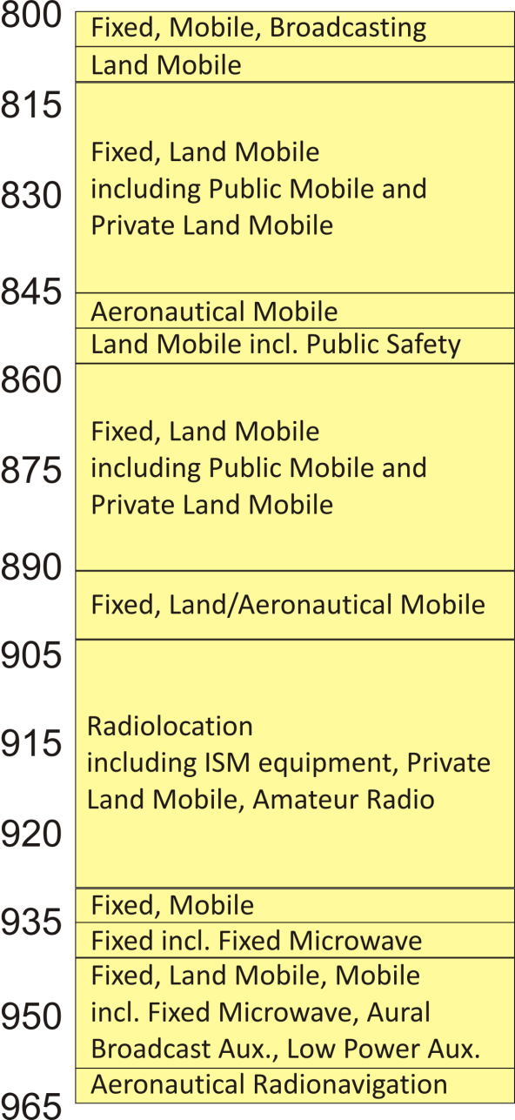
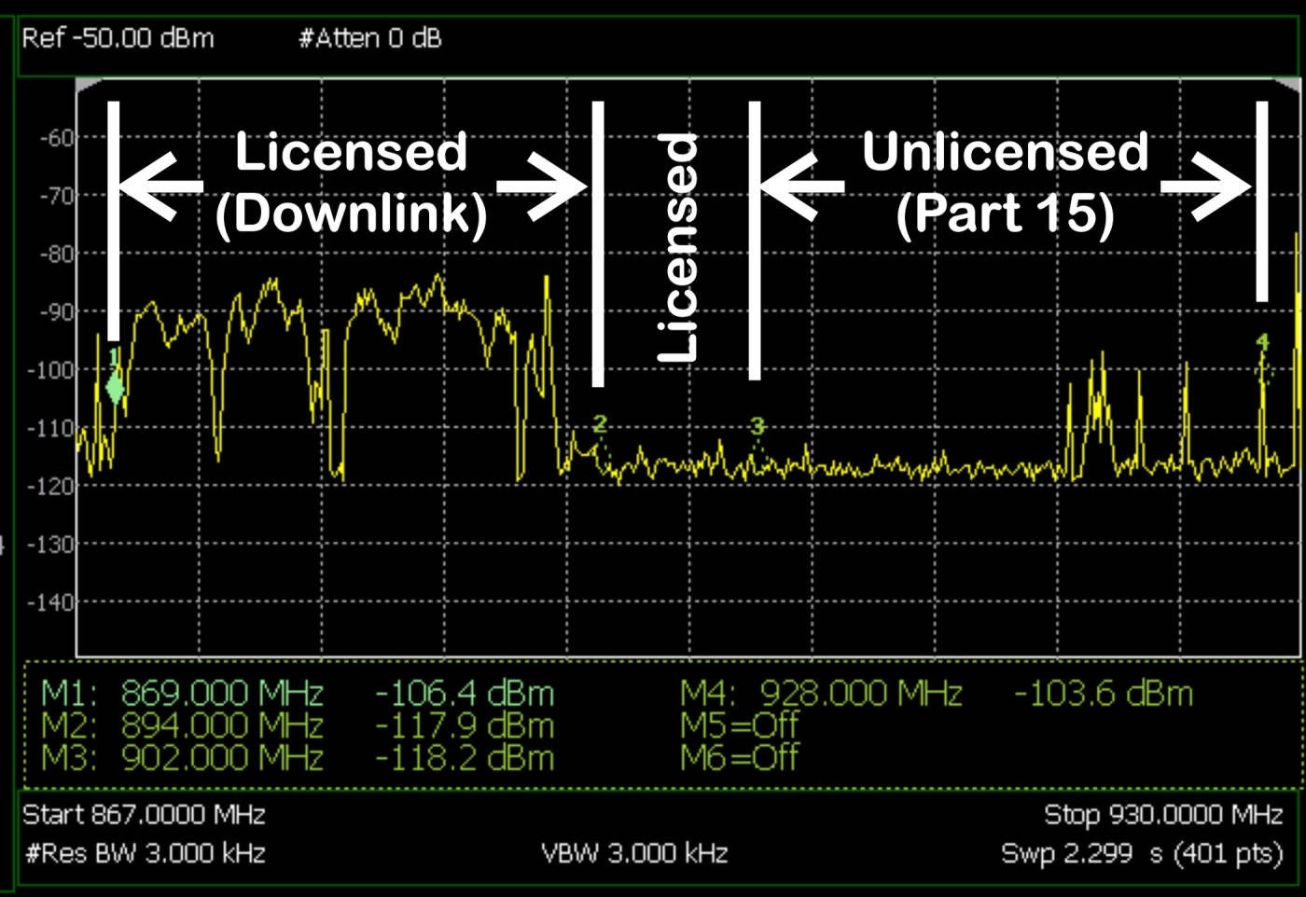
Licensed and Unlicensed Spectrum
Licensed : Protected against harmful interference
Unlicensed : Expected amount of interference
(Part 15 Rules)
(MHz)

Slide 5
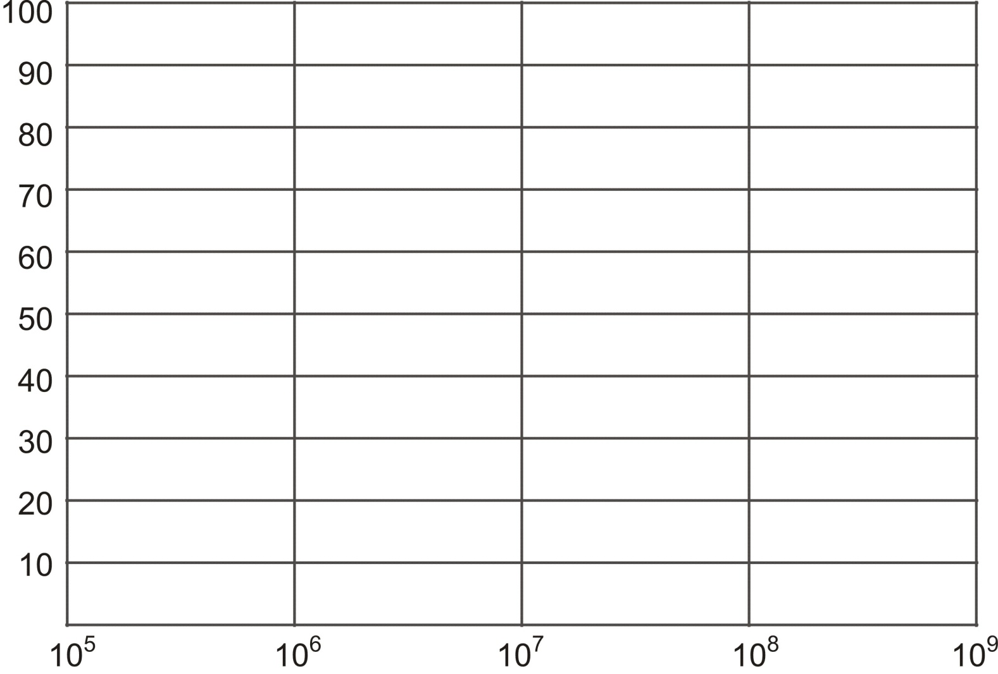
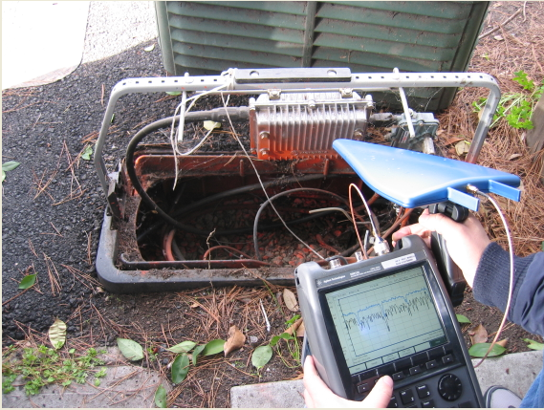
Ambient Man-Made Radio Noise
20dB difference: Business and Rural areas
Business
Residential
Quiet Rural
Median Noise above kTB (dB)
Urban
Suburban
Frequency (Hz)

Slide 6
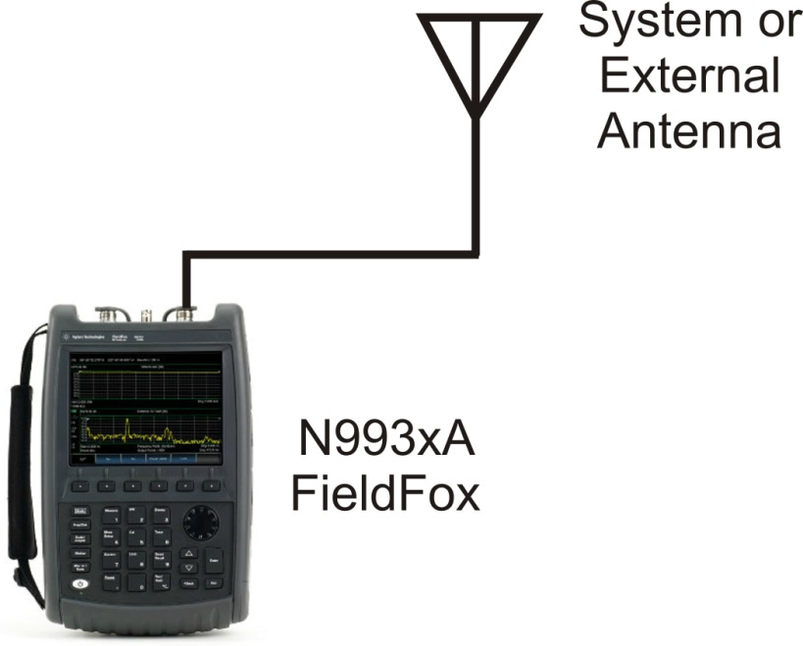

Ambient Man-Made Radio Noise Measurement
Some general rules
Very dependent on the distance from the source (power lines, radio, TV, mobile communications)
Lower freq. bands (VHF – UHF) often variable (frequency, emitted power, over time)
Higher freq bands (SHF – EHF) less occupied, propagation is directional (satellite, radar)
Avoid ‘Compressed’ level measurements

Slide 7
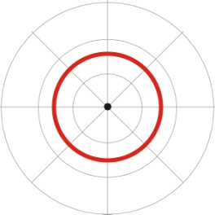
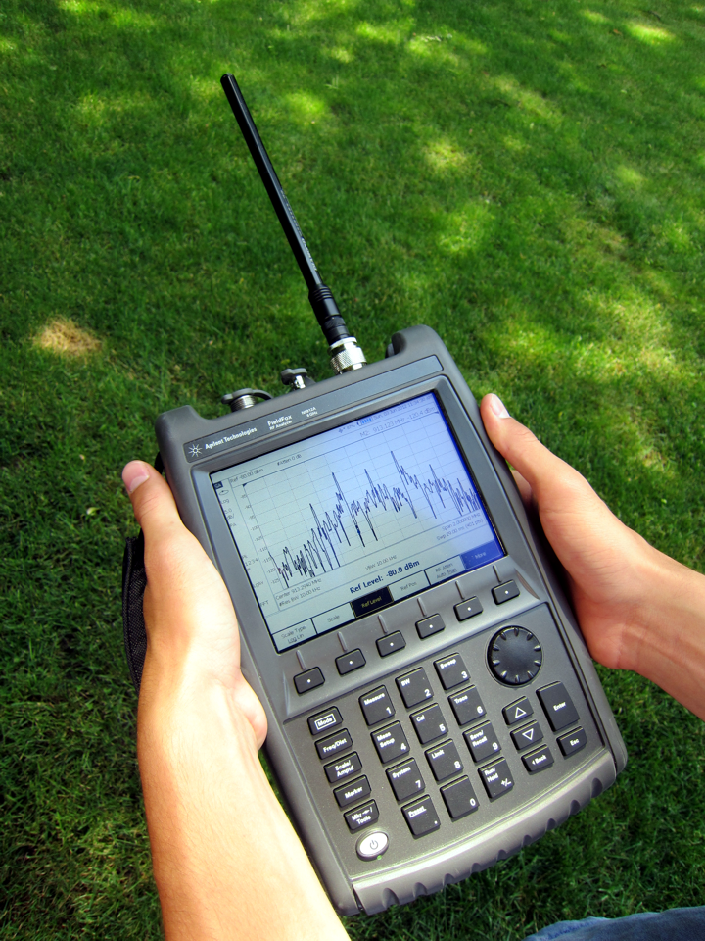
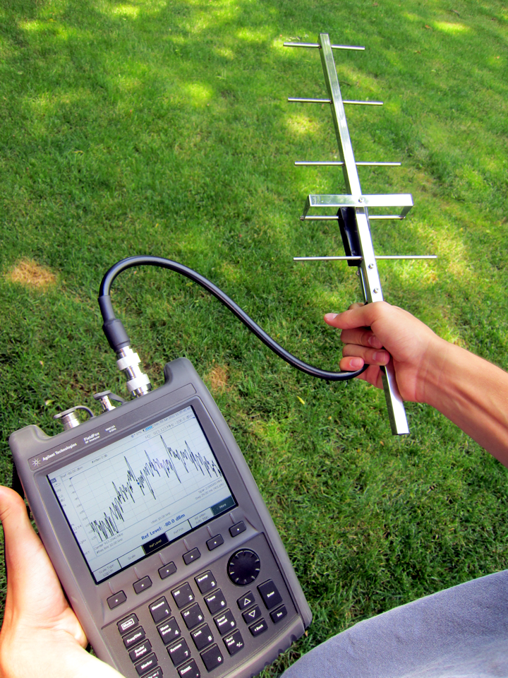
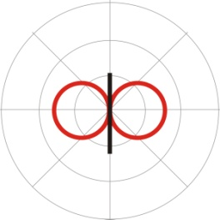


Antenna Configurations
Antenna patterns
Antenna connected directly
Antenna cabled to analyzer
Horizontal plane
Omni
Omnidirectional
High gain
Vertical plane
Horizontal plane
High gain
Vertical plane

Slide 8
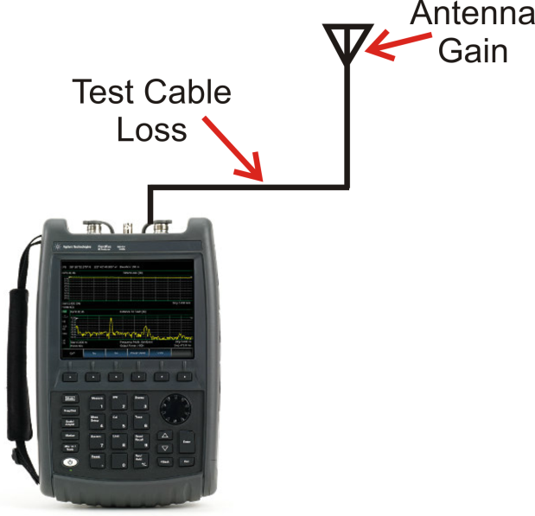


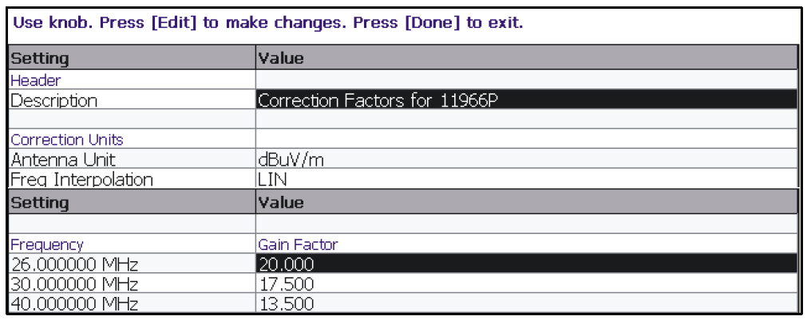
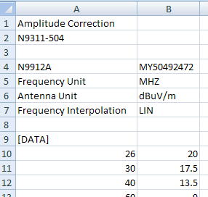
Amplitude Correction and Field Strength
Field strength units
FieldFox
Amplitude correction = antenna gain - cable loss
Corrections .csv
Correction factors editor

Slide 9
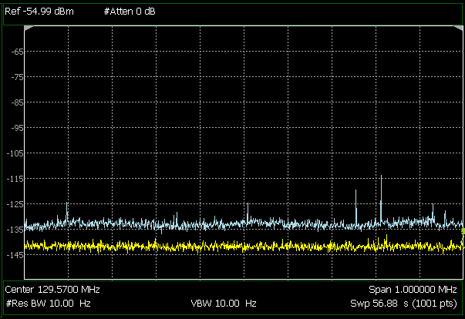
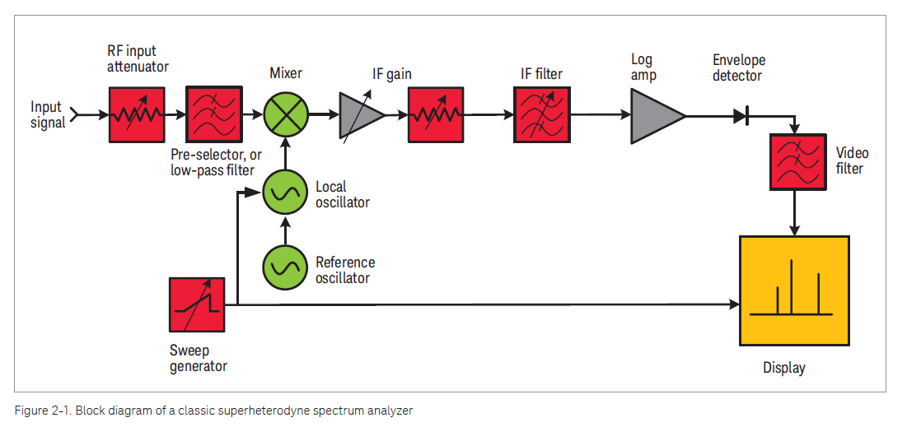
Ambient Man-made Radio Noise
Superheterodyne spectrum analyzer measurement
DANL (displayed average noise level) can be obtained by measuring noise level displayed with 50-ohm load.
However, DANL is effective (displayed) noise level. Effective input noise floor incl. losses (components prior to 1st gain stage)
Actual noise level is function of input signal.
Antenna connected
Input terminated

Slide 10
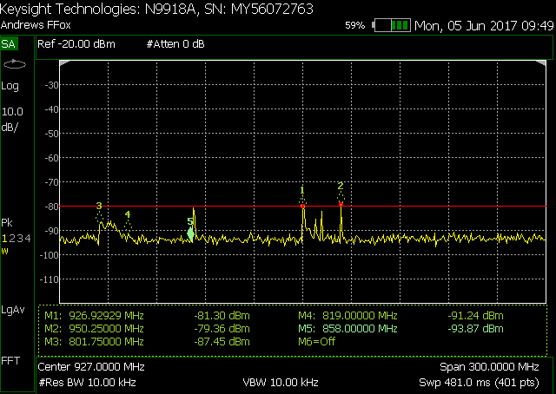
Spectrum Analyzer measurement
Example at Fc = 927 MHz, span = 300 MHz
Reference line
12 dB
Marker Table

Slide 11
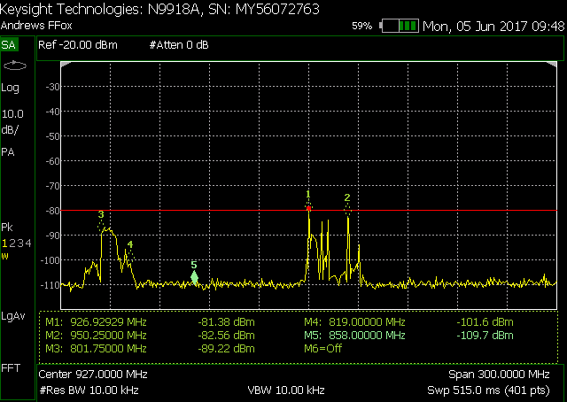
Spectrum Analyzer measurement
Example: same as before + built-in Pre-amp
28 dB

Slide 12
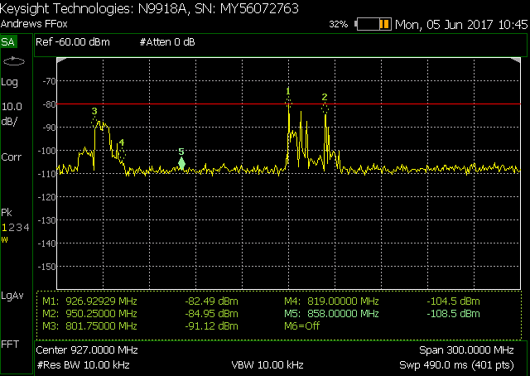
Spectrum Analyzer measurement
Example: external pre-amp from Antenna
28 dB

Slide 13
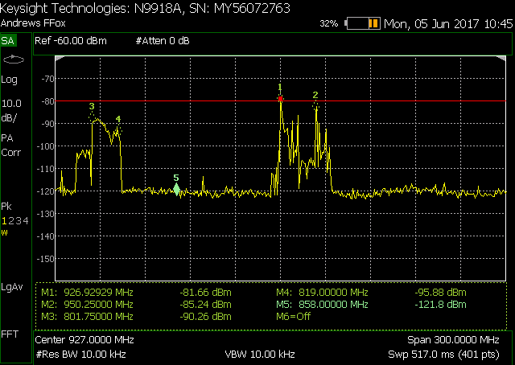
Sectrum Analyzer measurement
Example: combined built-in and ext. pre-amp
40 dB

Slide 14
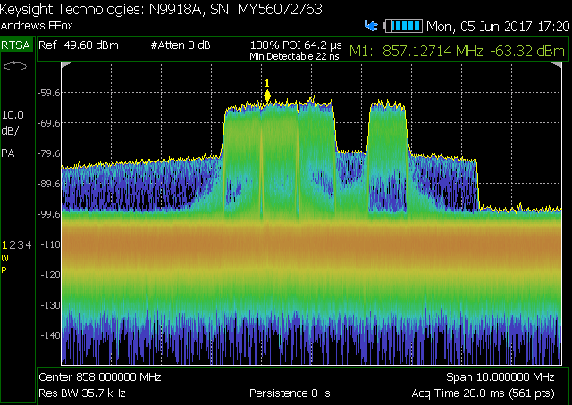
Real-time Spectrum Analyzer
Example: Spectrum Analyzer in ‘Density’ display

Slide 15
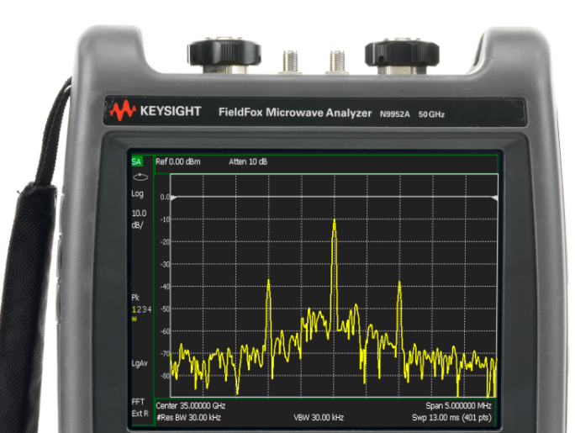
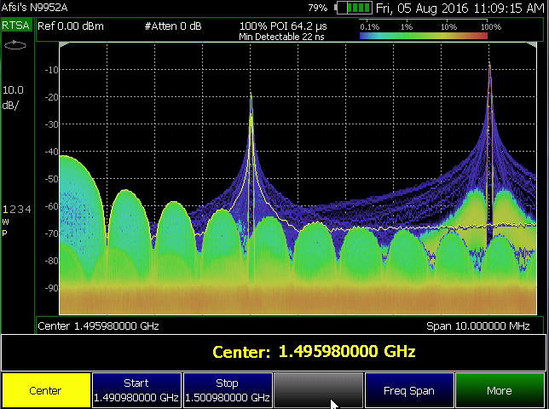
Keysight FieldFox
Handheld Real-time Spectrum Analyzer

Slide 16
Probability of missing signals
Comparison between Spectrum Analyzers
Freq
Real time BW
Time
Swept tuned SA
Snapshot FFT SA
Real-time SA
Real-time SA
Min. signal duration with POI: 12.2 us
Min. detectable signal: 22 ns
FFT rate: 120,000 FFT/s

Slide 17
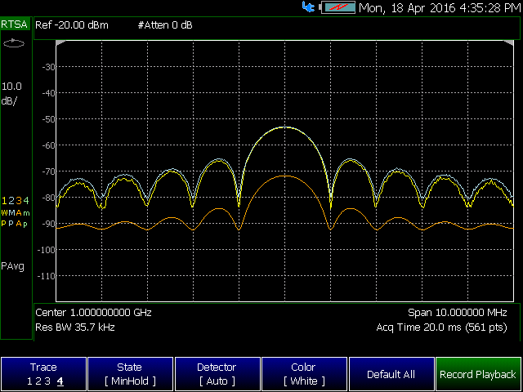
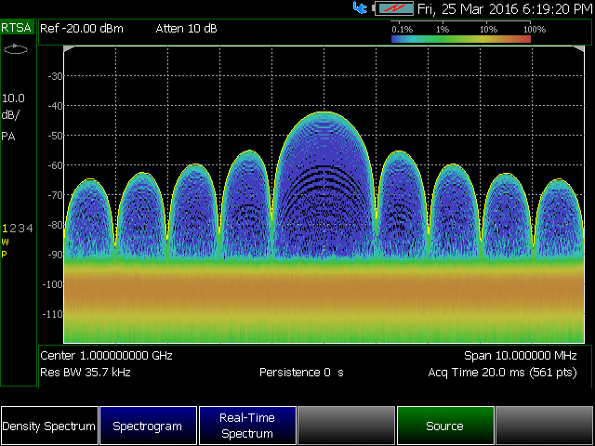
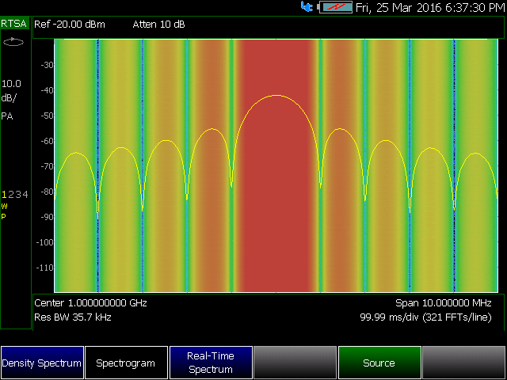
Real-time spectrum analysis (up to 50GHz)
3 unique display modes: instantaneous and over time
Real time spectrum
Up to 4 ‘live’ traces with Playback Record
Density display with
settable persistence
Spectrogram with Playback Record

Slide 18
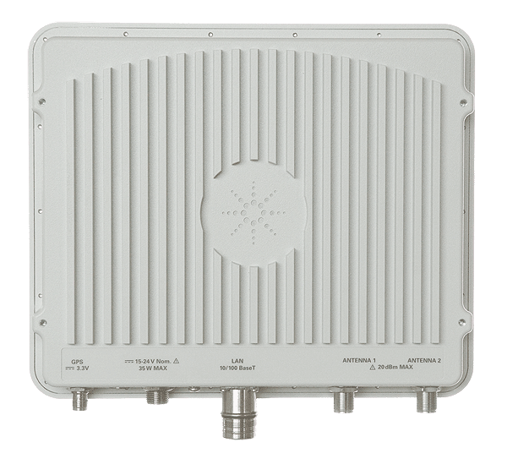
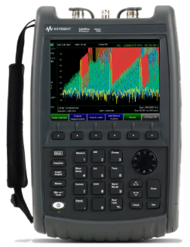
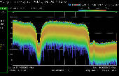
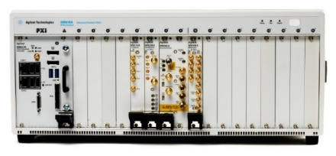
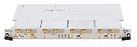
Keysight Signal Monitoring Portfolio
UXA/PXA Real Time Performance 3 Hz to 50 GHz, 255, 510 or 1 GHz BW Real-time spectrum analysis Real–time Streaming Monitor & capture elusive signals across the full analysis BW UXA 14.1” Multi-touch UI X-Series Measurement Applications: Proven ready to use measurements for signal analysis
PXI Flexible configurations VSA, VSG, VXT, CXA-m 1 MHz to 50 GHz Up to 160 MHz BW M9203A: 12 bit, 2 channels Up to 3.2 GS/s sampling rate & 2 GHz analog BW On board memory & custom FPGA Real time streaming M9362AD01 Quad Downconverter 10 MHz to 50 GHz 1.5 GHz BW per channel
AXIe Wideband Receivers High Speed Digitizers M9703B: 12 bit, 8 channels DC to 2 GHz instantaneous bandwidth Up to 3.2 GS/s for 1 CH Up to 64 coherent channels with M9514A On board FPGA Real time streaming M9709A: 8 bit, 32 channels DC to 500 GHz Up to 1.2 GS/s 50/100 MHz real time streaming
Remote Monitor/ Signal Analyzer Signal ID & Geolocation 20 MHz to 6 GHz with 20 MHz analysis BW N6820ES Signal Surveyor 4D + N6854A Geolocation Server Software Real time streaming N6841A-MFP or - NBR HF Receiver Coming Soon 1.5 to 30 MHz Full time stare of entire HF spectrum
FieldFox Carry Precision with You Up to 50 GHz 10 MHz analysis BW Real-time spectrum analysis Configurable with > 12 instruments such as SA, RTSA, CH Scanner, CAT, VNA, VVM, TDR, Power meter, etc World’s most rugged and capable handheld analyzer
Software N6820ES Signal Surveyor 4D: Automated high speed, high resolution RF search and signal Identification. Ability to task handoff receivers. N6854A RF Geolocation Server Software: Real time RF emitter geolocation and mapping 89601B VSA Software: Comprehensive toolset for demodulation and vector signal analysis N90XXA X-Series Measurement Applications: Proven ready to use measurements for signal analysis

Slide 19
References
Rolland Zhang, Keysight Technologies, Addressing Interference Problems Using Real-Time Spectrum Analysis, article reprint from Microwave Journal, 5992-1989EN
Blake Peterson, Hewlett-Packard – Keysight, Spectrum Analysis Basics, Application Note, 5952-0292
Cesidio Bianchi and Antonio Meloni, Terrestrial Natural and Man-made Electromagnetic Noise, Istituto Nazionale di Geofisica e Vulcanologia Roma-Italy

Slide 20

Questions and Answers…
KCT 2017

Slide 21
THANK YOU!
KCT 2017

