Slide 1
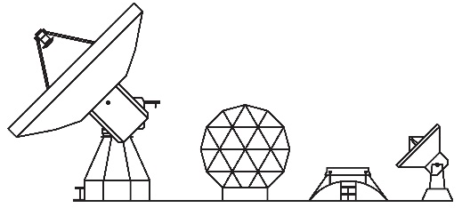
RFI measurements with Yebes VGOS broad-band receiver
P. García, J.A López-Pérez, F.J. Beltrán
Yebes Observatory
08/06/2017

Slide 2
INDEX
Introduction.
Receiver.
Problems.
RFI Measurements.
Conclusions.

Slide 3
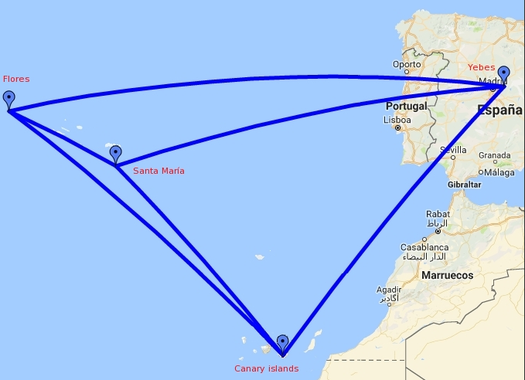
RAEGE
Atlantic Network of Geodynamical and Space Stations.
4 Geodynamical Stations:
Yebes.
Canarias.
Sta María Island.
Flores Island.
Inside on VGOS Project.

Slide 4
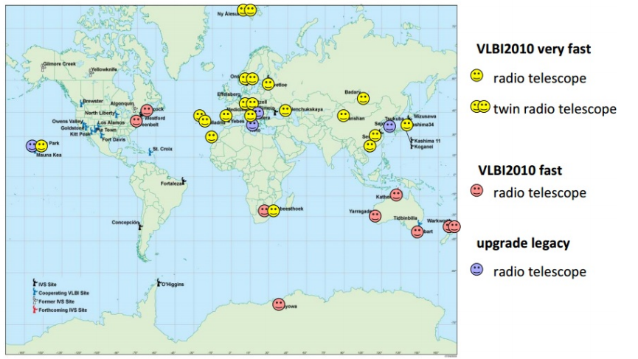
VGOS
VLBI Global Observing System.
Monitoring parameter variations Earth.
Smaller and quicker antennas :
D= 13.2 m.
Speed = 12 deg/seg.
New precision: 1 mm.
Broad-band (2- 14 GHz).

Slide 5
General specifications
Input frequency range : 2 – 14 GHz.
Output frequency range : DC – 1.5 GHz.
Noise Temperature < 30 Kelvin.
Dual polarization.
Total bandwidth of 8 GHz.

Slide 6
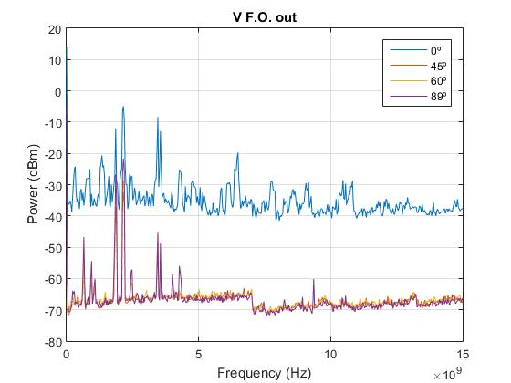
Problems
Radiofrequency interferences.
Receiver Saturation.
Solutions:
Superconducting filters.
Dichroic filters.

Slide 7
RFI MEASUREMENTS
Power measurements at the output of cryostat.
Power meter: DC-6GHz.
Spectrum at the output of cryostat.
Spectrum analyzer 1-16 GHz.
Some tests to correct the problem

Slide 8
Total power at Cryostat Output

Slide 9
Total power at Cryostat Output

Slide 10
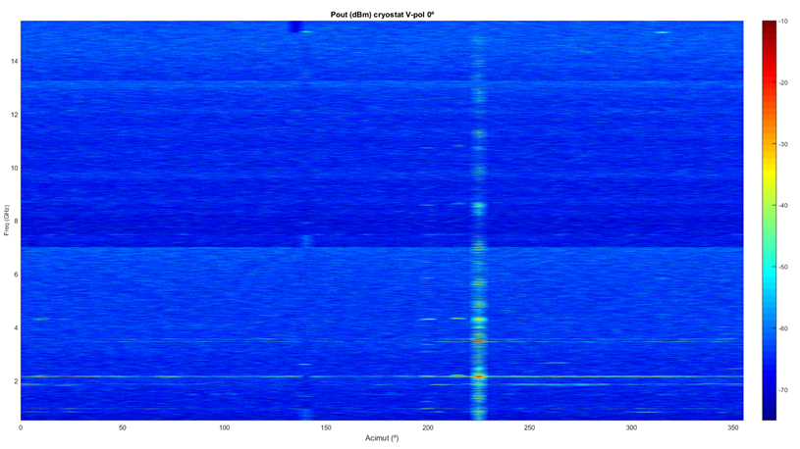
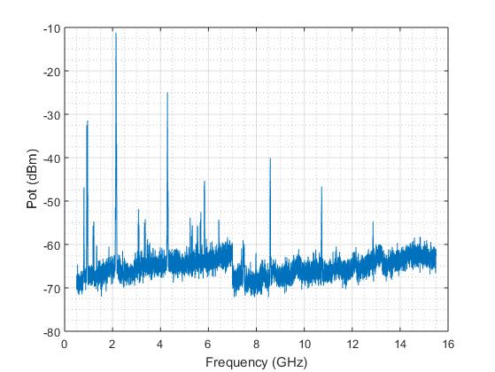
Spectrum at Cryostat Output 0º

Slide 11
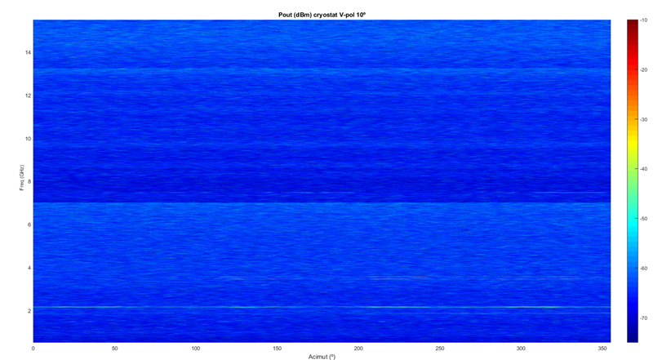
Spectrum at Cryostat Output 10º

Slide 12
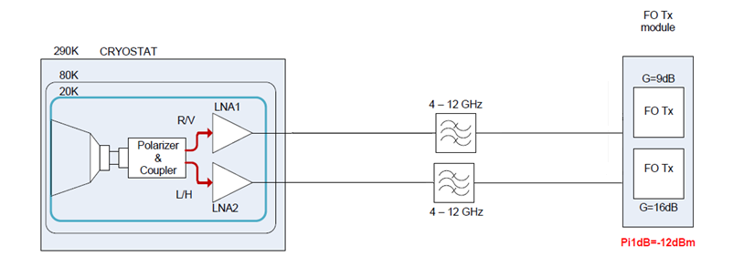
First test.

Slide 13
Total power at Cryostat Output

Slide 14
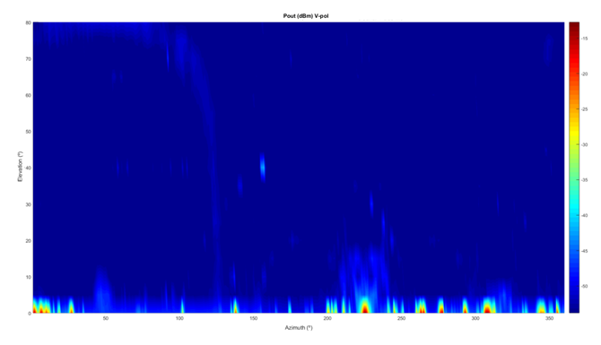
Total power at Cryostat Output

Slide 15
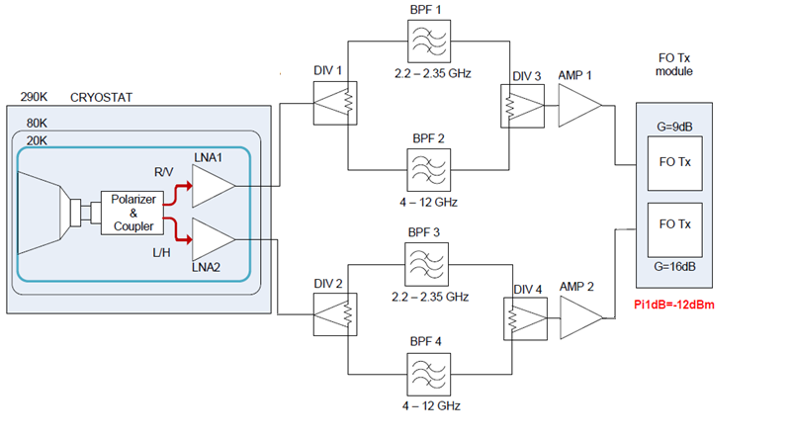
Second test

Slide 16
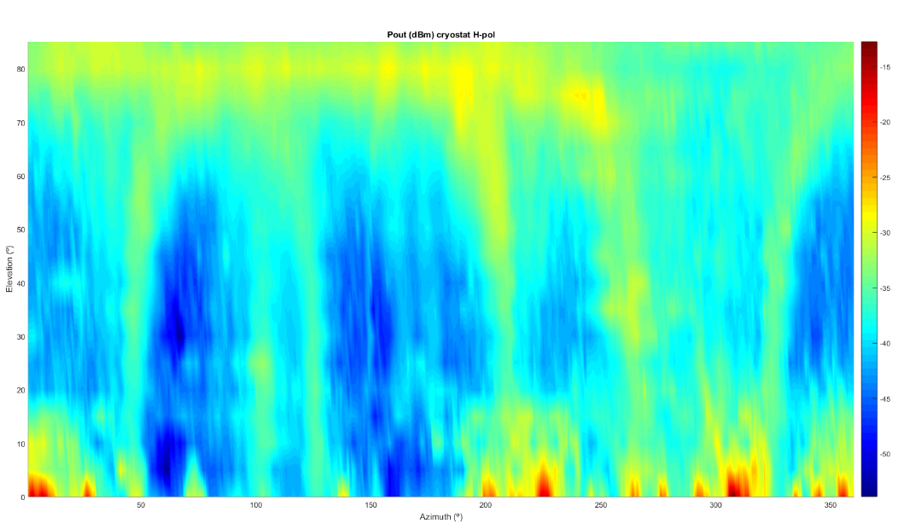
New situation
a) Original situation without pre-amplifier
b) New situation with filters and pre-amplifier
Tsys ≈ 70K
Tsys ≤ 50K

Slide 17
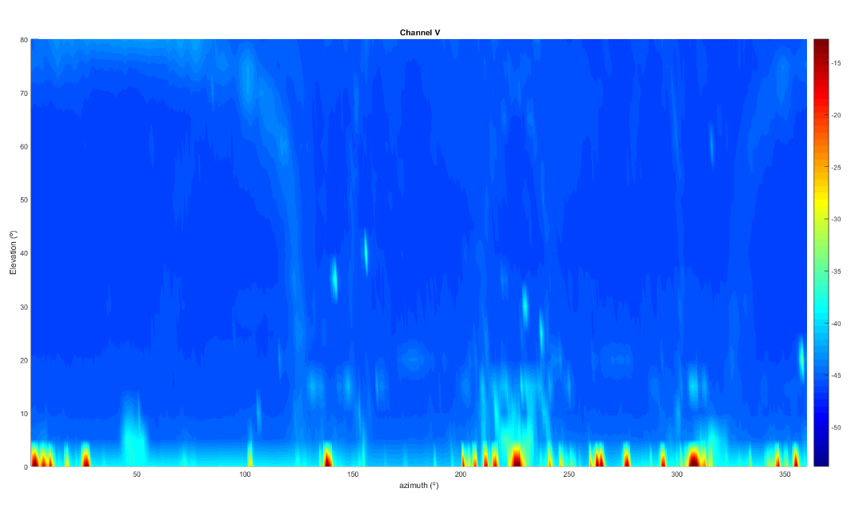
New situation
a) Original situation without pre-amplifier
b) New situation with filters and pre-amplifier
Tsys ≈ 70K
Tsys ≤ 50K

Slide 18
Conclusions
RFI problems.
Need to filter these signals.
Better Tsys with Pre-amplifiers.
Possible solutions:
Dual band filter.
Superconducting filter.

Slide 19
Questions?
Thanks for your attention.

