Slide 1
RFI Protection Activities in IAA RAS
A.Tsaruk, G. Ilin, A.Evstigneev, S. Grenkov
Institute of Applied Astronomy of the Russian Academy of Sciences
St. Petersburg, Russia
Detection and measurement of RFI in radio astronomy · Yebes Observatory · 8-9 June, 2017

Slide 2
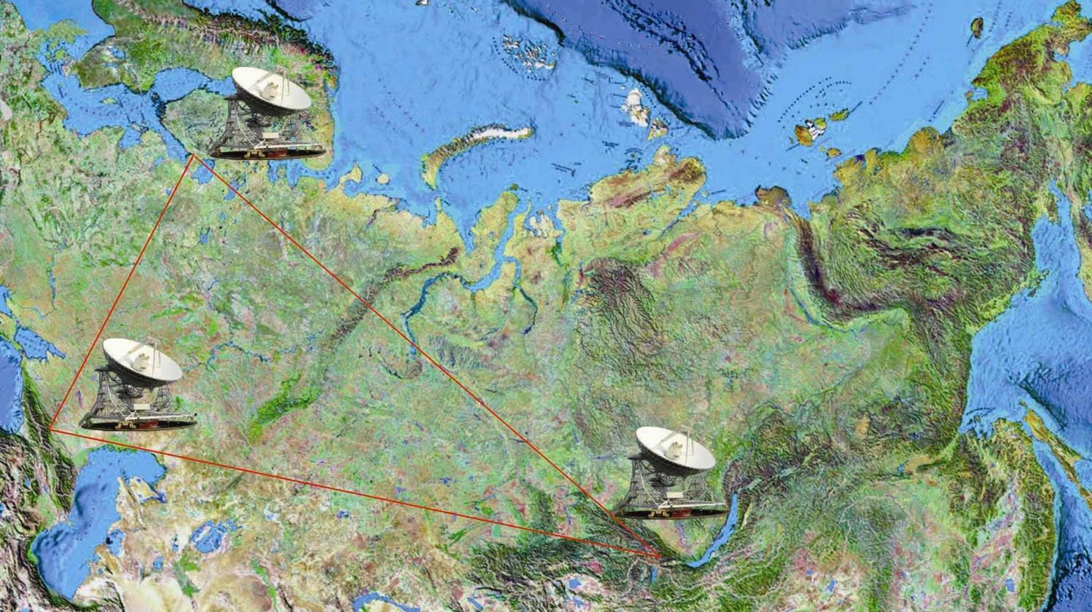
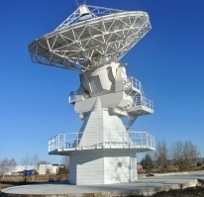
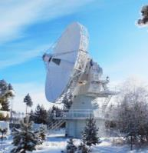
«Quasar» VLBI network
Svetloe
2014.7 km
4281.7 km
Zelenchukskaya
4404.9 km
Badary
Detection and measurement of RFI in radio astronomy · Yebes Observatory · 8-9 June, 2017

Slide 3
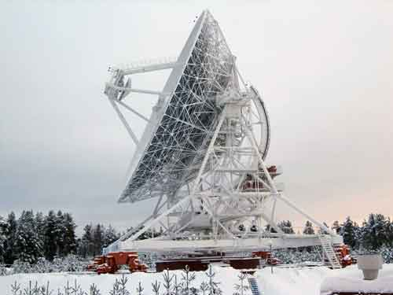
RT-32 Radio Telescope
Wave-length, cm | Frequency band | Bandwidth GHz | LO freq. GHz | IF Bandwidth MHz
18-21 | L | 1,38-1,72 | 1,26 | 120-460
13 | S | 2,15-2,50 | 2,02 | 130-480
6 | C | 4,60-5,10 | 4,50 | 100-600
3,5 | X | 8,18-9,08 | 8,08 | 100-1000
1,35 | K | 22,02-22,52 | 21,92 | 100-600
RFI types
 | Source | Input frequency, MHz | Level, over system noise, dB | Notes
L - band | Radionavigational satellite (GLONASS L1, GPS L1) | 1598,0625-1608,75 1575,42 | 25-30 | Maximum value
 | Mobile (GSM) | 1710-1720 | 25 | Azimuth depended
S - band | Mobile (UMTS,LTE) | 2134-2139 2300-2500 | 5-15 | UMTS high-pass filter
 | Fixed service , MW oven (Svetloe only) | 2400-2500 | 15 | Direction on resort, 2km distance
 | DORIS (Badary only) | 401,2510 | 10
Detection and measurement of RFI in radio astronomy · Yebes Observatory · 8-9 June, 2017

Slide 4
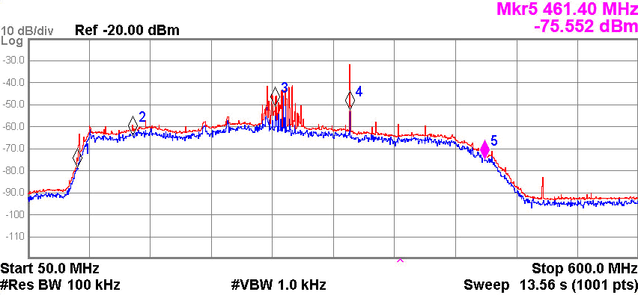
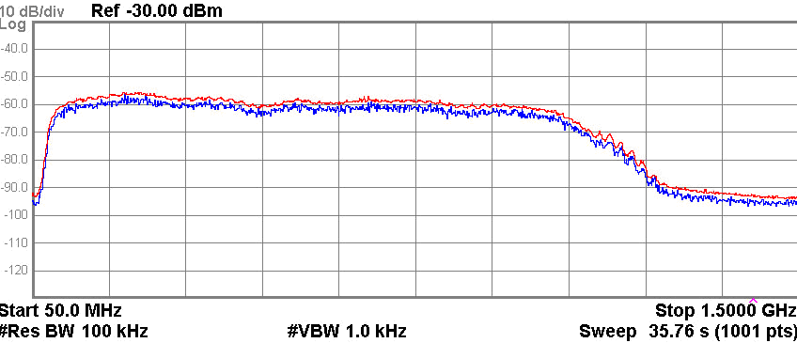
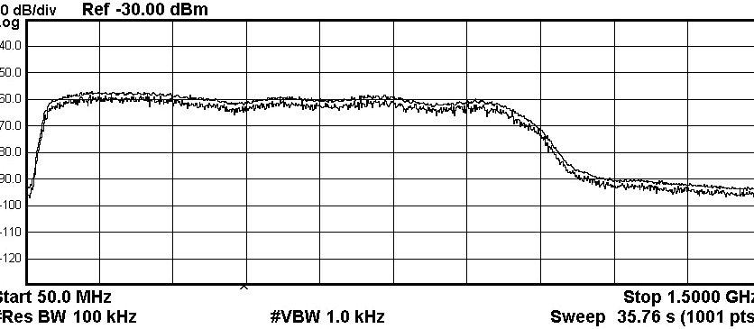
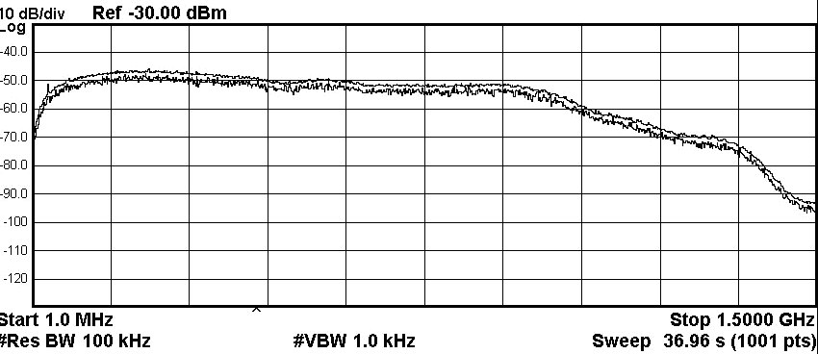
RFI Monitoring RT-32
L
S
C
X
Svetloe,
November 2016
K
4
Detection and measurement of RFI in radio astronomy · Yebes Observatory · 8-9 June, 2017

Slide 5
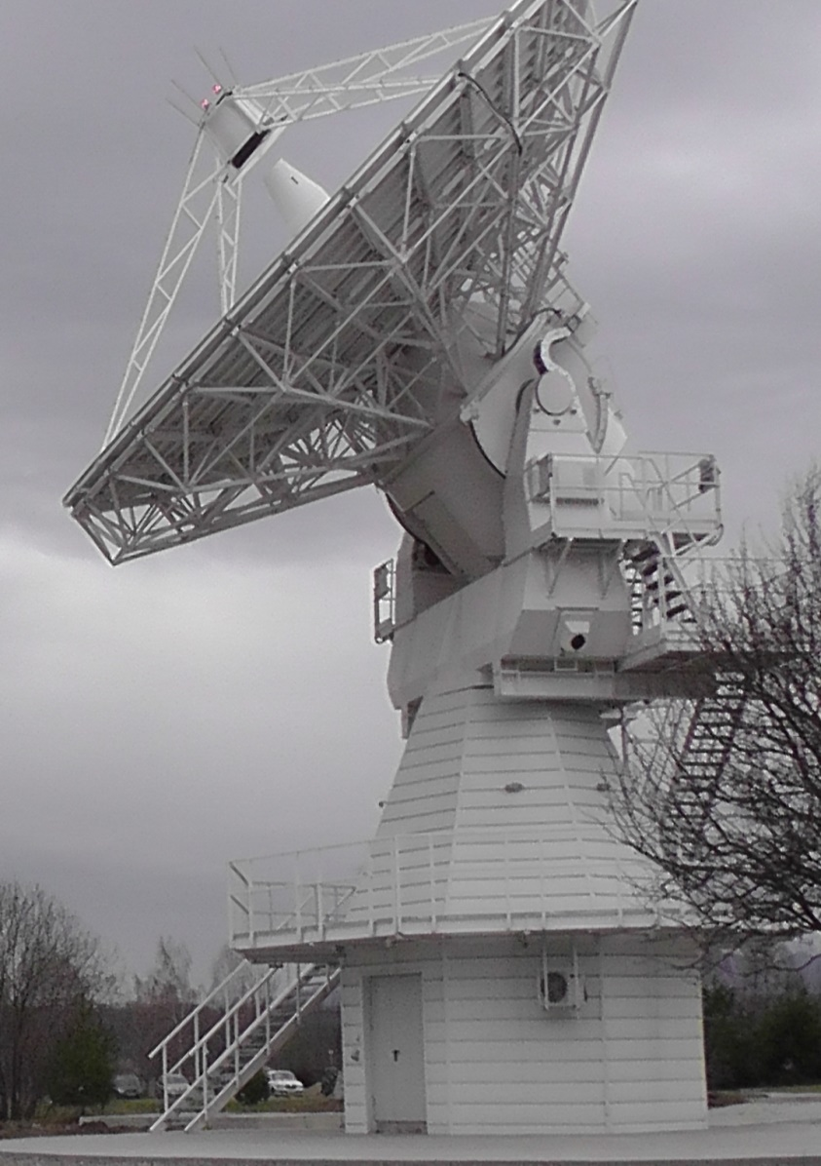
RT-13 Radio Telescope
Tri-band receiver
Frequency band | Bandwidth GHz | LO1 freq. GHz | LO2 freq. GHz | IF Bandwidth MHz
S | 2,2-2,6 | 3.6 | — | 1024-1536
X | 7-9,5 | 23,5-25,5 | 15 | 1024-2048
Ka | 28-34 | 21,5-27,0 | 5,5 | 1024-2048
Wideband receiver prototype
Bandwidth GHz | LO1 freq. GHz | LO2 freq. GHz | IF Bandwidth MHz
3-18 | 27-41 | 22 | 1024-2048
5
Detection and measurement of RFI in radio astronomy · Yebes Observatory · 8-9 June, 2017

Slide 6
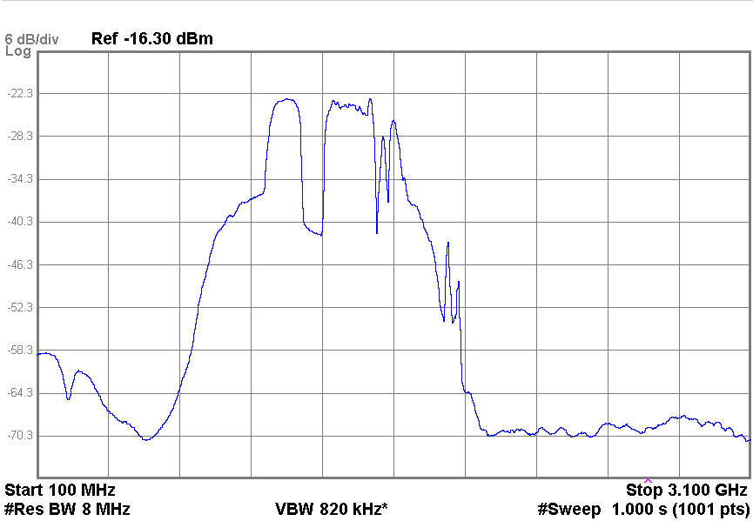
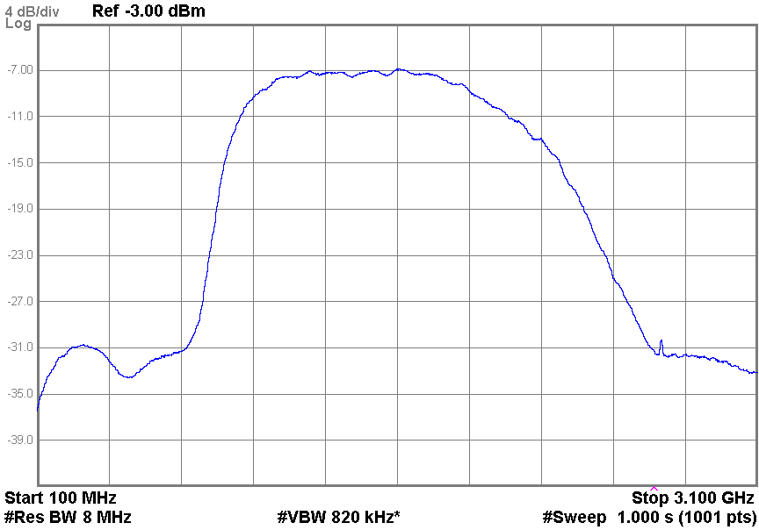
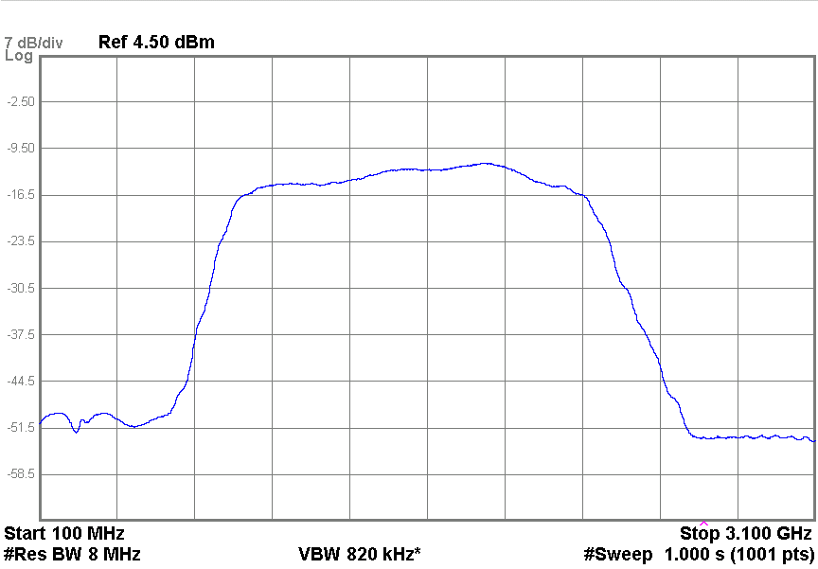
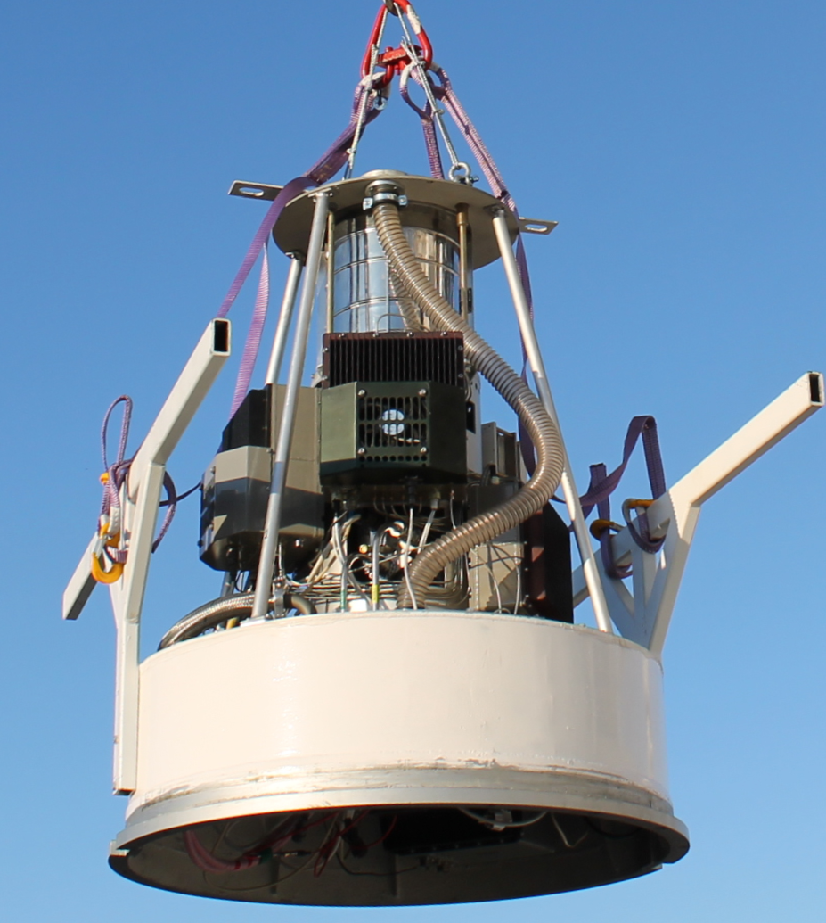
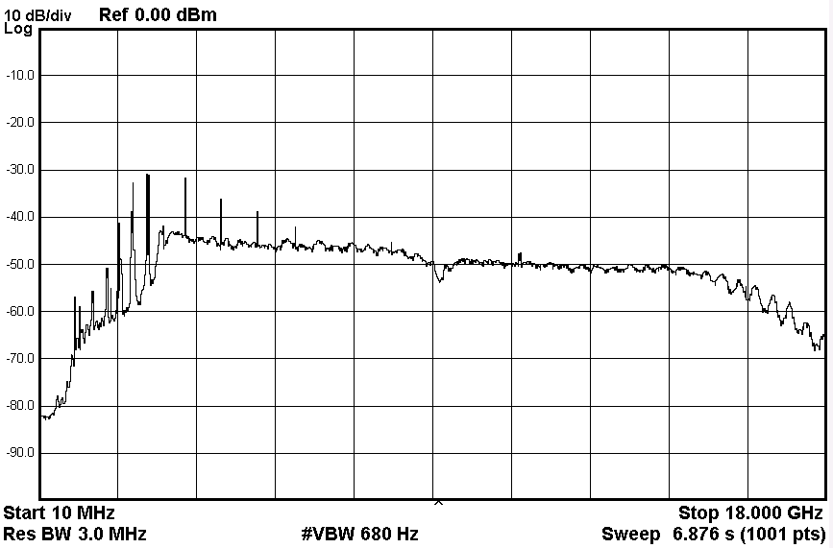
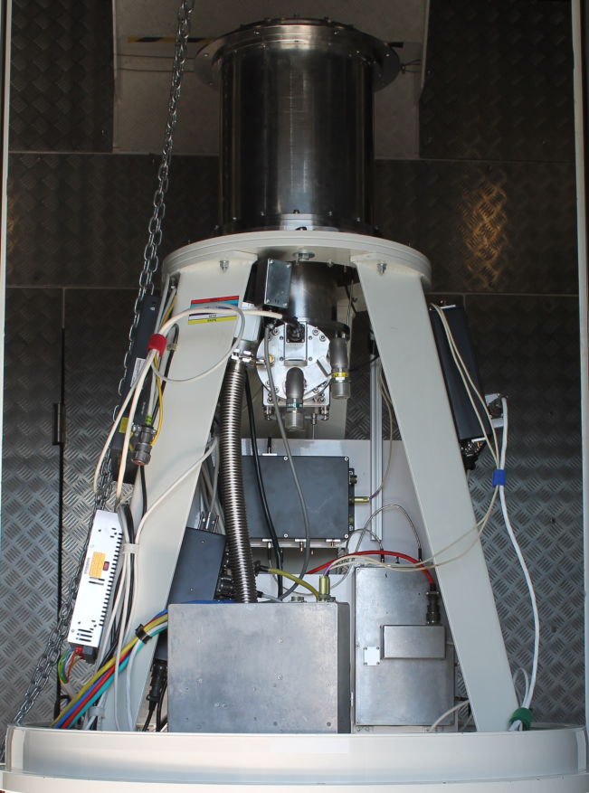
RT-13 RFI Measurement in Zelenchukskaya
S-band
X-band
Ka-band
Wideband
Tri-band
Wideband
6
Detection and measurement of RFI in radio astronomy · Yebes Observatory · 8-9 June, 2017

Slide 7
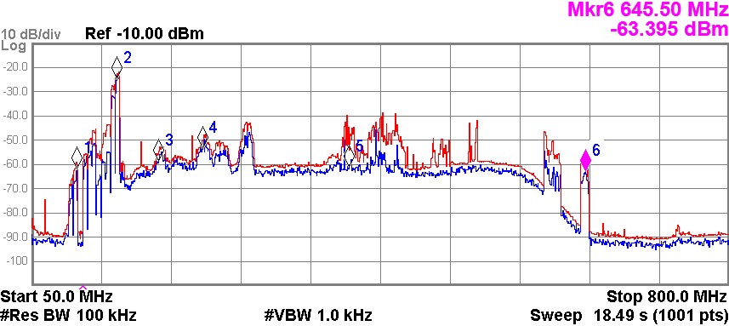
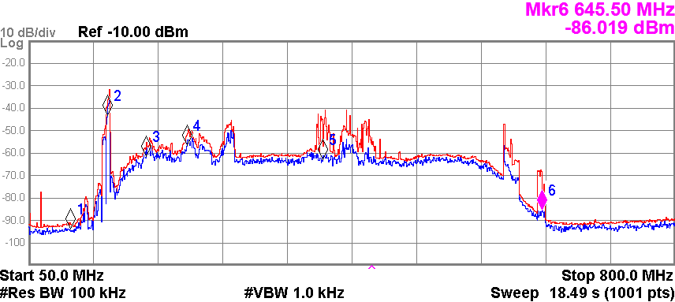
RFI Protection
Hardware filtering of zones occupied by powerful narrowband RFI
high-pass
filter
Svetloe S-band RT-32
S-band RT-13
7
Detection and measurement of RFI in radio astronomy · Yebes Observatory · 8-9 June, 2017

Slide 8
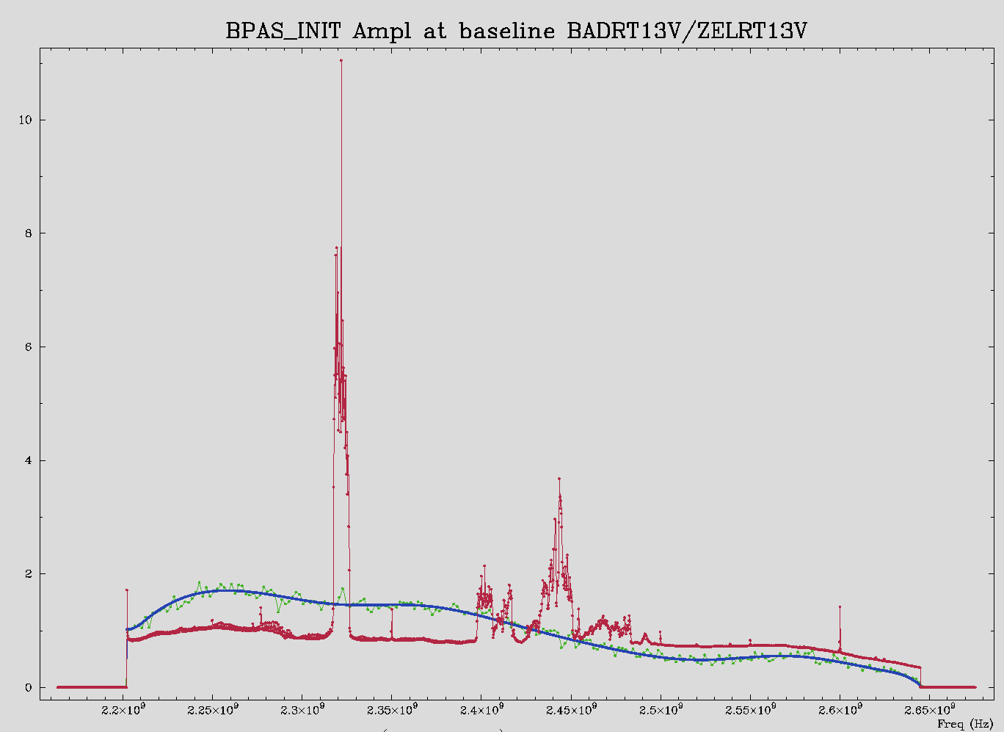
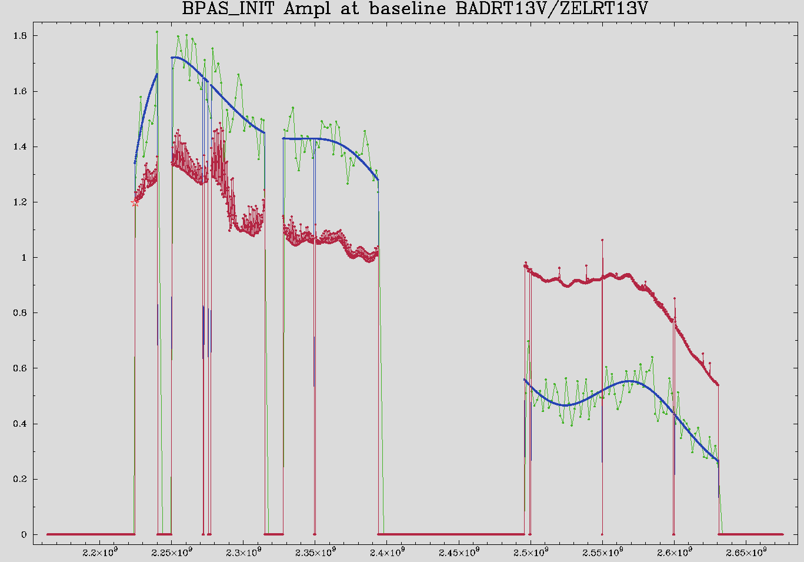
RFI Protection
Correlator and postprocessing software for interference filtering
RFI filtering in VLBI mode
DiFX — the software correlator:
Cut bandwidth on 2n MHz slices (zoom band) to exclude strong RFI signal from correlation.
PIMA — the postprocessing software:
Block arbitrary spectral channels of auto- and/or cross-correlation measures from calculations.
HOPS — the postprocessing software:
Block arbitrary IF channels from calculations.
Example of PIMA RFI filtering capability:
Experimental intensive session R1091D with RT-13 antennas on April, 1 2017 without notch Wi-Fi filter; Purpose to determine UT;
On the left panel strong RFI in Zelenchukskaya (estimated UT formal error 16.0 us);
On the right panel RFI is cuted out (estimated UT formal error 15.5 us).
8
Detection and measurement of RFI in radio astronomy · Yebes Observatory · 8-9 June, 2017
Notes:
.

Slide 9
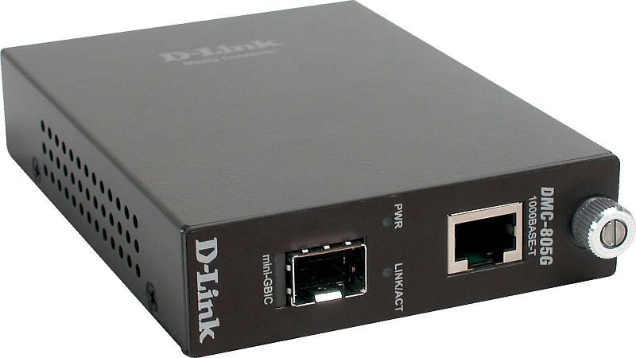
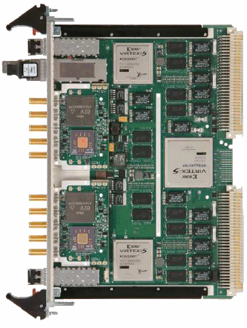
RFI Protection
Specialized hardware software complex for interference filtering
PC
Neptune-V5 VSX TEK Microsystems
The spectrally selective system of registration allows to do:
Measurement of receiving and amplifying channel;
Radiometry in the continuum;
Registration of radio emission in the spectral lines;
Registration of radio interference.
Ethernet 1000 BASE-T
SFP
Characteristics of the spectrum computation module:
Number of channels: 1 or 2;
Input bandwidth, MHz: 1024, 512, 256
The number of spectral channels (FFT points): 1024
Spectral resolution, MHz: 1, 0.5, 0.25
Supports both the modulation and full power mode;
Integrating time, s: 0.5 - 1800
IF input 2
2048 МHz
5 МHz
IF input 1
9
Detection and measurement of RFI in radio astronomy · Yebes Observatory · 8-9 June, 2017

Slide 10
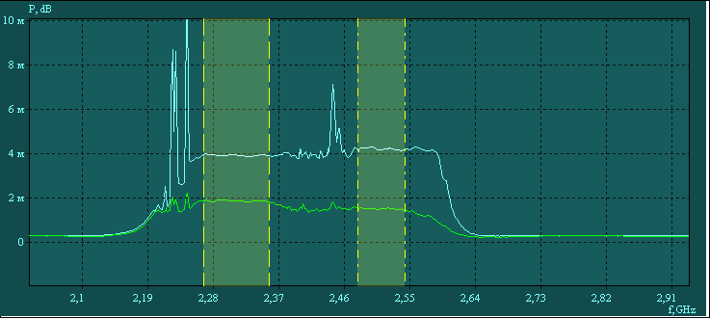
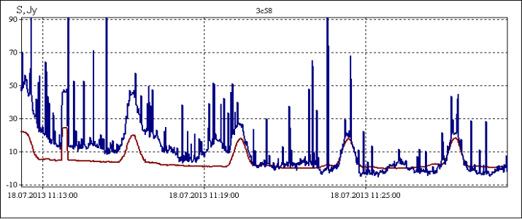
RFI Protection
Specialized hardware software complex for interference filtering
Bandwith selection
Source | 3c58
Frequency band | S
Date and Time | 18.07.13 11:13:00
Flux, Jy | 33.9
Integration time, s | 0.5
Blue — without RFI selection
Brown — with RFI selection
10
Detection and measurement of RFI in radio astronomy · Yebes Observatory · 8-9 June, 2017
Notes:
The software complex allows to select a RFI-free frequency band in the input frequency range. The results of the operation of this complex are shown in the observation of the 3c58 source. The blue color shows the measurement of the source flux density without interference filtering, and the brown one with filtering using the complex described.

Slide 11
RFI Protection
Interaction with the state RF spectrum regulation services
In accordance with the Russian Federation law "On Communications" for protection against interference it is necessary to obtain state registration of receiving devices of radio telescopes in the territory near the observatories.
Radio electronic device | Frequency band | Bandwidth GHz | Status
RT-32 | L | 1,38-1,72 | Registred until 01.12.2026
 | S | 2,15-2,50 | Registred until 01.12.2026
 | C | 4,60-5,10 | Registred until 01.12.2026
 | X | 8,18-9,08 | Registred until 01.12.2026
 | K | 22,02-22,52 | Registred until 01.12.2026
RT-13 | S | 2,2-2,6 | Registred until 10.10.2024
 | X | 7-9,5 | Registred until 10.10.2024
 | Ka | 28-34 | Registred until 10.10.2024
RT-13 | Wideband | 3-18 | Registred until 10.10.2024
11
Detection and measurement of RFI in radio astronomy · Yebes Observatory · 8-9 June, 2017

Slide 12
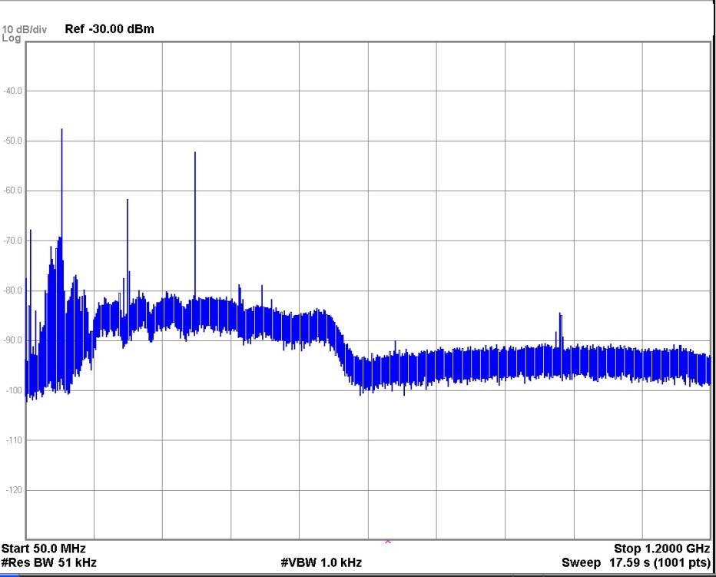
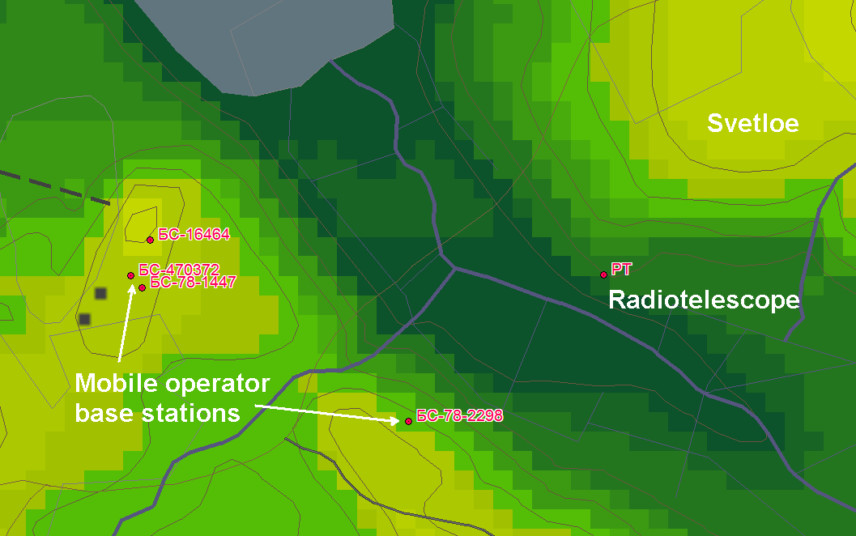
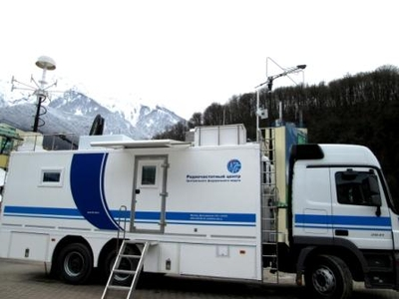
RFI Protection
Interaction with the state RF spectrum regulation services
The main RFI is the impact of base and user stations of mobile operators.
Searching for EMC disturbers near observatories using a radio telescope:
Base station № | Center Frequency (МHz) | Power (EIRP) Registered (dBW) | Power (EIRP) Measured (dBW) | Mobile operator
16464 | 2157,6 | -12,5 | 5,24 | VympelKom
 | 2162,6 |  | 7,94
470372 | 2137,4 | 19,33 | 0,28 | MegaFon
78-1447 | 2142,6 | -16,00 | off | MTS
1. We register an EMC problems in a certain direction (“Krasnoe lake” resort)
2. RF spectrum regulation service checks the base stations accordance with the frequency-territorial plan
3. Measurement of radiation power of base stations. Detection of the RFI source.
4. State Radio Frequency Center gives an order to a mobile operator to reduce the base station's power and pay a fine
12
Detection and measurement of RFI in radio astronomy · Yebes Observatory · 8-9 June, 2017

Slide 13
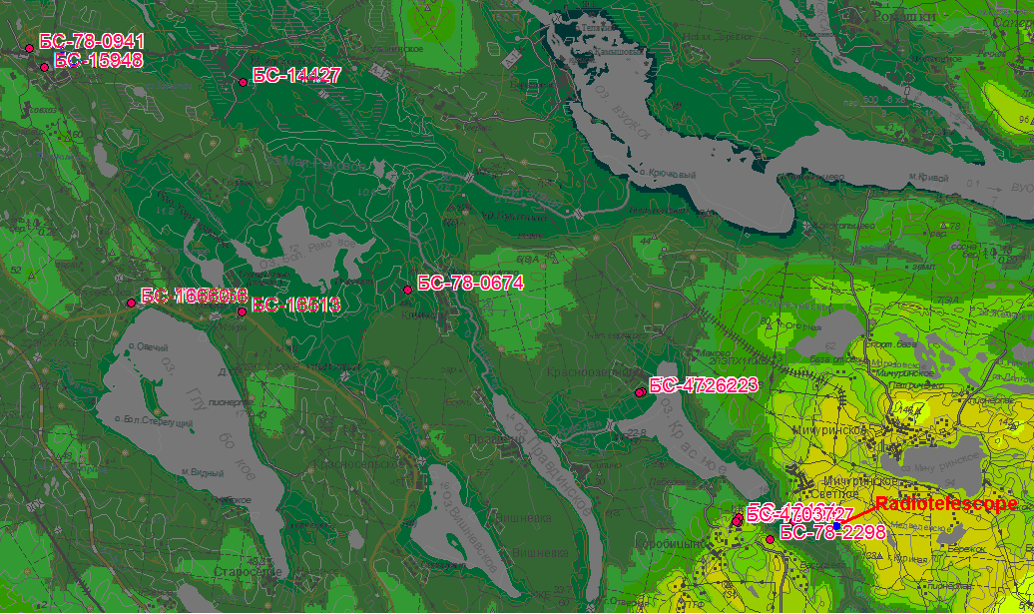
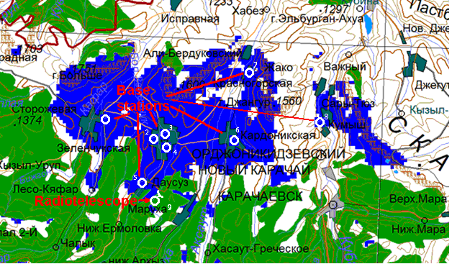
RFI Protection
Interaction with the state RF spectrum regulation services
Mobile operators are required to perform tests with a radio telescope when installing or change power of base stations at a distance of 40 km from the observatory.
The power level of the base station is coordinated with the IAA RAS
Zelenchukskaya
Svetloe
13
Detection and measurement of RFI in radio astronomy · Yebes Observatory · 8-9 June, 2017

Slide 14
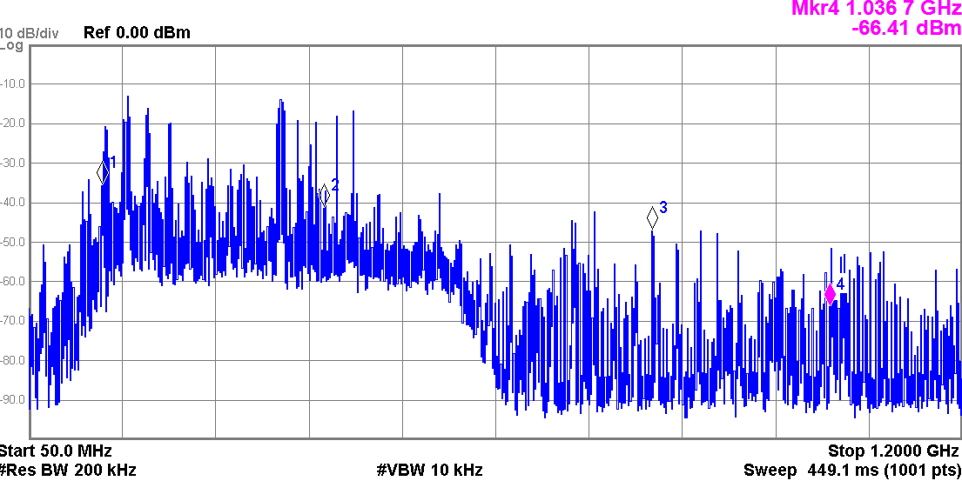
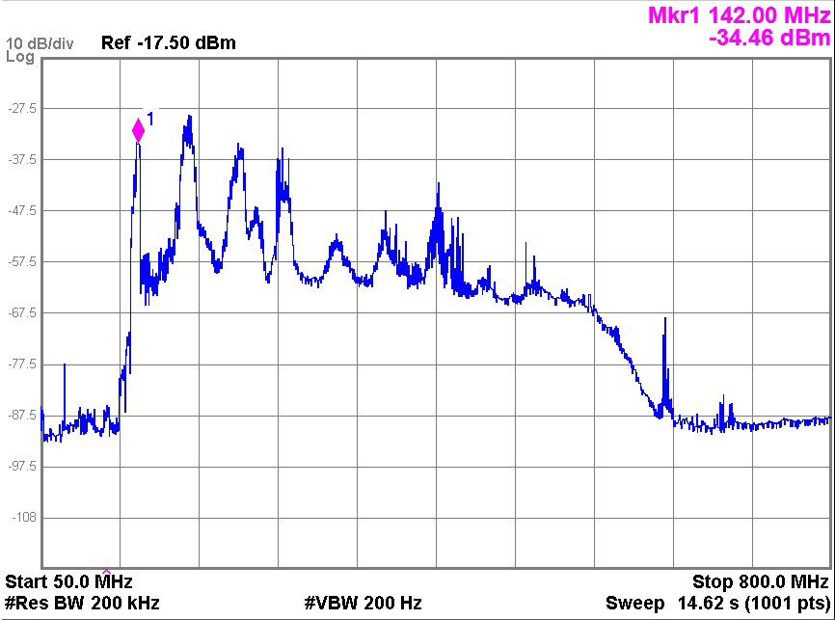
Conclusion
For the RFI mitigation in the IAA RAS observatory the next techniques are used:
hardware filtering of zones occupied by powerful narrowband RFI
specialized hardware software complex for interference filtering
active interaction with the state RF spectrum regulation services for troubleshoots EMC problems
2014
(intermodulation products bring down the entire S-band receiver)
2015
2016
Svetloe S-band
At the moment we are able to control the RFI situation at “Quasar” Network Observatories
14
Detection and measurement of RFI in radio astronomy · Yebes Observatory · 8-9 June, 2017

Slide 15
Thank you!
Detection and measurement of RFI in radio astronomy · Yebes Observatory · 8-9 June, 2017

