Slide 1
Efficient mitigation of RFI at radio astronomy observatories
Thomas Krenz
Product Manager
Spectrum Monitoring Systems

Slide 2
The theory
Various frequency bands are (exclusively) assigned to radio astronomy
Example: German Frequency Allocation Plan
1400 MHz
1427 MHz
Range | # Bands | Total bandwidth
HF | 2 | 170 kHz
V/UHF | 14 | 106 MHz
SHF | 12 | 1,1 GHz
EHF | 52 | 175 GHz
Radio astronomy

Slide 3
The larger picture
You are here
Notes:
So does everybody else …

Slide 4
The real life
National regulators have to ensure interference free environment
In many countries regulators react slower than expected
Consequently, many companies and organizations defend their spectrum themselves
Typically, they use ITU-compliant equipment

Slide 5




The customer specific solution
Benefits of using the same equipment as local regulator
  Credibility
  Hassle-free data exchange
  Potential sharing of hardware
  Security

Slide 6
Lessons learned from 120 countries
Points to ponder when planning RFI measurements
  Why?
    Check current situation before important mission
    Understand long term situation
    Locate / identify interferer
    Collect data for complaint to local regulator
  Short term or long term measurements?
    Low duty cycle signals / time variant interferers
    Larger amount of data -> requirement for automated processes and sophisticated data reduction
  Where to put the equipment?

Slide 7
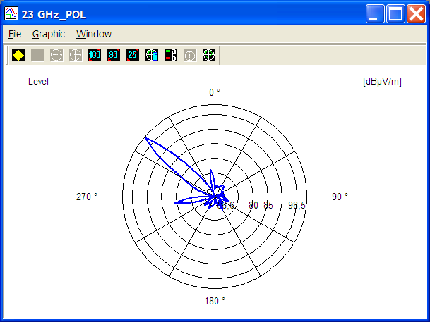
Lessons learned from 120 countries
Points to ponder when planning RFI measurements
  Omnidirectional or directional antenna?
    Omni is faster -> better time resolution -> detection of burst
    Directional provides location information and has higher sensitivity
  Measurements for both polarization necessary?
  Average or MaxHold?
  Calibrate !!!

Slide 8
The customer specific solution
Special requirements for radio astronomy observatories
  Efficient, easy operation
  Fully automatic procedures
  Frequency coverage according to astronomy bands
  Technical specifications matching the specific demands, e.g. sensitivity, linearity, dynamic range, …

Slide 9
The customer specific solution
Selected equipment
Hardware
  Compact, autonomous monitoring systems
  Location finding systems
  Handheld equipment
Software
  Dedicated spectrum monitoring control software
  Fully automatic operation
  Real-time interference detection, identification and localization
  Provide necessary information so that other systems can follow-up

Slide 10
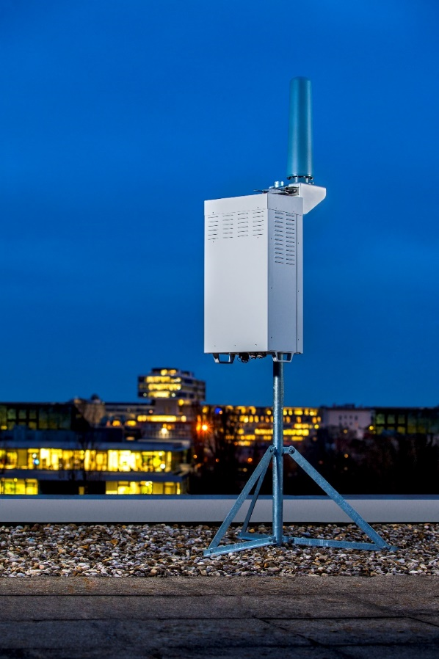
The customer specific solution
UMS300
Compact outdoor system
ITU – compliant
Monitoring, DF, TDOA
Minimum infrastructure requirements

Slide 11
The customer specific solution
UMS300
1 = Peltier element
2 = System computer
3 = Power control board
4 = Connection panel
5 = 3/4G modem
6 = Antenna selection switch
7 = Receiver
8 = Router
9 = SSD drive

Slide 12
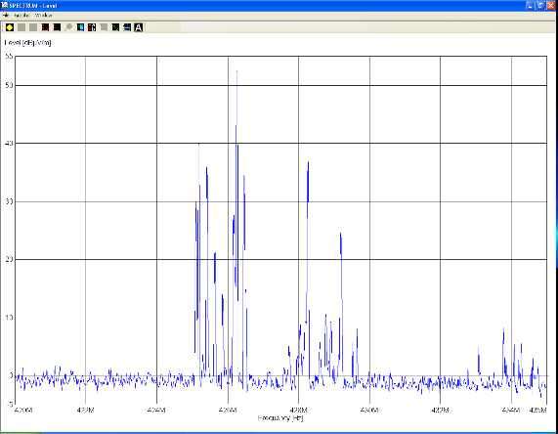
The customer specific solution
UMS300
Monitoring
  Frequency range 9 kHz – 26,5 GHz
  Optional up to 256 GHz
  Multichannel digital down conversion (DDC) within real-time bandwidth
  I/Q recording

Slide 13
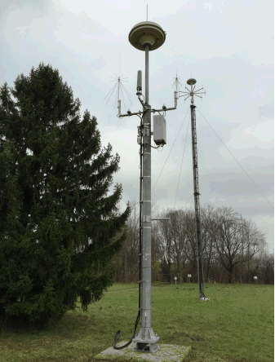
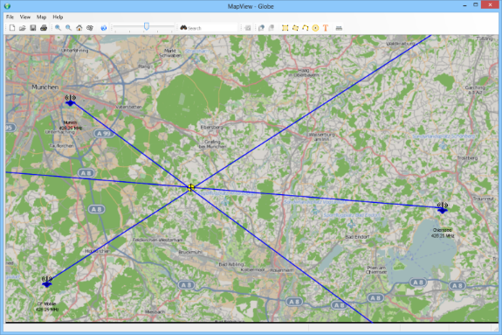
The customer specific solution
UMS300
Direction finding
  Wideband DF mode
  DF antennas with active / passive switching
  DF antennas for horizontal / vertical polarization

Slide 14
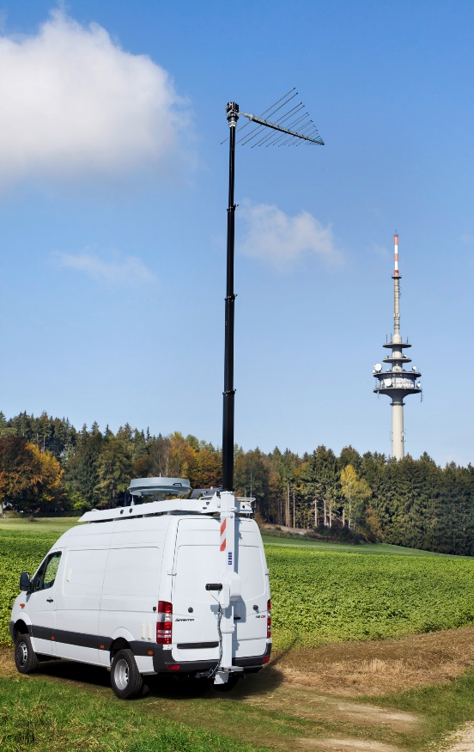
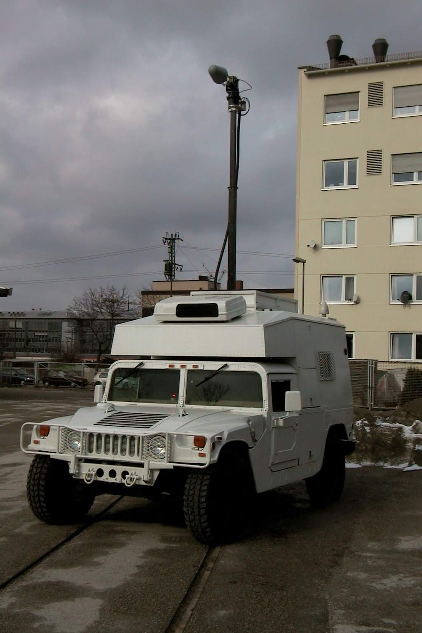
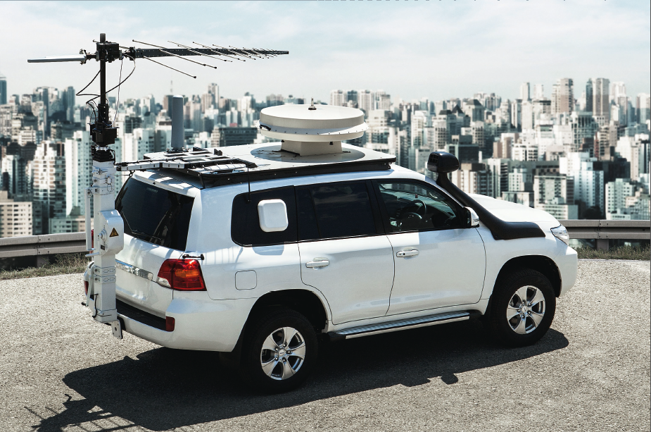
The customer specific solution
Mobile monitoring systems

Slide 15
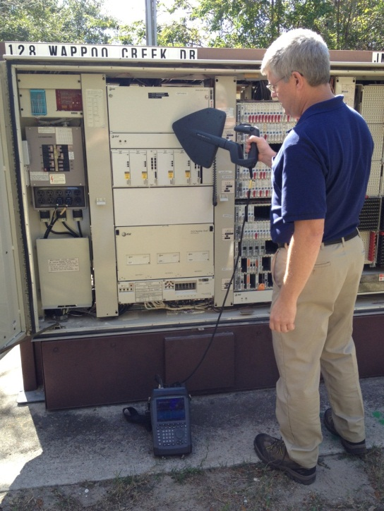

The customer specific solution
PR100
Handheld monitoring receiver

Slide 16
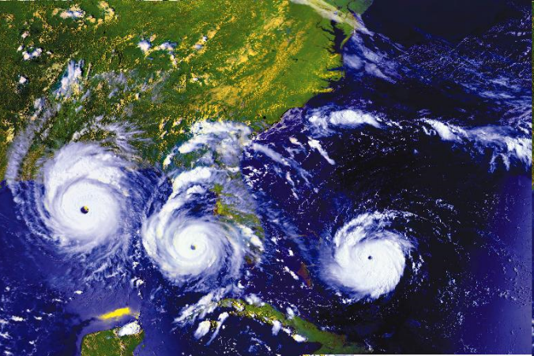
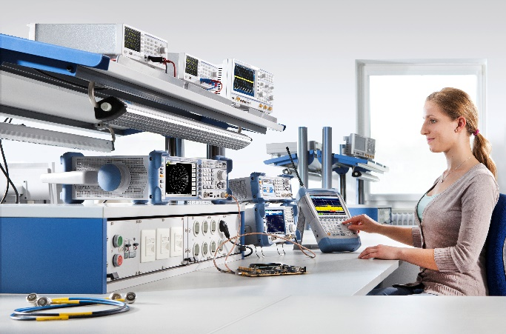
The customer specific solution
Monitoring receiver vs. spectrum analyzer
Different device types developed for different applications
Monitoring receiver – real world Spectrum analyzer – laboratory environment

Slide 17
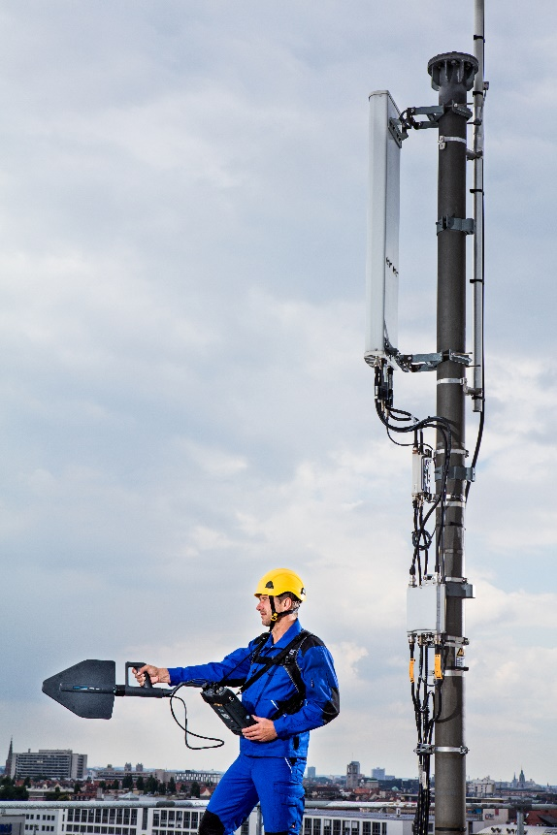
The customer specific solution
Monitoring receiver vs. spectrum analyzer
Monitoring receiver
  Unknown signal scenario (frequency, level, modulation, timing, …)
  Signal fed via antenna
  Signal can not be influenced by operator
  Measurements can (often) not be repeated

Slide 18
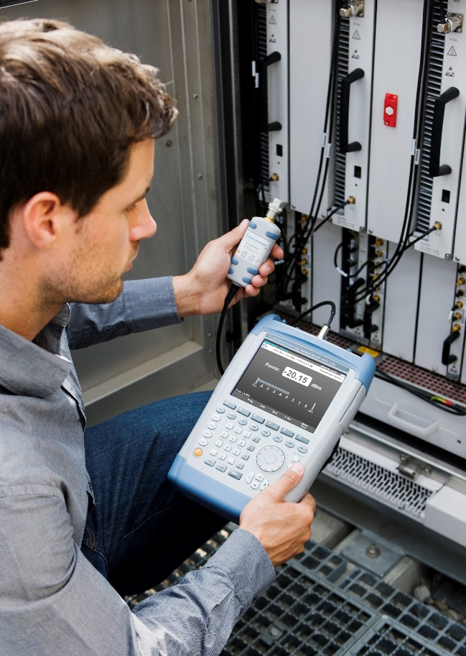
The customer specific solution
Monitoring receiver vs. spectrum analyzer
Spectrum analyzer
  Known signal scenario
  Signal fed via cable
  Signal can easily be influenced by operator
  Measurements can be repeated

Slide 19
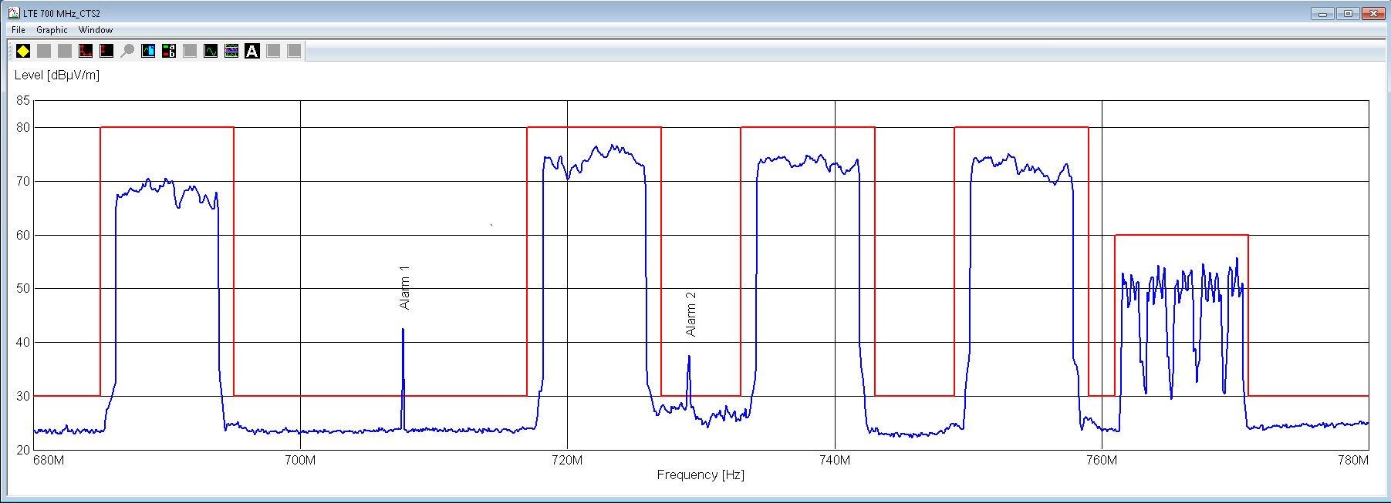
The customer specific solution
ARGUS control software
Real-time comparison of live results with reference data

Slide 20
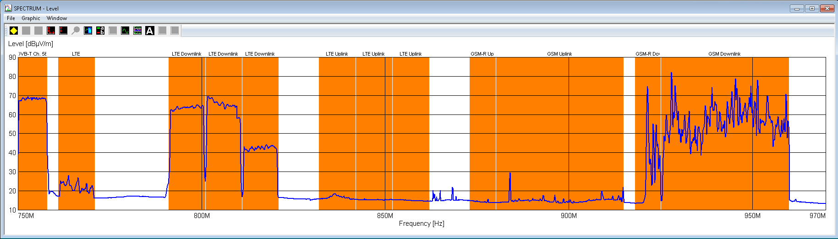
The customer specific solution
ARGUS control software
Real-time comparison of live results with reference data

Slide 21
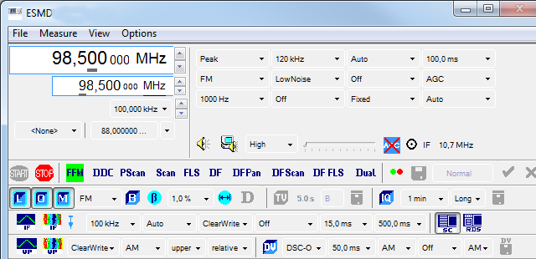
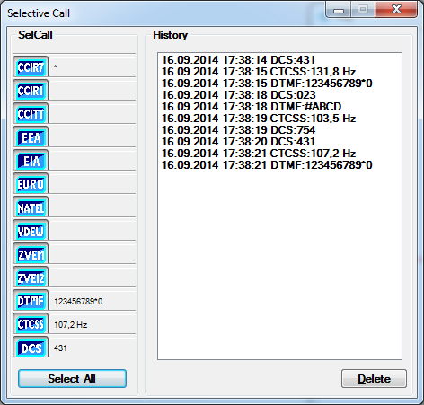
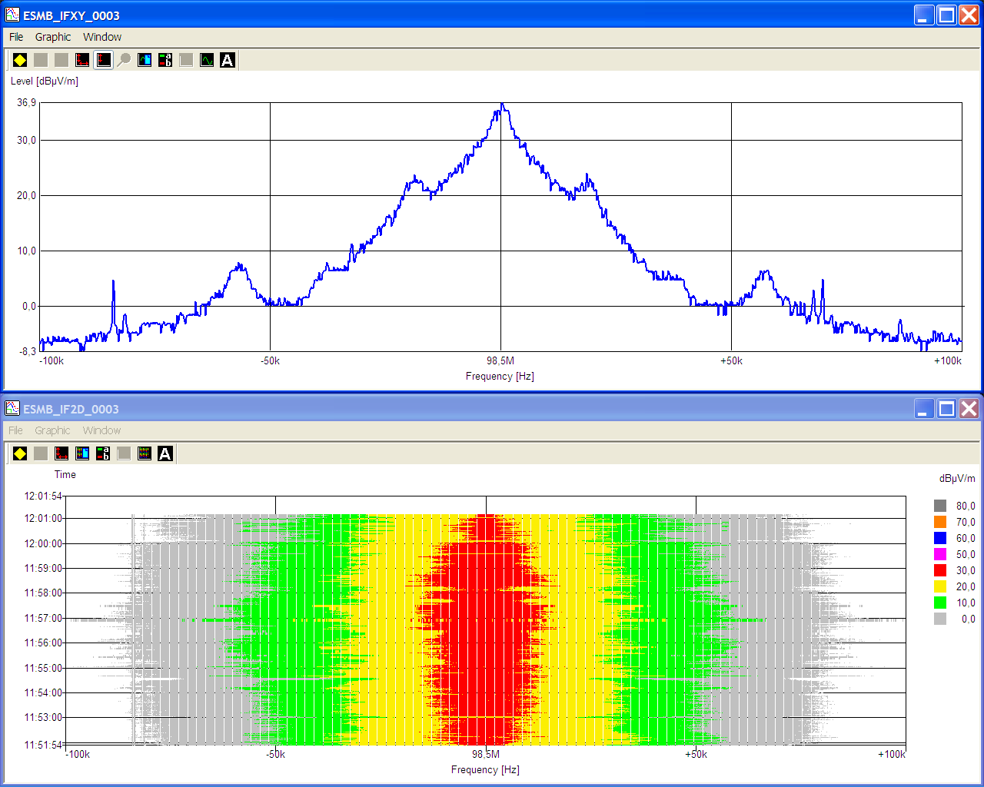
The customer specific solution
ARGUS control software
Identification of interferer

Slide 22
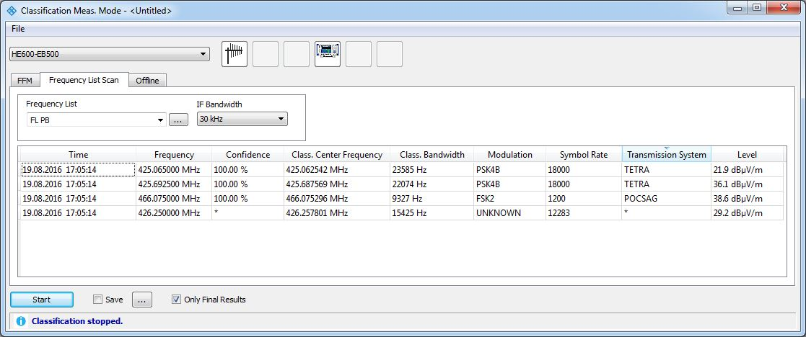
The customer specific solution
ARGUS control software
Identification of interferer

Slide 23
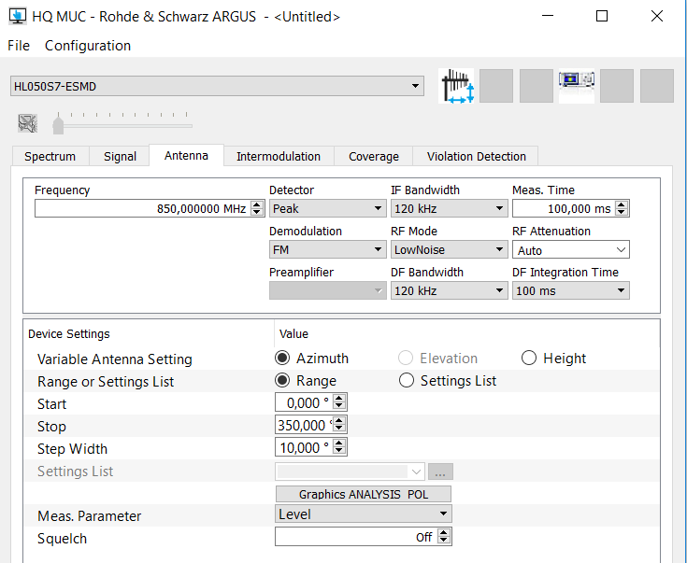
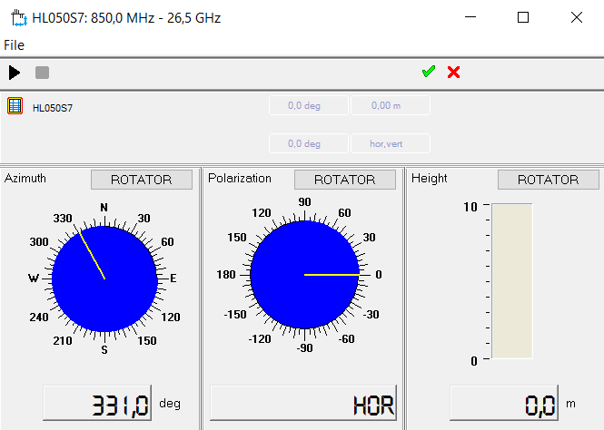
The customer specific solution
ARGUS control software
Sophisticated antenna control

Slide 24
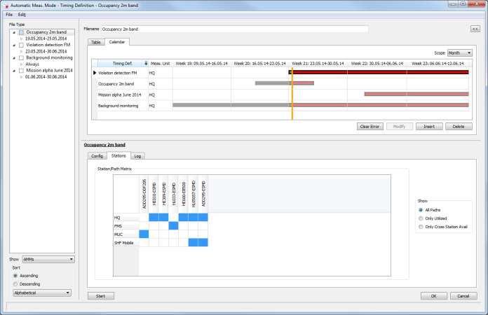
The customer specific solution
ARGUS control software
Automatic multi-tasking according to schedule

Slide 25
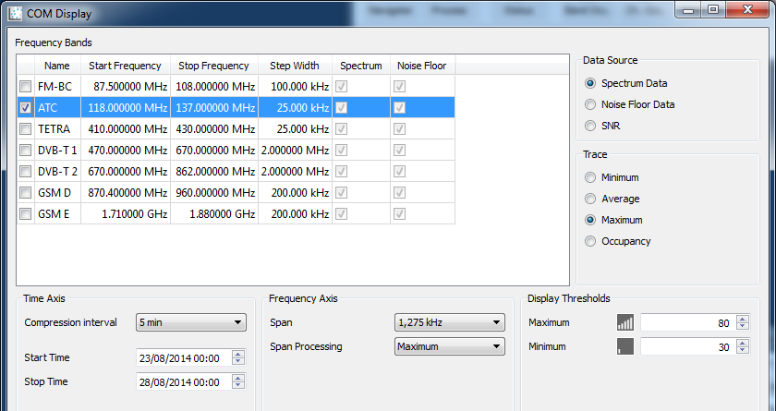
The customer specific solution
ARGUS control software
Continuous monitoring with smart data reduction

Slide 26

Summary
Radio frequency interference exists
Rohde & Schwarz has dedicated, proven tools to mitigate RFI
Don’t miss the Nobel Prize because of RFI

